Slide 1
CEIS 106 Course Project Navigating Linux Operating System
By Devaraj Kumar Daniel

Slide 2
Table of Contents
Slide
Introduction 3
Navigating Linux File System 4-8
Shell Scripting in Linux 9-13
User Management in Linux 14-18
Networking in Linux 19-23
Performance Monitoring in Linux 24-27
Challenges of project 28
Career Skills acquired 29
Conclusion 30

Slide 3
Intoduction
For this project we were instructed to setup a virtual machine and get familiar with the linux operating systems and its various tools. The following areas were covered during this project:
- Using the linux file system
- Using and Creating Scripts
- Creating and Managing Users and Groups
- Using Network Tools and Setting up Networks
- Monitoring System Hardware
Before Getting Started I had to make sure my Host computer was ready for the virtual machine.
I had to change settings in my bios to enable virtual cores for my computer
I then had to install a virtual machine program and then install the linux os on it.
The version of Linux I used was the latest at the time of installation.

Slide 4
Navigating Linux File System

Slide 5
Navigate the Linux filesystem tree
1. What is the pwd command an acronym for? What about the cd command?
Answer here:
The pwd command stands for print working directory and the cd command stands for change directory
2. Explain the differences between a relative path and an absolute/full path in Linux.
Answer here:
The absolute path in Linux has no ambiguity there is only one path such as /home/documents/newfolder/file
The relative path might look like /home/documents/link to file. Our directory is going to change in relation to the working directory we are currently using

Slide 6
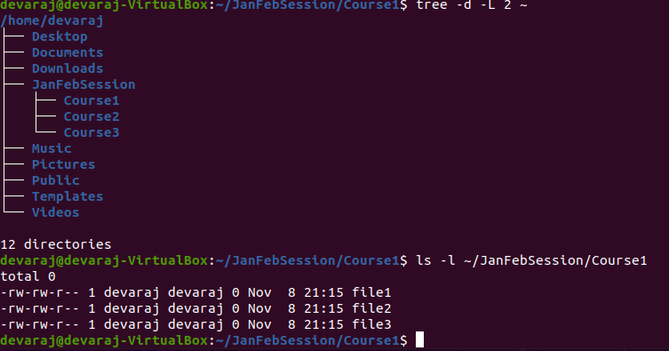
Create directories and files
To navigate throughout folders the use of the cd, ~, pwd commands are important
The pwd command stands for print working directory and the cd command stands for change directory
~ is the hotkey that is used with cd to return to the home directory
The ls command is used to list files or folders in linux an can be used with various other keys for different commands

Slide 7
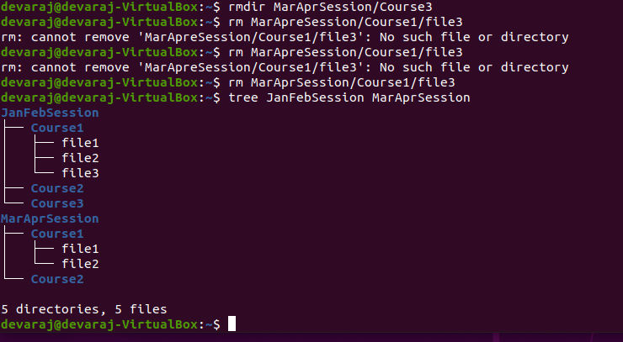
Copy and remove directories and files
The rm command is used to remove things for this instance we are removing the Course 3 folder and its subsequent items in the folder for the directory MarAprSession
The tree commands displays the file structure of a given directory

Slide 8
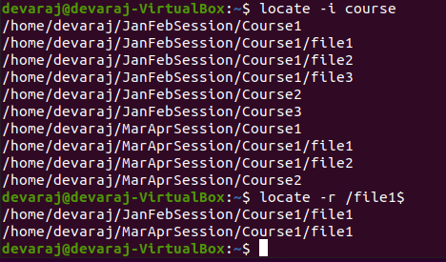
Locate directories and files
The locate command followed by a variety of other keys will locate files by name and then with other keys locate files with filters

Slide 9
Shell Scripting in Linux

Slide 10
Create a shell script
1. What are the file permissions of the script?
Answer here:
It has a read write (OWNER) - read write (GROUP) –read (EVERYONE ELSE)
2. What’s the name of the user-defined variable in the script?
Answer here:
text
3. Which redirection meta-character is used in the script? What does it do?
Answer here:
>>. It takes the output of whatever is on the left-hand side and puts it into a file

Slide 11
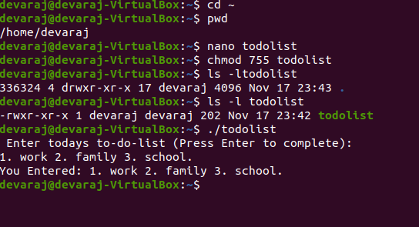
Change script file permissions
Nano is a text editor for linux similar to that of notepad on windows
Nano in this case is used to create a script called to do list
To begin the script the lines #!/bin/bash must be the first line and then your script comes after
The chmod command is used for the permissions for the script

Slide 12
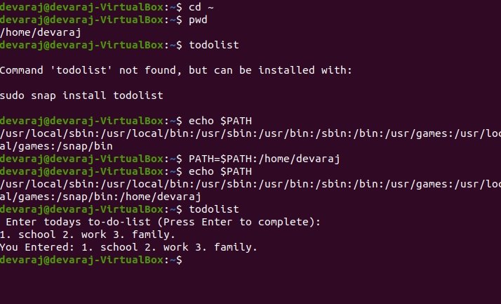
Set the PATH variable
PATH is an environment variable that contains a list of directories. When a command or script is called without an absolute or relative pathname, the shell searches the directories in the list for the executable file. If the file is not found, a “command not found” error message is displayed

Slide 13
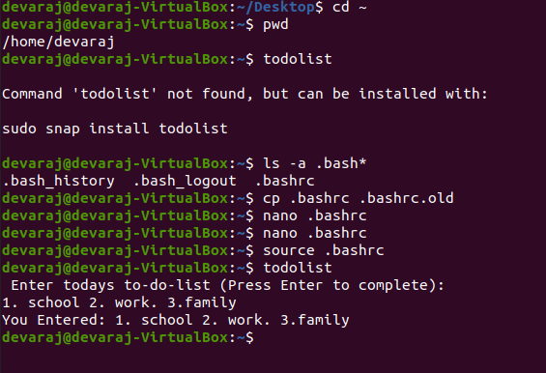
Make the PATH variable permanent
One way of setting the PATH variable permanently is to modify the hidden .bashrc file which runs every time you open a new terminal window

Slide 14
User Management in Linux

Slide 15
Add users and groups in CLI
1. What does the –m option in the useradd command do?
Answer here:
-m option is to create the users home directory.
2. What does the -3 option in the tail command do?
Answer here:
It displays the last 3 lines of a file's information in this case the groups file information. The tail command in general will print the last 10 lines of a file
3. Which line of the /etc/group file lists members of the “students” group? Copy it here.
Answer here:

Slide 16
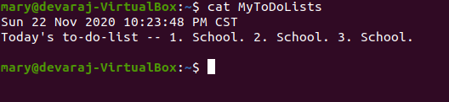
Test user and group settings
The command cat allows the creation of files, view contents of files, and redirect output in the terminal or files
After modifying changing the ownership of the script todolist and adding another user account called mary to a group called students, I was able to run the script that previously belonged to my user account on the account mary

Slide 17
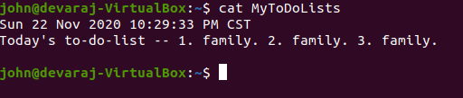
Add users in GUI
Like how we can change and manage users from the command line we can do the same thing from the gui that linux has. After adding user john to the student's group from the User Settings GUI we performed the same task of running the todolist script

Slide 18
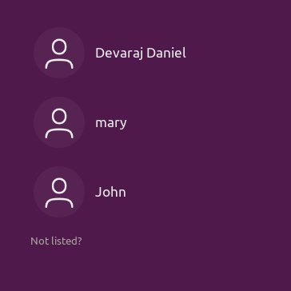

Remove users and groups
Looking at the login screens to determine if we successfully created our user accounts to add to the student groups and then reconfirming that we can delete those accounts

Slide 19
Networking in Linux

Slide 20
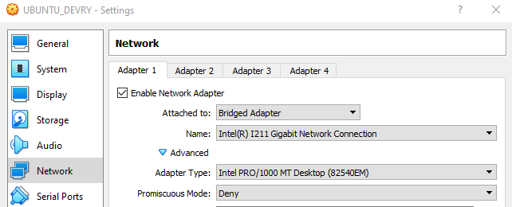
Connect the Ubuntu VM to the Internet
Before being able to connect my linux system to the internet, I had to adjust settings in my virtual machine for bridged mode. This will allow the virtual machine to use my host computers network card.

Slide 21
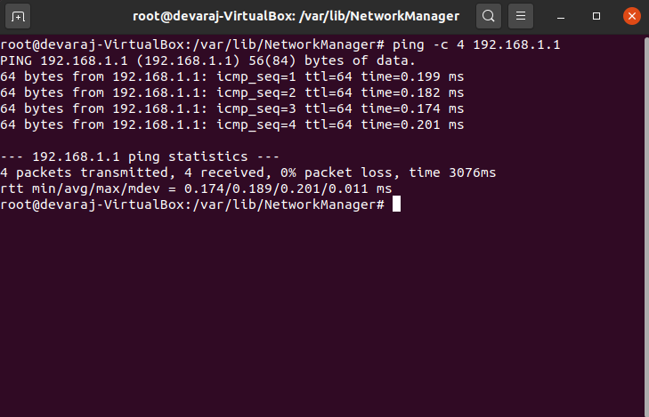
Discover host IP configurations
1. What is the IP address of your Ubuntu machine?
Answer here:
192.168.1.183
2. What is the IP address of its default gateway?
Answer here:
192.168.1.1
3. What is the IP address of its DHCP server?
Answer here:
192.168.1.183
4. What is the IP address of its DNS server?
Answer here:
192.168.1.1

Slide 22
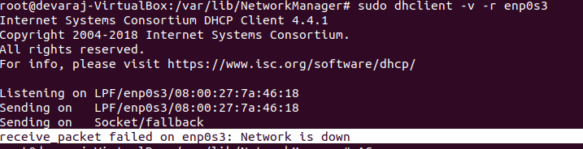
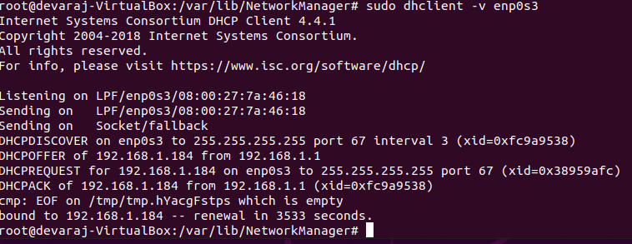
Manage network interfaces
1. Which DHCP message is shown in the output of the sudo dhclient –v –r ens33 command?
Answer here:
2. Which four DHCP messages are shown in the output of the sudo dhclient –v ens33 command?
Answer here:

Slide 23
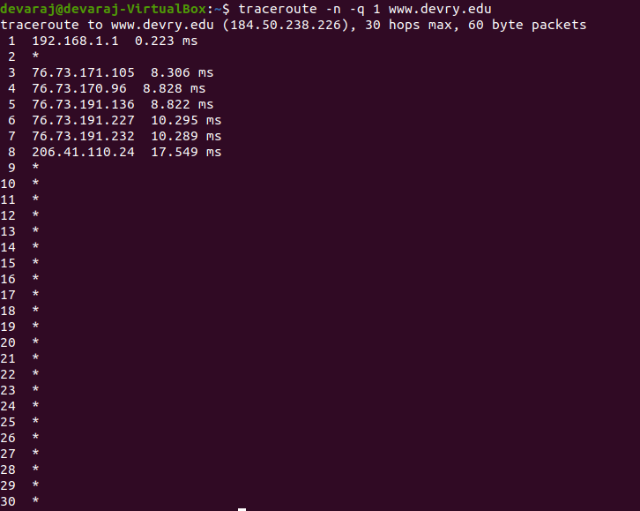
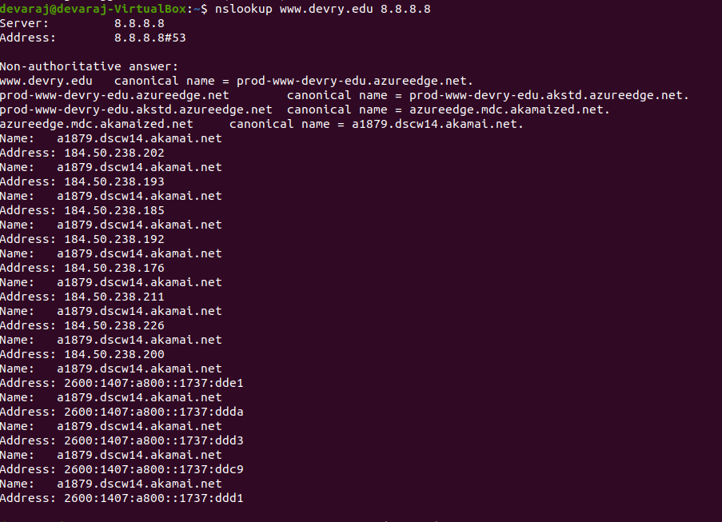
Use network utilities
The traceroute command is used for tracing where a packet travels before it reaches its destination on a network in this case, we traced a packet traveling to DeVry's web server
The nslookup command is used to get information from the dns of a server
We used it in this case to lookup information from the devry dns

Slide 24
Performance Monitoring in Linux

Slide 25
Monitor Linux processes
1. What is the default action of the 15 SIGTERM kill signal?
Answer here:
It kills the process
2. In the System Monitor window, click on % CPU to sort the processes by CPU load. Which process shows the highest percentage of CPU usage?
Answer here:
The GNOME-SHELL

Slide 26
Monitor user activities
Issue the sudo accton on command to turn on GNC accounting. Enter lastcomm apt to check if the apt command was executed before. Remember to turn off GNC accounting (sudo accton off) after answering the questions.
1. What flag value is displayed in the output?
Answer here:
S and F
2. Why is the name of the user who ran the processes shown as root, not your username?
Answer here:
Because we used the sudo command with apt. In my opinion, how I remember how sudo works is that SUDO stands for super user do, which give temporary permission to act as the super user which is root. Therefore we enter our password when doing this so we can get temporary access to SUPER USER.

Slide 27
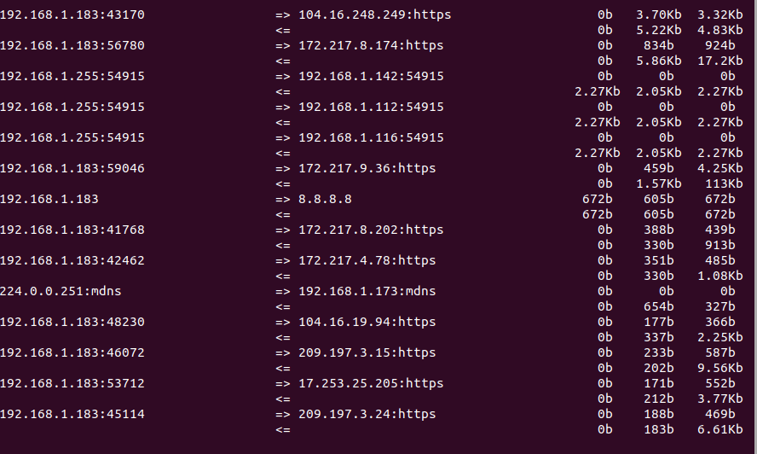
Monitor network bandwidth usage
Using the iftop utility, we can view traffic on a network
In this case we viewed the traffic by ip instead of its dns
Using this tool is useful to view computers that may be using a lot of the networks or computers that may be infected and using the network at odd times of the day

Slide 28
Challenges of Project
Some of the challenges of the project were as follows:
  Getting used to the linux language
  Getting the system prepared for the Virtual Machine
  Knowing when you need to be a super user or not
  Using Some of the commands
  Using the command line instead of a GUI to perform tasks

Slide 29
Career Skills Obtained
The Career Skills obtained from this project were as follows:
  Knowledge on how operating systems in general work
  How to navigate the linux file system from the command line
  How to manage a linux system
  How to setup networks in linux
  How to use tools to monitor a system
  How to setup a virtual machine to test things

Slide 30
Conclusion
This project was fun and interesting. I am studying to be a database manager and I know that knowing how to use the linux system is going to be a must for me. I really enjoyed making scripts and using the network utility tools. It was cool to setup a virtual machine and then mess around with the linux system. I hope devry continues to do cool projects like this.

