Slide 1
NETW191 Final
Devaraj Daniel

Slide 2
Table of Contents
Slide
Introduction 3
IPv4 and IPv6 Addressing 4-6
Virtual Machine (VM) Dynamic IP assignment 7-10
Connectivity Test and Visio Network Diagram 11-14
IP Subnetting and Loopback interfaces 15-18
WLAN Implementation 19-22
Challenges of project 23
Career Skills acquired 24
Conclusion 25

Slide 3
Introduction
For this project we were instructed to setup a virtual machine an get familiar with network setup and protocols. The following areas were covered during this project:
Developing and Building a Network
Hardware setup, subnetting and connection testing
Network documentation and WLAN implementation
Before Getting Started I had to make sure my Host computer was ready for the virtual machine.
I had to change settings in my bios to enable virtual cores for my computer
I then had to install a virtual machine program and then install the linux os on it.
I then had to make sure That the provided travel router was functional and working.
The version of Linux I used was the latest at the time of installation.

Slide 4

IPv4 and IPv6 Addressing

Slide 5
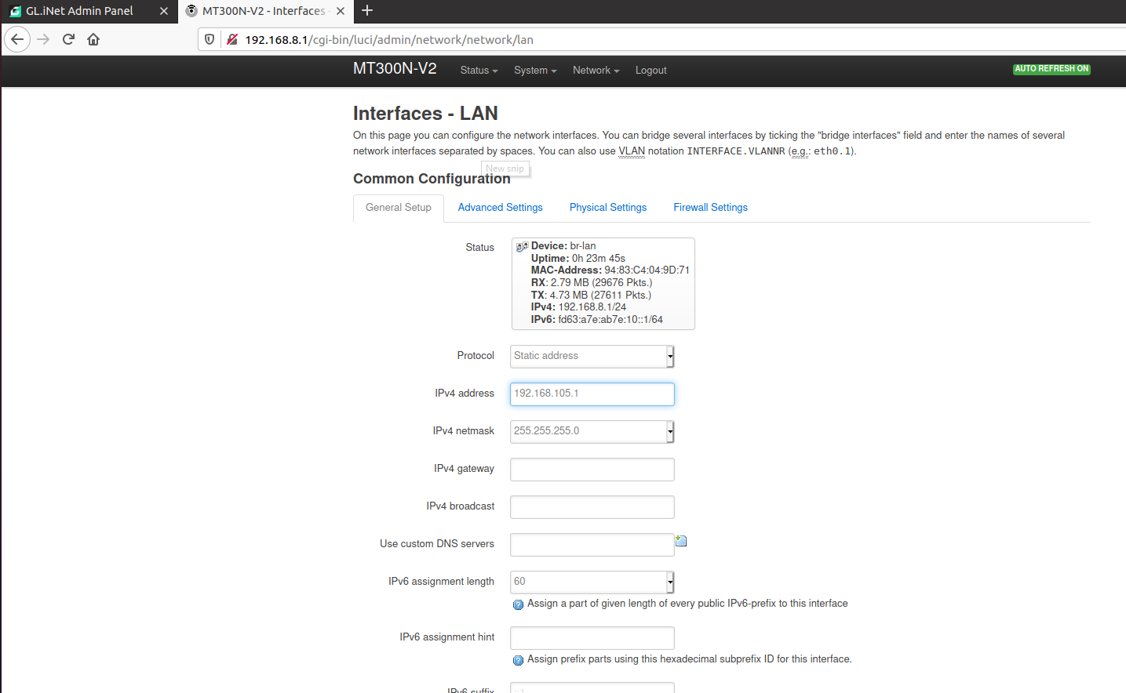
IPv4 Address Assignment of the Travel Router
This screenshot should include:
IPv4 address
IPv4 netmask
The following was setting up the travel router to have an ipv4 address and netmask

Slide 6
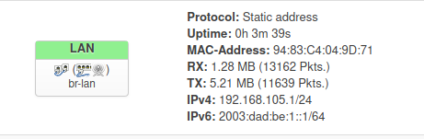
IPv6 Address Assignment of the Travel Router
This screenshot should include:
IPv6 address
IPv6 prefix
The following was setting up the travel router with an ipv6 address

Slide 7
Virtual Machine (VM) Dynamic IP assignment

Slide 8
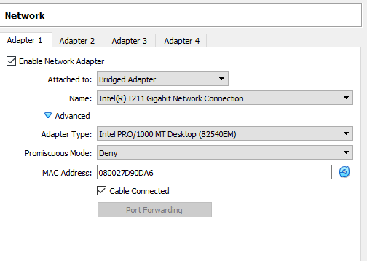
VM Bridging Settings
This screenshot should show the host computer network adaptor you want to automatically bridge.
Before being able to connect my linux system to the internet, I had to adjust settings in my virtual machine for bridged mode. This will allow the virtual machine to use my host computers network card.

Slide 9
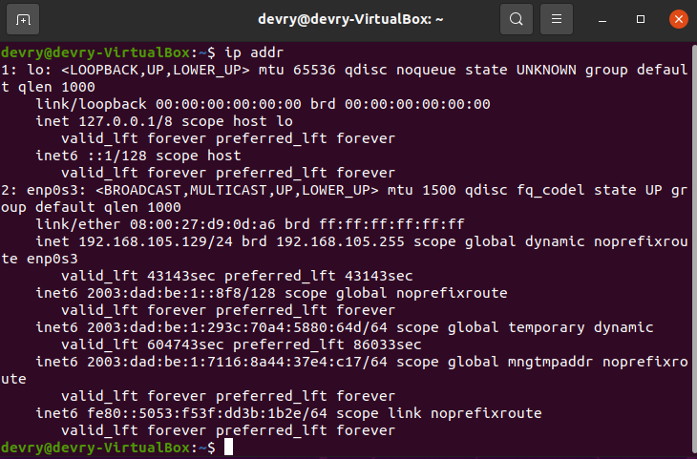
Ubuntu VM Dynamic IP Assignment
This screenshot should show correct IPv4 and IPv6 addresses of the Ubuntu VM.
We used linux commands to display the ipv4 and ipv6 addresses of our virtual machine

Slide 10
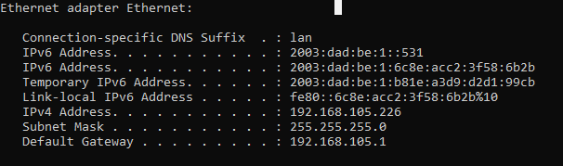
Host Computer Dynamic IP Assignment
This screenshot should show correct IPv4 and IPv6 addresses of the Windows host computer.
We wanted to make sure that we correctly configured our travel router

Slide 11
Connectivity Test and Visio Network Diagram

Slide 12
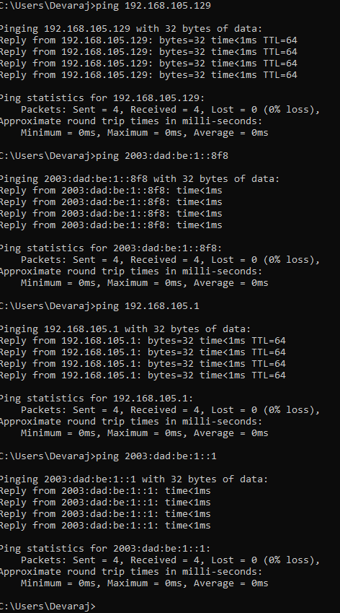
Connectivity Test From the Host Computer to all Other Devices
This screenshot should show four successful ping tests.
Commands Used were ping, we tested both our ipv4 and ipv6 networks from the host to our travel router

Slide 13
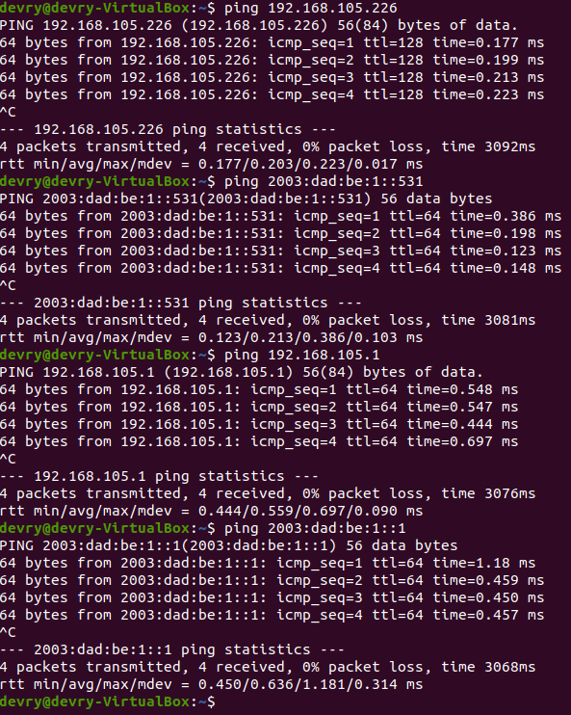
Connectivity Test From the Ubuntu VM to all Other Devices
This screenshot should show four successful ping tests.
Commands Used were ping, we tested both our ipv4 and ipv6 networks from the VM to our travel router

Slide 14
Microsoft Visio Network Diagram
This diagram should depict the interconnection of the host computer, Ubuntu VM, and travel router.

Slide 15
IP Subnetting and Loopback interfaces

Slide 16
Subnetting Table
This table should include two /25 subnets, including the network address, first usable host address, last usable host address, and broadcast address for each subnet.
 | Subnet Notation | Network Address (1st Ip Address) | First Usable Host Address(2nd Ip Address) | Last Usable Host Address | Broadcast Address (The last Ip Address)
1st Subnet | 255.255.255.128/25 | 192.168.5.0 | 192.168.5.1 | 192.168.5.126 | 192.168.5.127
2nd Subnet | 255.255.255.128/25 | 192.168.5.128 | 192.168.5.129 | 192.168.5.254 | 192.168.5.255

Slide 17
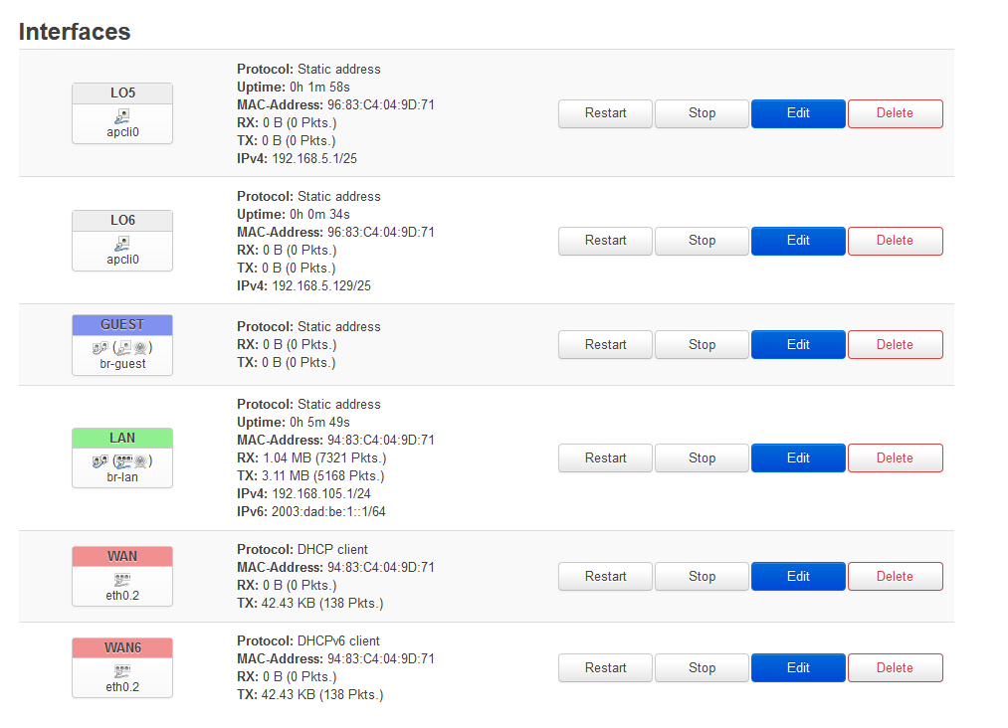
Loopback Interfaces
This screenshot should show both Lo5 and Lo6 loopback interfaces and their correct IPv4 addresses.
Configured loopbacks for our Ipv4 and Ipv6 devices for diagnostic testing

Slide 18
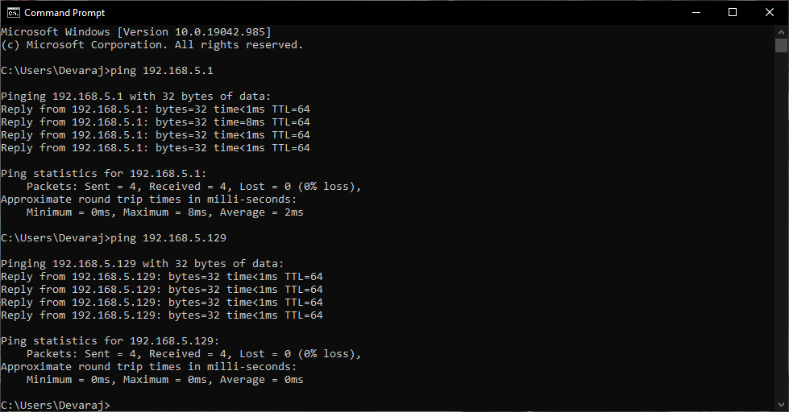
Ping Tests
This screenshot should show two successful ping tests from the host computer to the Lo5 and Lo6 interfaces.
Pinging our loopback devices to make sure we configured them correctly

Slide 19
WLAN Implementation

Slide 20
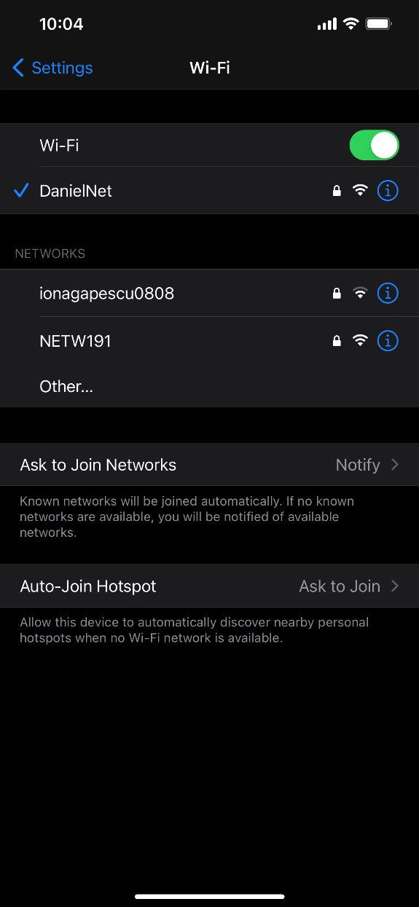
List of SSID Names
This screenshot should show the newly configured NETW191 SSID.
Testing our WIFI network we made

Slide 21
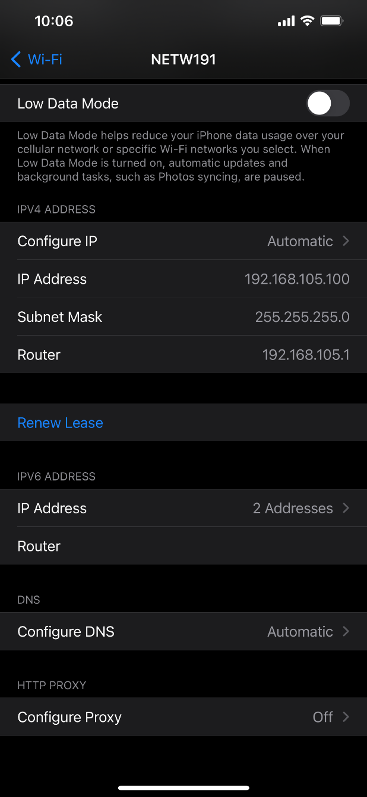
Wi-Fi Client
IP Address
This screenshot should show the IP address of your Wi-Fi device that’s associated with the NETW191 network.
Showing the ip address the travel router gave to my phone after we configured our WIFI network

Slide 22
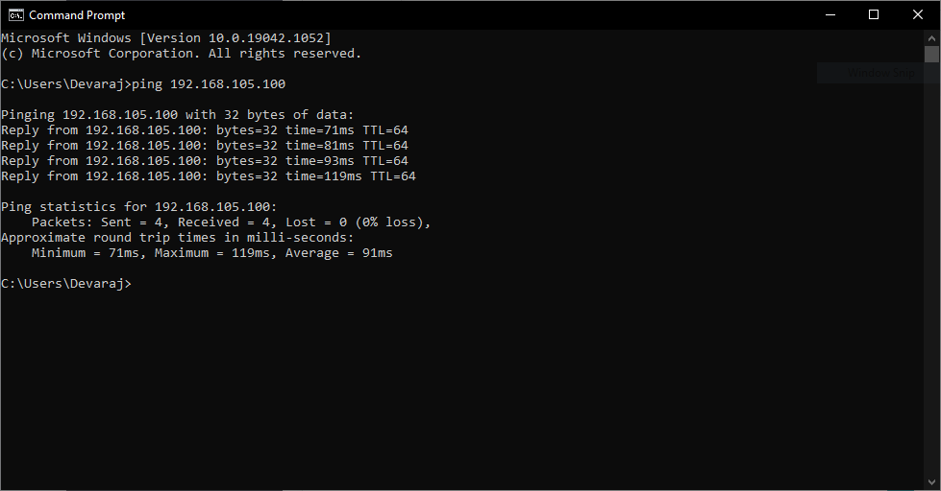
Ping Test
This screenshot should show a successful ping test from the host computer to your Wi-Fi device that’s associated with the NETW191 network.
Pinging my phone from my host computer to make sure they are on the same network

Slide 23
Challenges in Project
Some of the challenges of the project were as follows:
  Getting used to some of the linux commands
  Getting the system prepared for the Virtual Machine
  Sometimes logging into the travel router
  Setting up the travel router with the ipv4 and ipv6 addresses

Slide 24
Career Skills Obtained
Some of the Career Skills I Obtained:
Setting up and configuring a network
Identify and setup IPv4 and IPv6 Networks
Use command line tools to maintain networks
Develop a network diagram

Slide 25
Conclusion
This project was fun from start to finish and I learned a lot through this project and the lectures given. Through the entirety of the course, it was fascinating to see the different things involved with networking and how devices interact with different network devices. I liked how the project was very easy to follow and understand what we were doing. Devry is doing a good job keeping these hands-on projects.

