Slide 1
CIS 355A Final: Landscape GUI
Devaraj Kumar Daniel

Slide 2
Table of Contents
Slide
Introduction 3
Designing 4-7
Making the GUI 8-10
Adding Design Elements 11-13
Using Object Arrays 14-16
Writing Data from a GUI to a file 17-19
Writing Data from a GUI to a Database 20-22
Challenges faced during Project 23
Career Skills Obtained 24
Conclusion 25

Slide 3
Introduction
For this project we were tasked to create a Java based program that did the following:
Design a GUI application
Design the GUI using Diagrams
Add Design Elements to the GUI
Store data from the program using a data base
Store data from the program using a file
Before Starting the project I had install Netbeans IDE and MYSQL database

Slide 4
Designing

Slide 5
Design Phase
During the design phase of this project, we were tasked to create a UML and Wireframe Diagram
This was so that the plan to create the classes and design of the application would be laid out clearly and understood amongst a potential team of programmers how the program is supposed to function

Slide 6
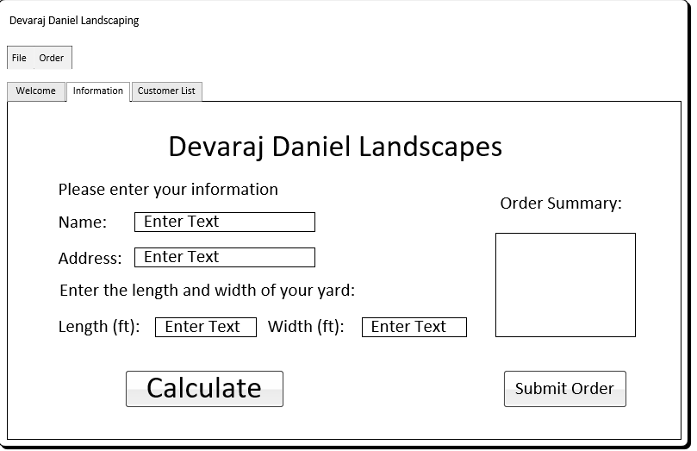
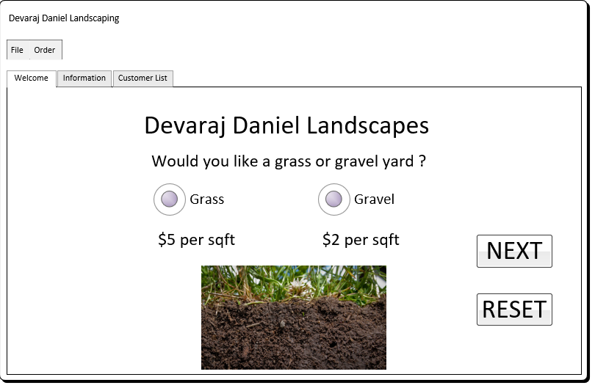
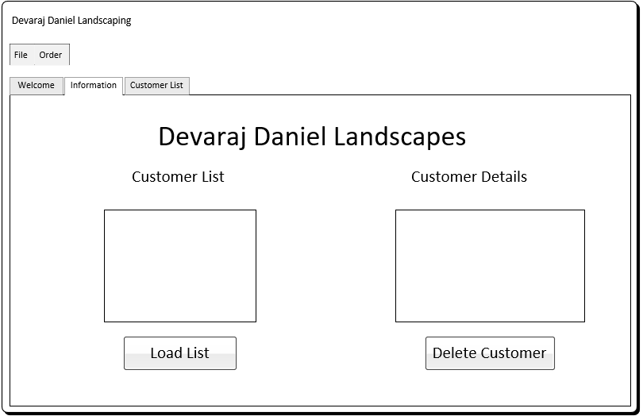
Wireframe Diagram

Slide 7
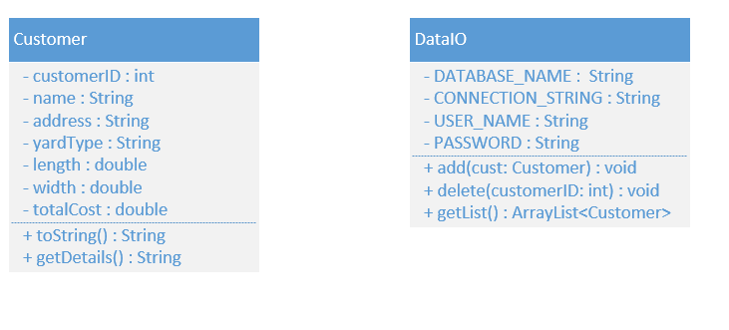
UML Class Diagram

Slide 8
Making the GUI

Slide 9
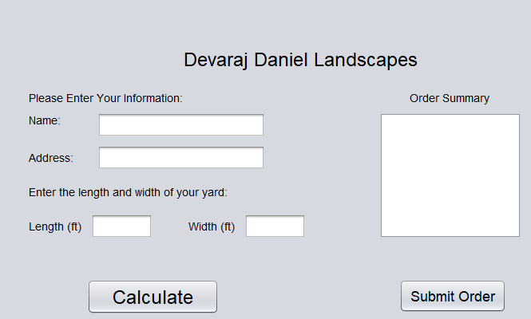
Simple GUI Application

Slide 10
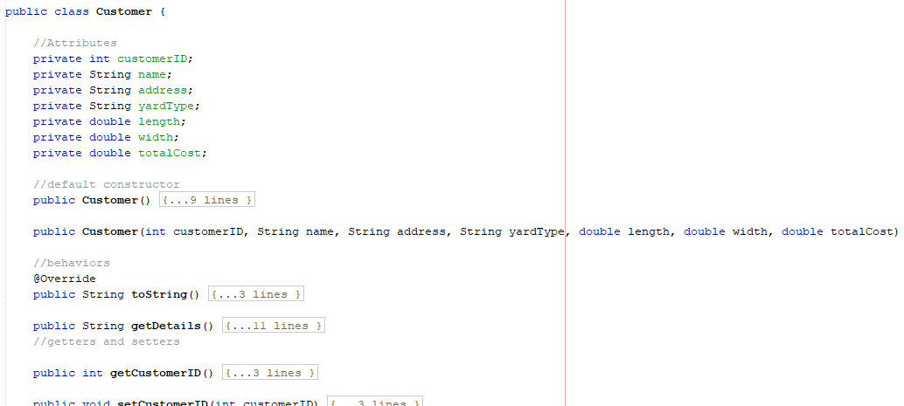
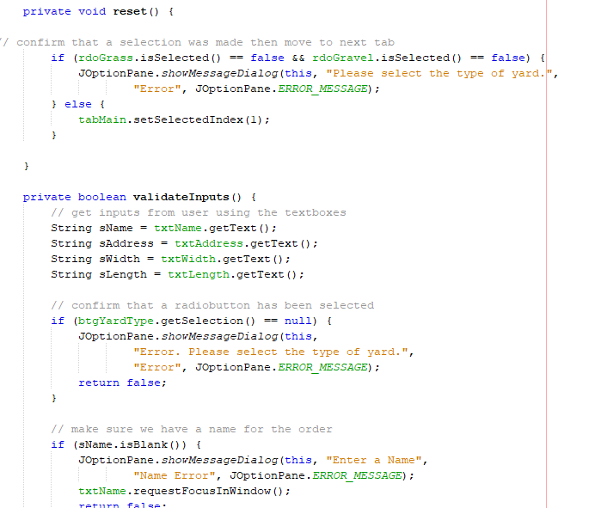
Event Code added

Slide 11
Adding Design Elements

Slide 12
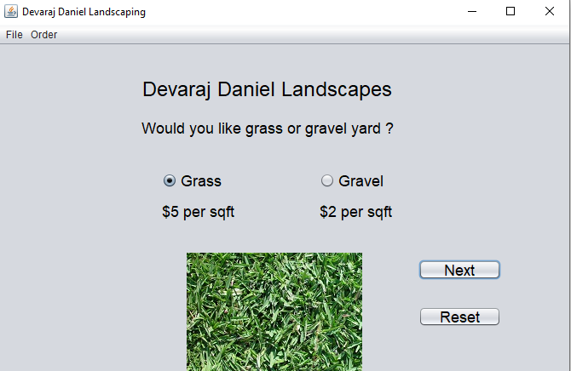
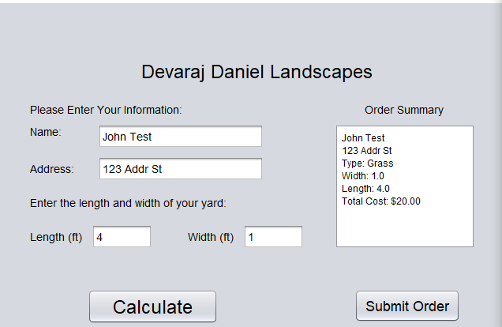
We added some design elements to make it look like a more modern application. The submit order button at the time was not functional. A reset button was created that was functional

Slide 13
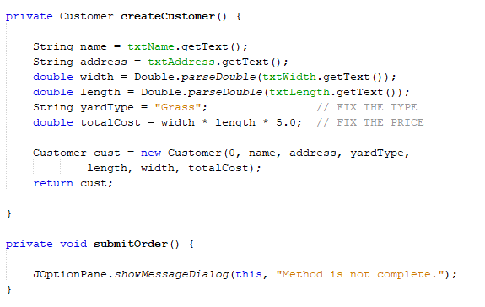
Event Code
We added a landscape GUI info class that will grab the information from the GUI

Slide 14
Using Object Arrays

Slide 15
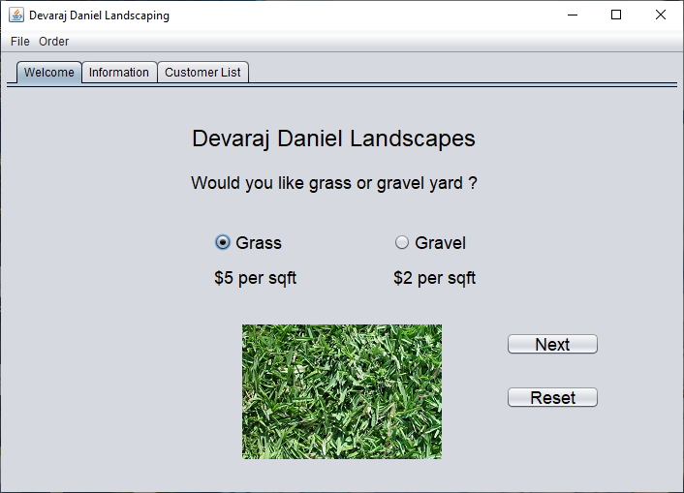
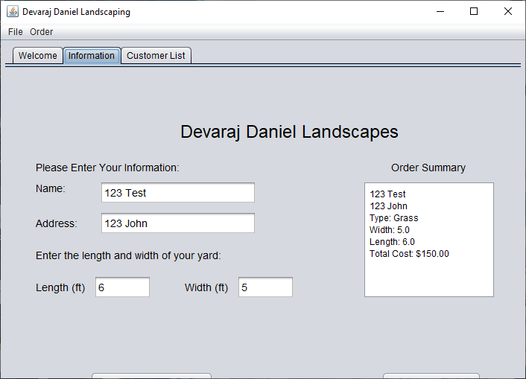
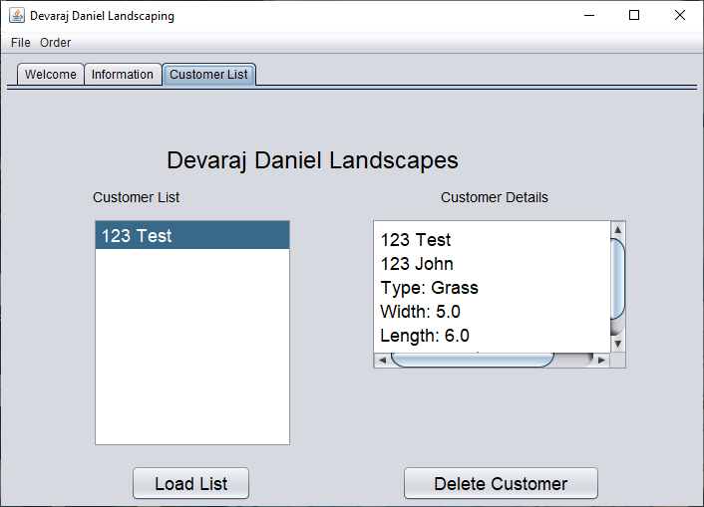
Adding tabs to the GUI
We added functional tabs the gui the corresponded to the wireframe diagram we created previously . The submit order button is also functional now

Slide 16
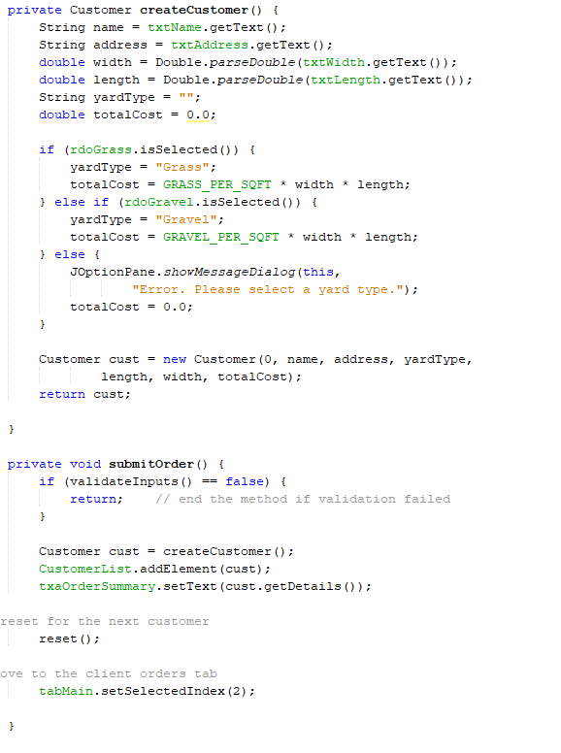
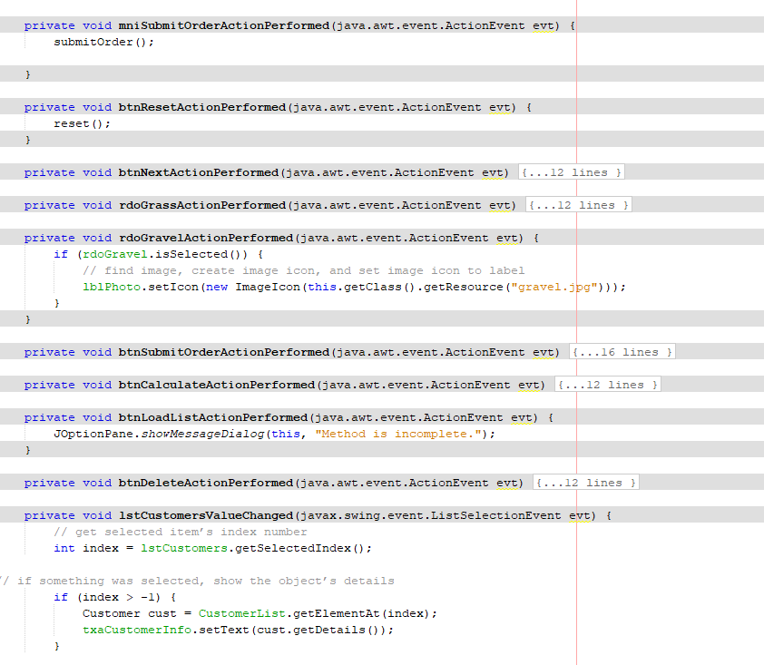
Event code added

Slide 17
Writing data from a GUI to a File

Slide 18
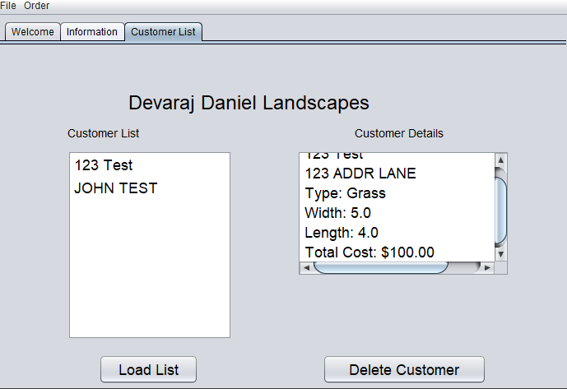
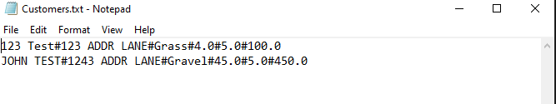
Adding file writing capabilities

Slide 19
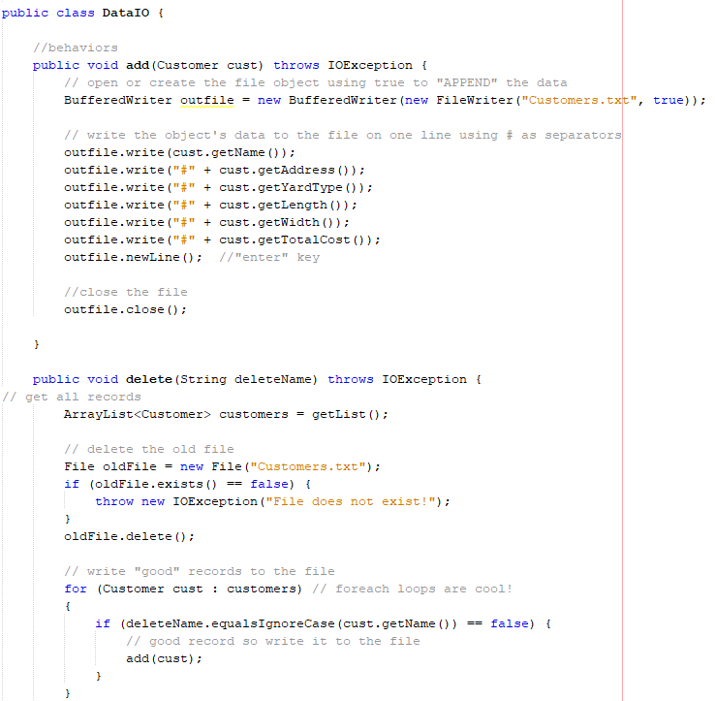
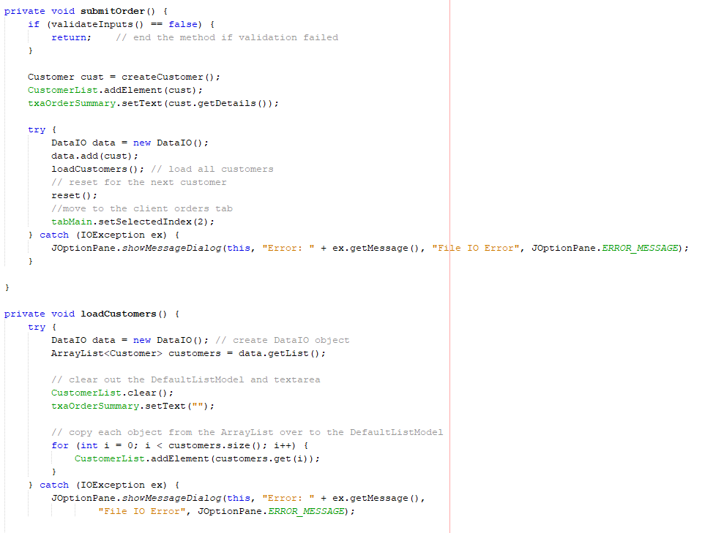
Event Code Added

Slide 20
Writing data from a GUI to a Database

Slide 21
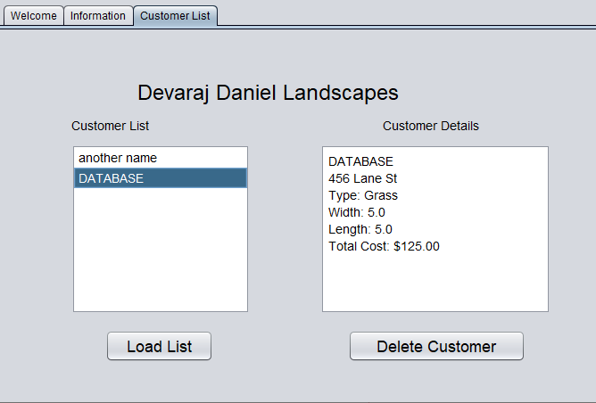
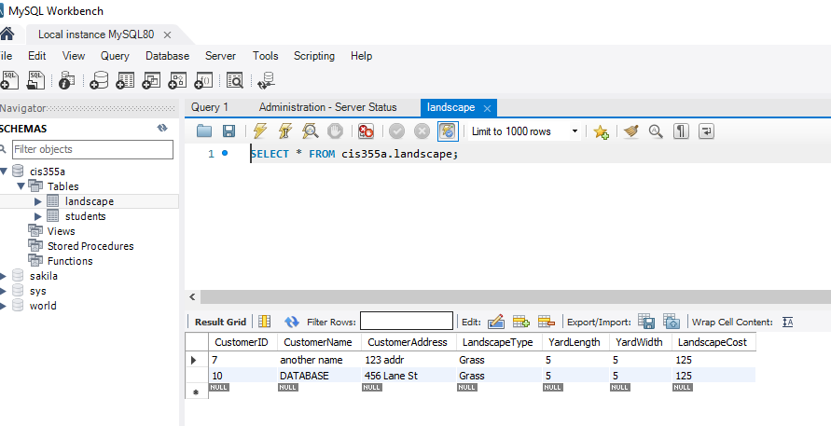

Slide 22
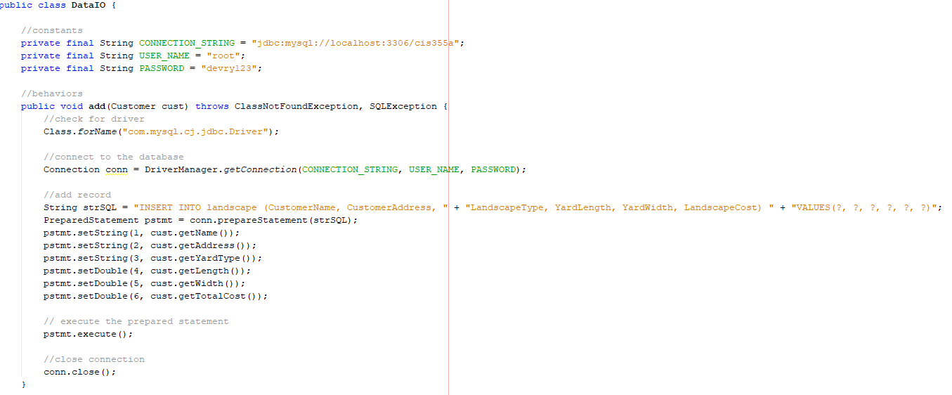
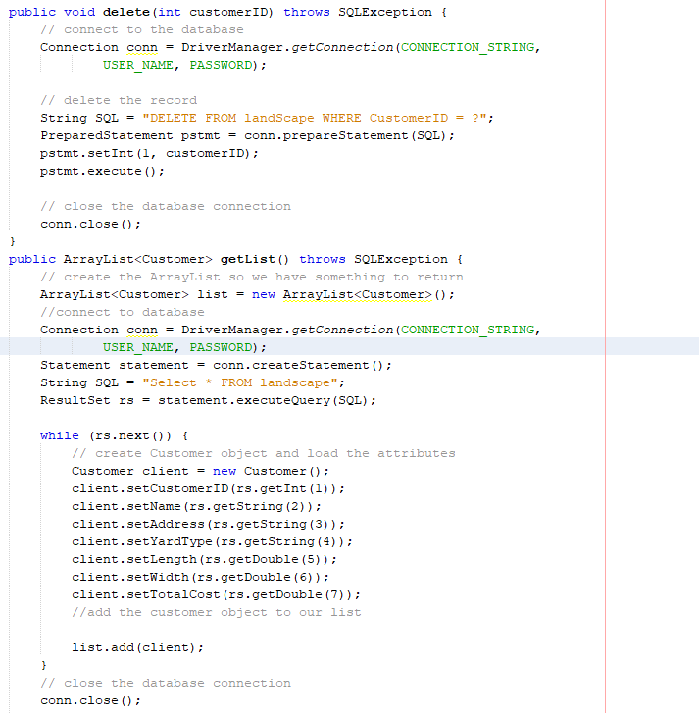
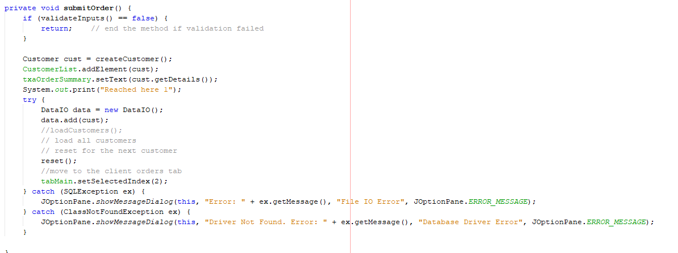
Event code added
Code was added so that the GUI can interact with a database when orders are submitted.

Slide 23
Challenges faced during Project
Getting the database to connect to the GUI and data to be written successfully to it.
Programming array of objects
Remembering to name all the elements of the GUI
Getting everything aligned in the GUI
Setting up the environment the first time

Slide 24
Career Skills Obtained
How to program a GUI with java
Connecting a GUI application to a database
Designing a GUI
Using a Wireframe and UML Diagram to design a program
Developing a program that reads and writes to files

Slide 25
Conclusion
This project was really challenging and fun to do. It was intriguing to see how applications interact with a database. Personally, I am a person that learns best with hands on activities, and this was perfect. After this project, I learned that if you plan everything out pre-hand and the logic is correct programming comes down to syntax. Figuring out the logical part is the hardest. I hope devry continues to do projects like this.

