Slide 1
SEC 290 FINAL
Devaraj Kumar Daniel

Slide 2
Table of Contents
Slide
Introduction 3
Intrusion Analysis using Wireshark 4-8
Open SSL 9-11
Snort 12-16
Live Memory Analysis 17-21
Firewall 22-25
Challenges of project 26
Career Skills acquired 27
Conclusion 28

Slide 3
Introduction
For this project we were instructed to use a virtual machine to get familiar with various security measures and tools to analyze a network and explore ways secure a network with various software's and integrated tools within Linux and Microsoft Windows.
The following areas were covered during this:
Using Wireshark
Exploring SSL Encryption
Using Snort sensors for intrusion Detection
Using Live Memory Analysis
Setting Up firewall rules

Slide 4
Module 2:
Intrusion Analysis using Wireshark
We answered questions based on using wireshark in our virtual machines

Slide 5
Basic Attack Analysis
Answer the questions below from Part 4 of the Project. Analyze what is taking place.
Look at packet no. 20 and packet no. 22. They are both ICMP traffic, but what are the differences between the packets?
There Destinations and sources IP’s are different.
What is the cause of these differences? (Hint: OS) How do you know that? ___________________________________________
Review packet no. 37 and beyond, what do you think is taking place here?
The Computer is trying to establish a connection and then it getting dropped with a TCP RST attack that is why it changes from grey to red beyond 37.
Look at packet no. 14520 and 22486 and compare the packets – what is suspicious about these packets?
Both packets are reset TCP attack packets being sent to the same destination but originating from different sources
What are the destinations being targeted?
The destination is 192.168.25.200
Take a few minutes to review the packet trace and your answers. Summarize your analysis here:
. What I conclude from this packet trace is that the machine established a connection but then got sent a malicious packet. When the system tried to establish a connection, it got attacked in an endless loop of trying to establish a connection but then the packet sends a reset request thus loosing connection

Slide 6
Web Attack Analysis
Answer the questions below from Part 5 of the Project. Analyze what is taking place.
What are the web attacks found within the trace? List the first six or seven that you see. Which one(s) are successful?
Packet #3,4,8,9,10,12. Packet # 4
Locate packet no. 4. What is interesting about this packet session? What, if any, indicators of compromise (IOC) do you see?
This packet is using HTTP and running a script and then gives a refer to nsa.gov
Locate packet numbers 31-40. What is interesting there? What, if any, indicators of compromise (IOC) do you see?
Packets 31-40 runs a program that ends up making the machine redirect to something that looks like Microsoft support but is not.
Locate packet numbers 57-64, what is interesting there?
A weird looking script is running with an http protocol and has a reference to nsa.gov
Take a few minutes to review the packet trace and your answers. Summarize your analysis here:
This packet trace looks all sorts of weird because multiple random scripts and redirects are happening to unknown things and if there is something like a government site it would not be using http as the protocol.

Slide 7
Advanced Analysis With Questions
Answer the questions below from Part 6 of the Project. Analyze what is taking place.
Open the advancedattack1.pcap file. Look at the traffic. Answer these questions:
  What does it appear is taking place in the first series of packets?
    An arp scan
  What hosts respond to the ARP requests?
    192.168.25.50
  Starting at packet no. 402, what does it appear is taking place now?
  a connection is established with the attackers machine
In the filter window enter the following: tcp.flags.syn == 1 and tcp.flags.ack == 1
  Create a listing of the ports that are open for host 192.168.25.50: 80-40919
  Create a listing of ports that are open for host 192.168.25.1: 53-55972
  Based on information above, what ports are well known for attack attempts? 80,443
Enter the following filter to isolate traffic to this port: tcp.port == 25 What do you observe?
  There is a reset packet being sent to port 25
Click on packet no. 5929. Right-click and select Follow | TCP Stream. What do you observe?
  There is a message the comes up and says Internal Host Microsoft ESMPT mail service with a version number and a date
Enter the following into the filter window: ip.src == 192.168.25.50 and tcp.port == 25. What do you observe?
    The host computer is sending information to the attacker computer via a Microsoft mail service port
Enter the following in the filter window: ip.src == 192.168.25.1 and tcp.port == 81 and tcp.flags.syn == 1 and tcp.flags.ack == 1. In this case, there is nothing displayed. So, what can we determine? ___________________________________
Navigate to packet no. 14584 and right-click and select Follow | TCP Stream. What do you observe?
  There is a dns mask mask message with a version bind message
Clear the filter and enter the following: tcp.port == 81. Right-click packet no. 14585 and select Follow | TCP Stream. Now what do you
  It gives information on a server.

Slide 8
Advanced Analysis Summary
We have uncovered quite a bit of information in this trace, but have we identified any indicators of compromise thus far? What other observations can you make about this packet capture?
Provide your summary analysis and observations here:
What I conclude happened was that an arp scan occurred and the one host 192.168.25.50 was the only machine that responded so after that packets were sent to that machine that established a connection with a malicious server that is sending out unwanted packets.

Slide 9
Module 3:
Open SSL
We ran a temp SSL server and then ran a series of commands to demonstrated using SSl

Slide 10
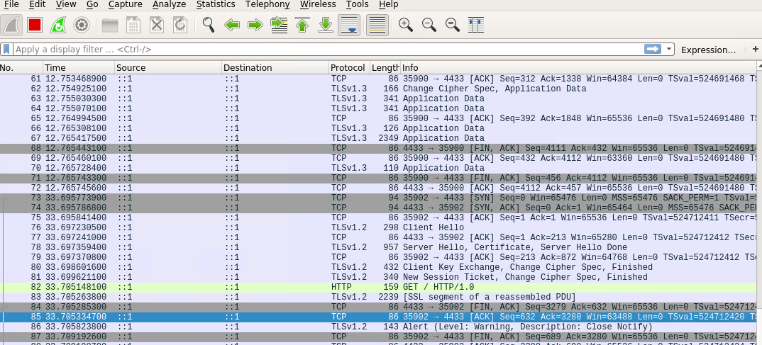
Creating and testing an SSL/TLS file
.
It should show the GET request in the Info column.

Slide 11
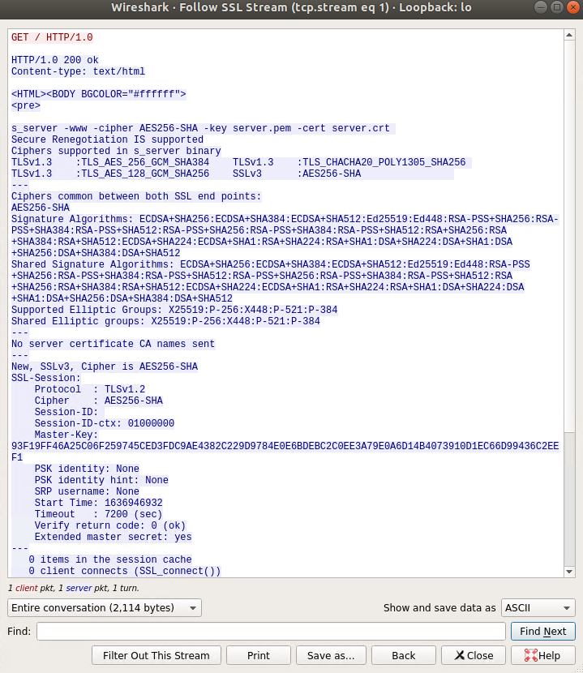
Creating and testing an SSL/TLS file cont’d
Successfully decrypting SSL Stream

Slide 12
Module 4: Snort

Slide 13
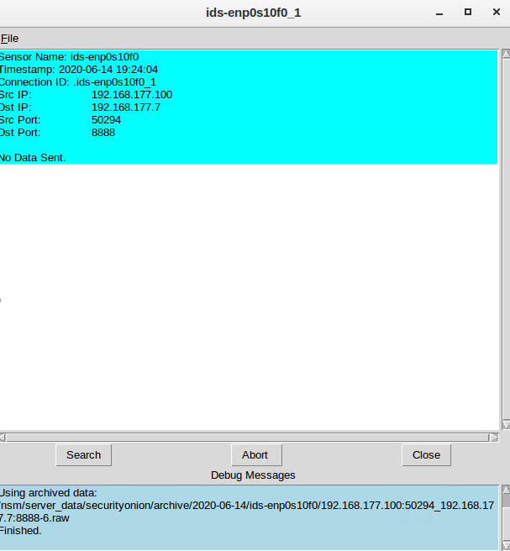
Testing Snort rules
It should show the transcript of the XMAS scan alert.

Slide 14
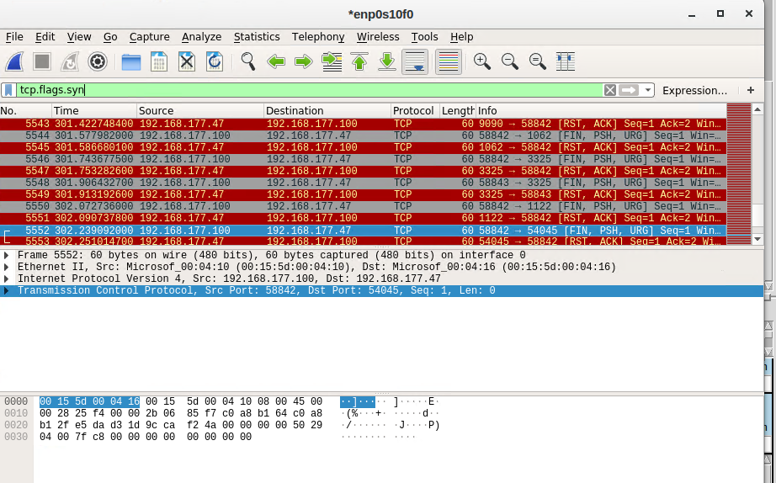
Testing Snort rules cont’d
It should show the TCP packets generated by the XMAS scan.

Slide 15
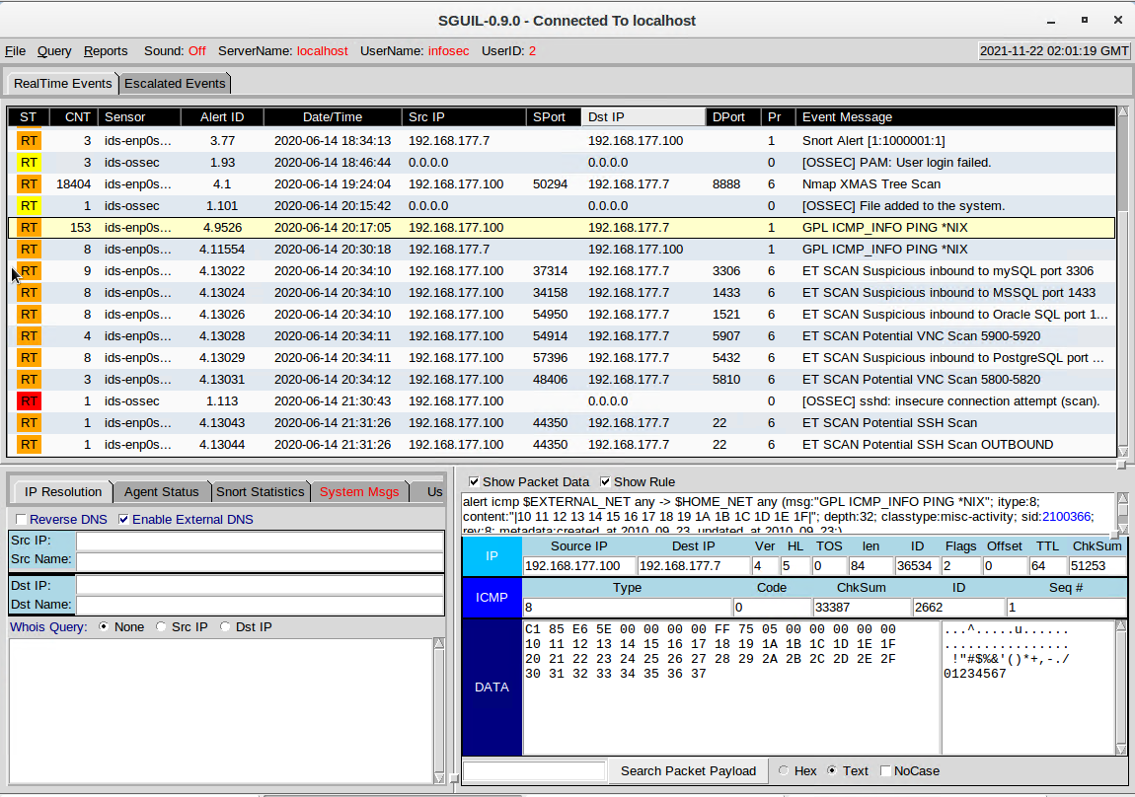
Creating Snort rules
It should show the ping activity alert.

Slide 16
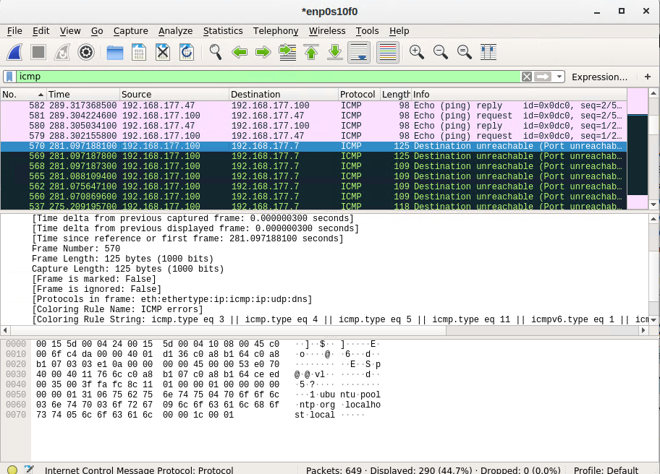
Creating Snort rules cont’d
It should show the ICMP packets generated by the ping activity.

Slide 17
Module 5 Live Memory Analysis
We used Linux tools to analyze memory

Slide 18
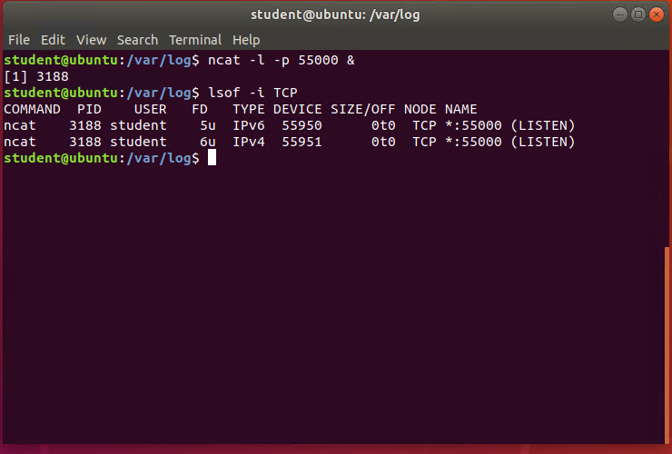
Linux Processes
It should show port 55000 open for both IPv4 and IPv6.

Slide 19
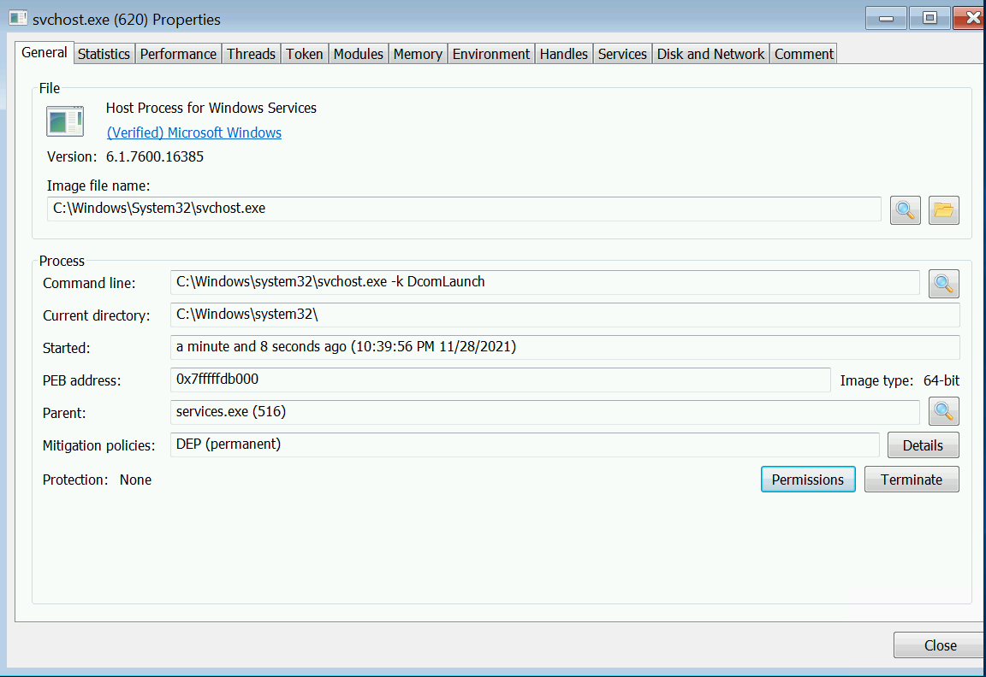
Process Hacker
It should show properties of a chosen process.

Slide 20
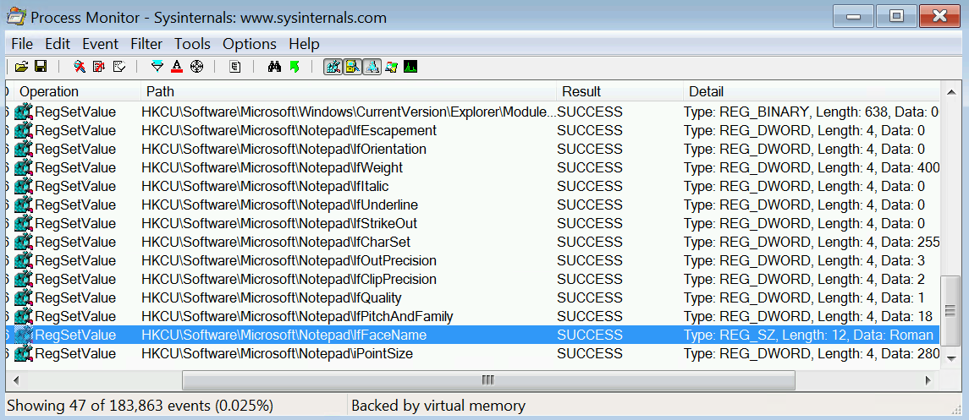
Process Monitor
It should show ifFaceName in the Path column and Data: Roman in the Detail column.

Slide 21
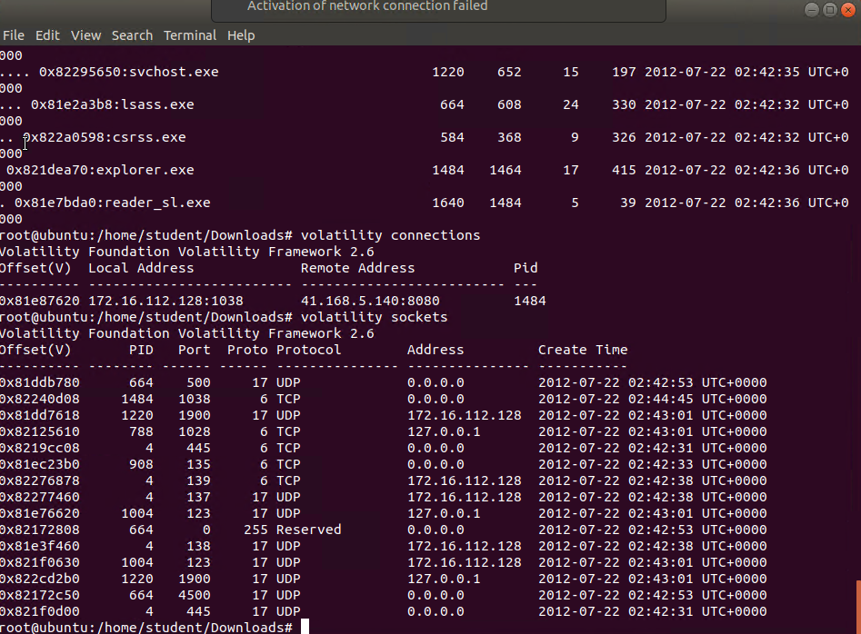
Volatility
It should show compromised network connections.

Slide 22
Module 6 Firewall
We configured a firewall with specific rules

Slide 23
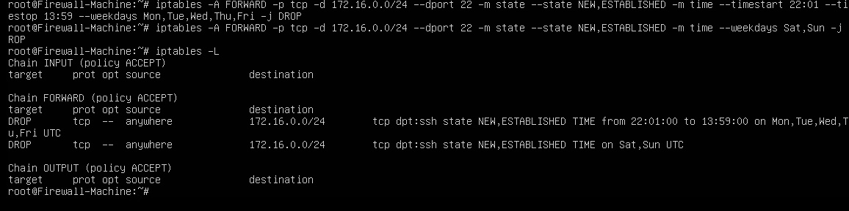
Time-based access
It should show two time-based access rules in the FORWARD chain.

Slide 24
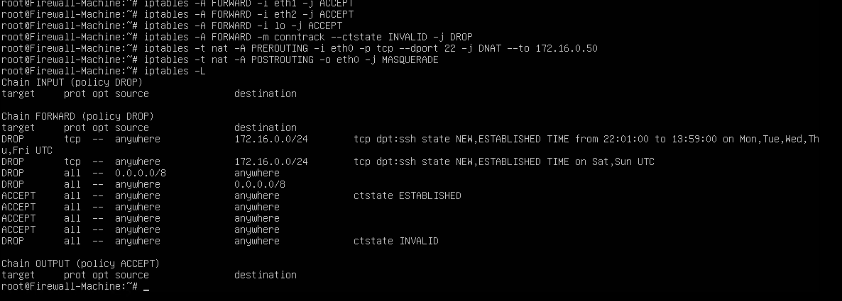
Dynamic NAT
It should include prerouting and postrouting rules.

Slide 25
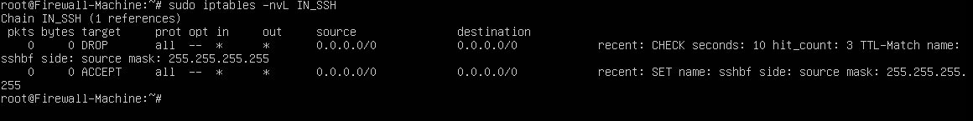
Brute forcing of SSH logins
It should show the dropped SSH packet count.

Slide 26
Challenges in Project
Some of the challenges in the project were as follows:
Using some of the Linux Commands
Sometimes Connecting the Virtual Machine
Identifying Correct Information when using Wireshark

Slide 27
Career Skills Obtained
Some of the career skills obtained were as follows:
Configuring a firewall with specific rules
Using Wireshark to analyze and figure out potential threats to a network
Using snort tools
Analyzing memory
Using SSL

Slide 28
Conclusion
This project was fun and hands on. It was a little bit challenging however when analyzing because I was not used to looking for certain pieces of information like what looks like suspect activity on a network with Wireshark and what normal activity should look like. I hope DeVry continues to do these types of projects in the future.

