Slide 1
SEC 285 Final
Using various tools to enhance/monitor security for a system
Devaraj kumar daniel

Slide 2
Table of Contents
Slide
Introduction 3
Asymmetric Key Encryption 4-6
Stateful Firewall 7-9
Bring Your Own Device Policy 10-11
Multifactor Authentication 12-14
Vulnerability Assessment 15-20
Challenges of project 21
Career Skills acquired 22
Conclusion 23

Slide 3
Introduction
The purpose of this project was to learn and demonstrate various things that a person may have to perform and know relating to information security. This projects shows:
Configuring and testing processes using Azure Cloud
Enabling encryption
Enabling a Stateful Firewall
Adding multifactor authentication to a system
Vulnerability Assessment
We used Microsoft Azure and various virtual machines to perform different security tasks.

Slide 4
Asymmetric Key Encryption
Demonstrating how to add encryption to a document in linux and then decrypting that document

Slide 5
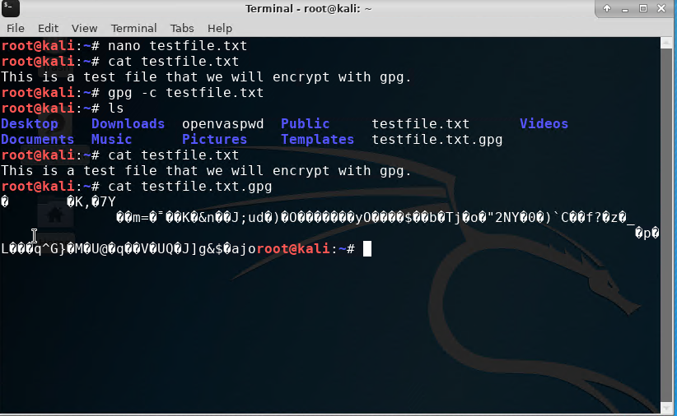
File Encryption
This screenshot should show the following.
Content of the plaintext file
Content of the encrypted file
We were instructed to create a text document then encrypt it in linux

Slide 6
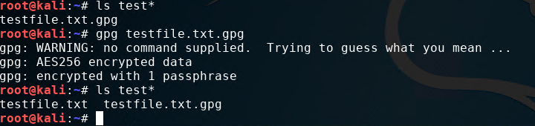
File Decryption
This screenshot should show the following.
The encrypted file being listed by itself
The decrypting process
Both the encrypted file and the original plaintext file being listed
This was showing how to use Linux commands to decrypt the previous text file

Slide 7
Stateful Firewall
Enabling a stateful firewall to our linux machine

Slide 8
Question
What effect does the sudo iptables --policy INPUT DROP command have on the access to computing resources?
Answer here:
Running the above command essentially closes all the input ports on the computer. It changed the rules for the firewall to drop all traffic.
References:
https://wiki.centos.org/HowTos/Network/IPTables

Slide 9
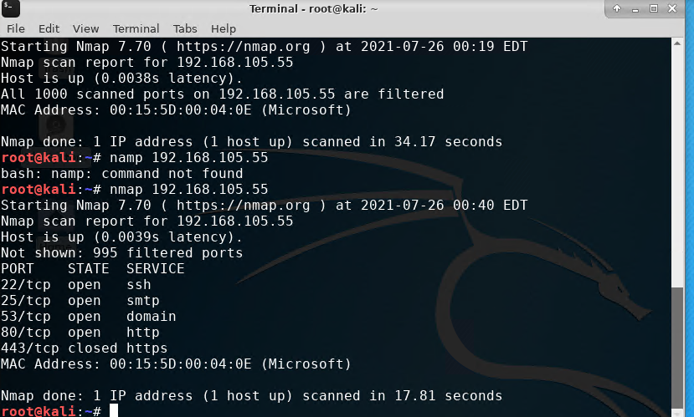
Nmap Scan
This screenshot should show the Nmap scan result of the Linux Server VM.
Using Nmap to scan the vm’s network

Slide 10
Bring Your Own Device Security Policy
Creating our own security policy for personal devices

Slide 11
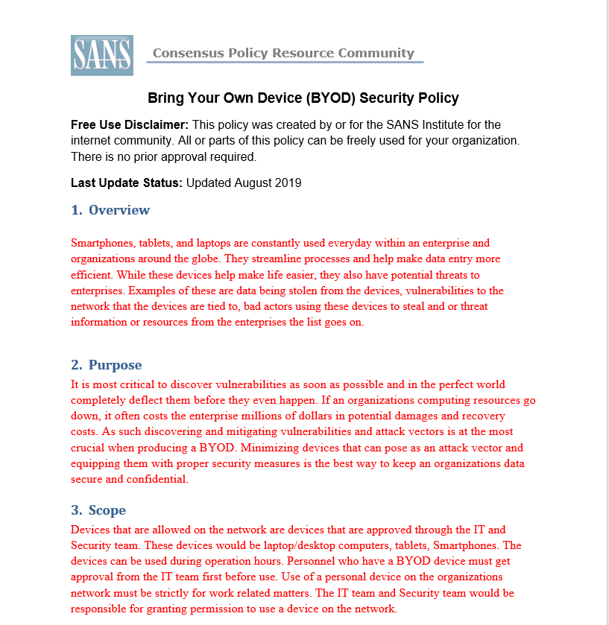
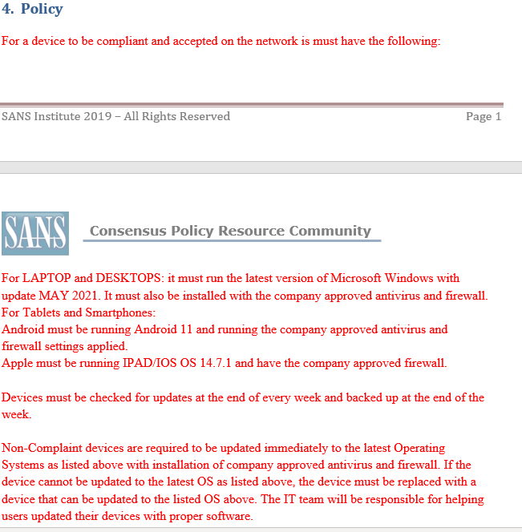
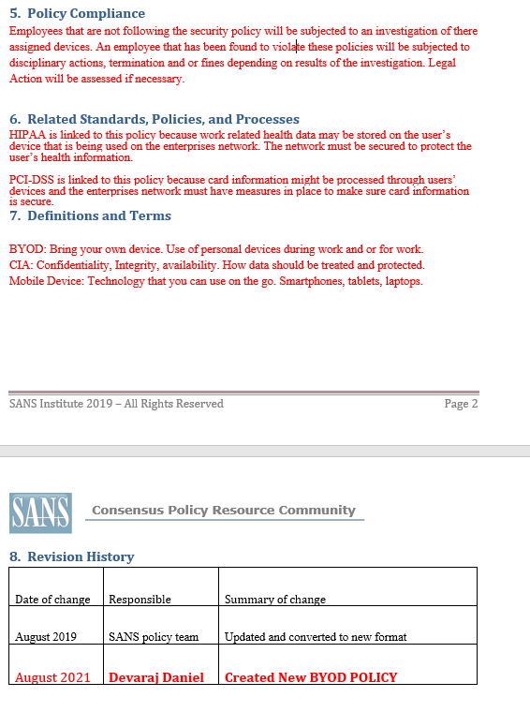
BYOD Security Policy
This slide should have the complete security policy template inserted as an object.
This was a makeshift byod policy for a imaginary company.

Slide 12
Multifactor Authentication
Enabling mfa to our Linux machine

Slide 13
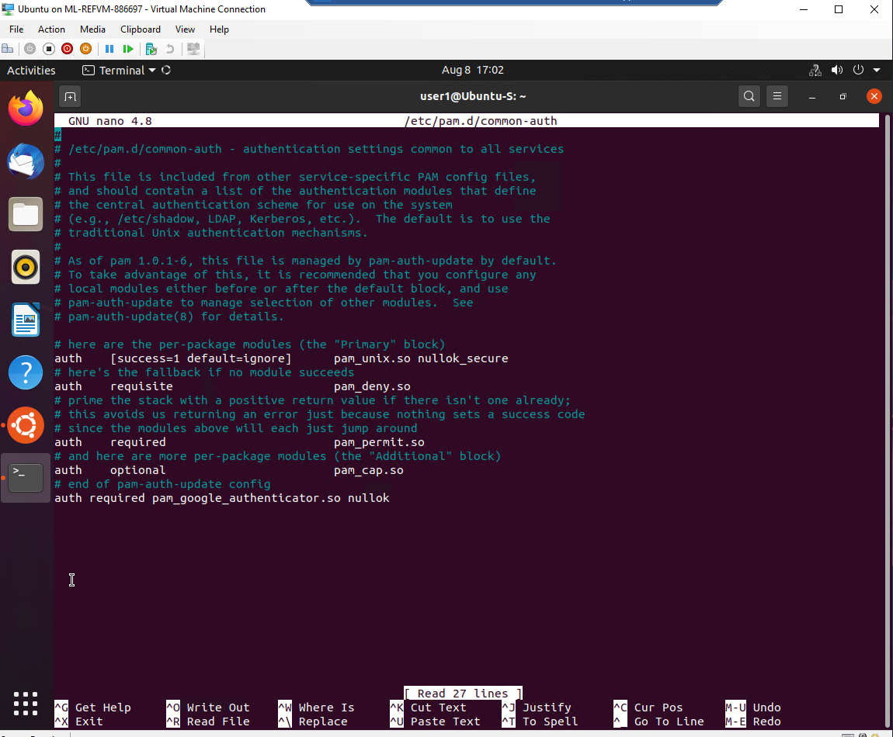
Common-auth Configuration File
This screenshot should show the entry that indicates the use of the Google Authenticator module.
We enabled google authenticator for our linux machine

Slide 14
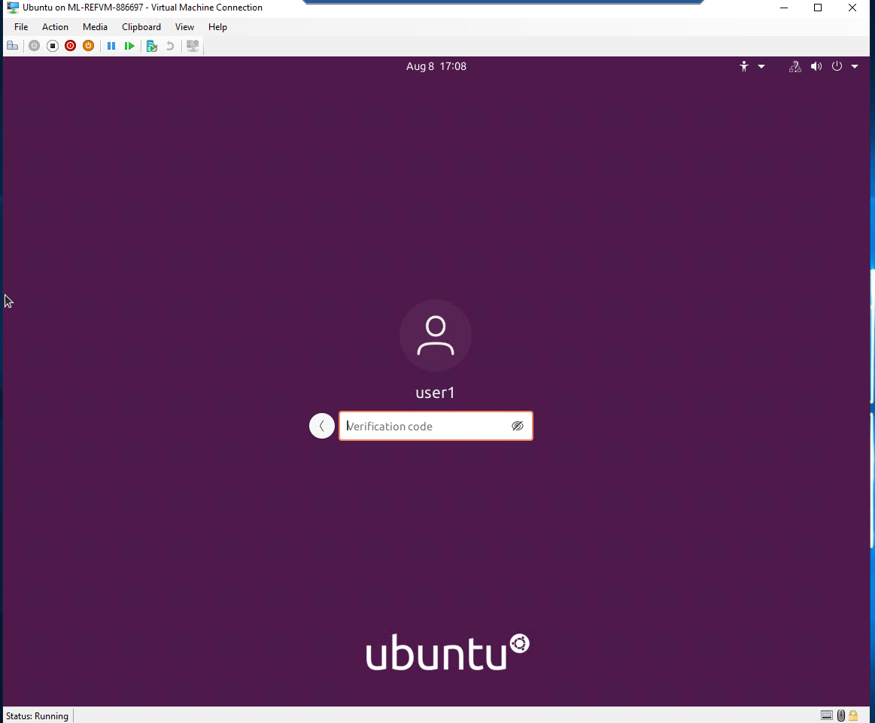
MFA Logon Screen
This screenshot should show the logon screen where a verification code is required.
This screen shows google authenticator working

Slide 15
Vulnerability Assessment
Using various tools to scan our network and see vulnerabilities in them

Slide 16
Scanning networks
For the next few slides we used various network scanning tools on our vm’s

Slide 17


Nmap
This screenshot should include the scan result showing both the Kali and Linux Server VMs.

Slide 18
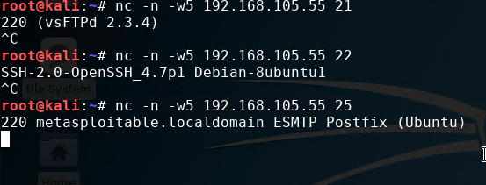
NetCat
This screenshot should include the scan result showing both the Kali and Linux Server VMs.

Slide 19
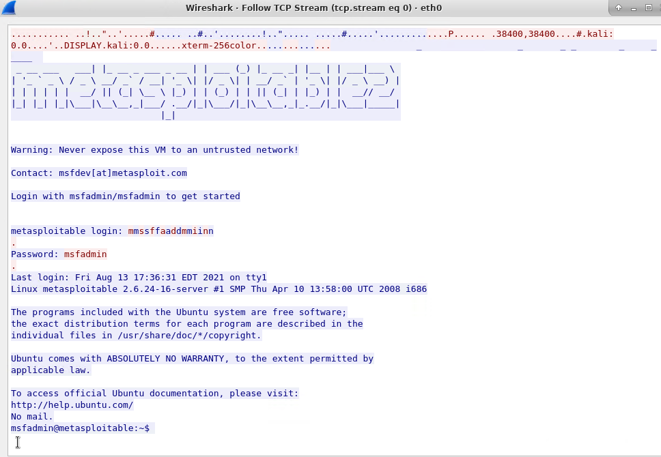
Wireshark
This screenshot should include the Wireshark—Follow TCP Steam window showing the Telnet username and password.

Slide 20
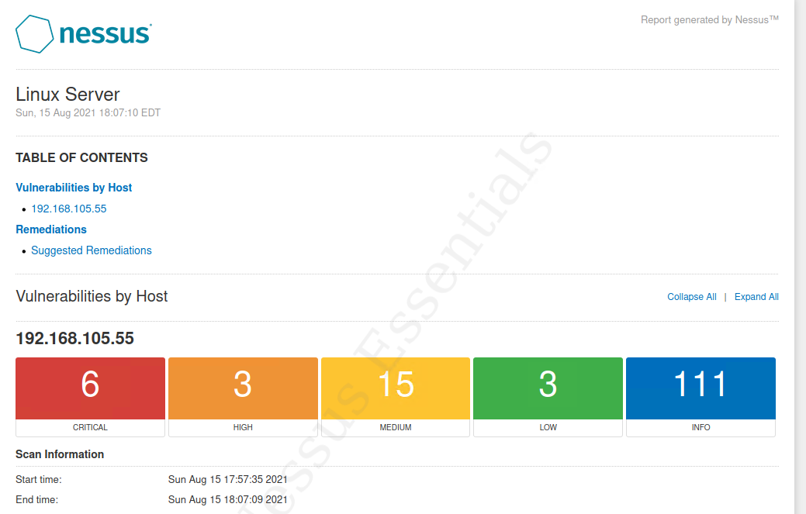
Nessus
This screenshot should include the high-level view of the Nessus vulnerability scan report (showing categories of vulnerability in different colors).

Slide 21
Challenges of Project
Some of the challenges of the project were as follows:
Getting the Microsoft Azure Virtual Machine Up
Using the Linux command line
Filling out the BYOD Policy Template

Slide 22
Career Skills Obtained
Some of the career skills obtained from this project are was follows:
Learned how to use various tools to assess security
Learned how to setup multifactor authentication to a system
Learned how to develop a security policy
Learned how to encrypt

Slide 23
Conclusion
This project was fun to do and super informative. It was challenging at times but educational. As a student I like it when I am hands on with a project, it really simulated how real-life scenarios would be. I hope DeVry continues to do projects like this.

