Slide 1
CEIS 101 Course Project
Smart Home Secruity System
By Devaraj Kumar Daniel

Slide 2
Table of Contents
Slide
Introduction 3
Tinkercad Prototype 4-6
Inventory of Components 7-11
Door Sensor 12-16
Distance Sensor 17-22
Automated Light System 23-27
Challenges of project 28
Career Skills acquired 29
Conclusion 30

Slide 3
Introduction
For this project we were instructed to make a smart home automation security system. To do this I did the following:
  Designed a working prototype system using Tinker cad
  Built a real-world system using the Tech Core Kit provided from DeVry
  Programming with Arduino IDE using C++ as the language.
The smart Home system capabilities are as follows:
  Door Sensor
  Distance Sensor
  Automated Light System

Slide 4
Prototype Circuit Simulation in Tinkercad

Slide 5
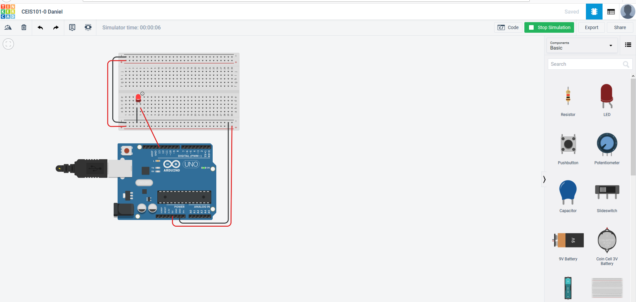
Circuit (screenshot)

Slide 6
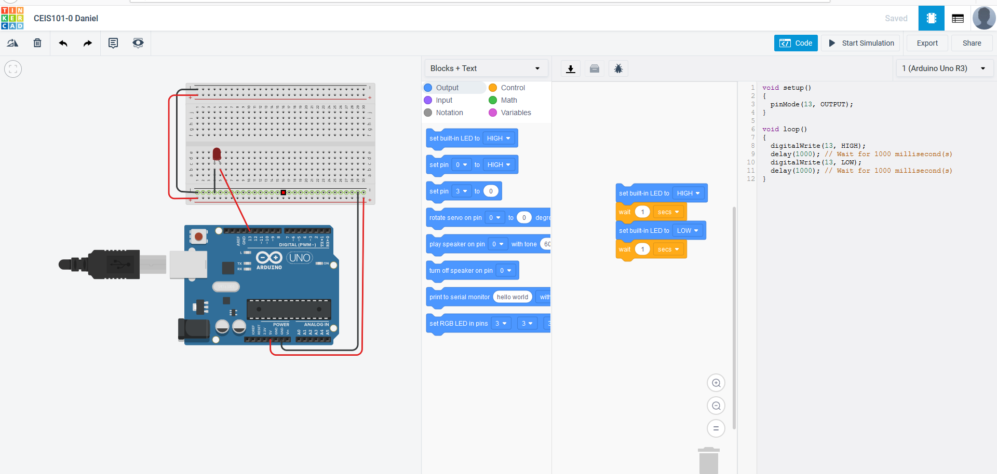
Code (screenshot)

Slide 7
Inventory of parts
Building a circuit and displaying a message

Slide 8
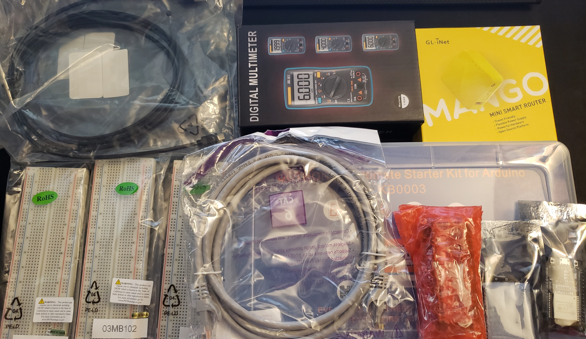
Inventory of IoT Kit (picture)
UCTRONICS Kit
ESP32 (2)
LCD Modules (2)
Breadboards (3)
Mini Router
Patch Cable
Digital Multi Meter
USB to Micro USB (2)

Slide 9
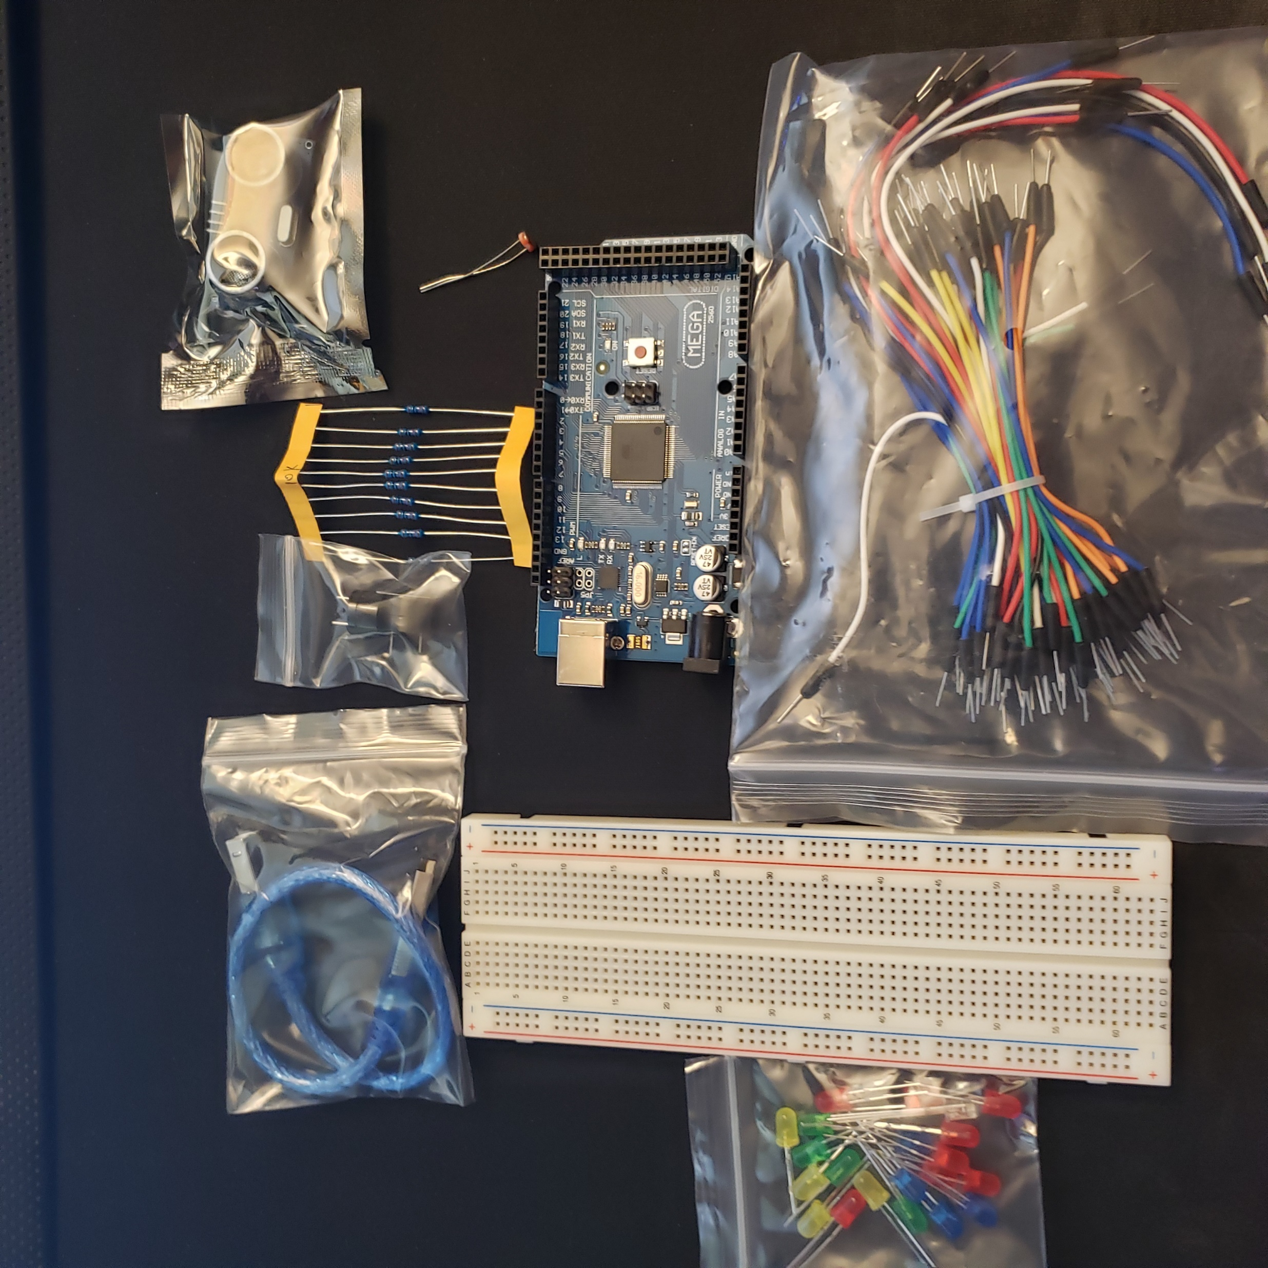
Organization of Project Components (picture)
Arduino Mega 2560
Breadboard
Resistor 10kΩ
LEDs
Ultrasonic Sensor
Passive Buzzer
Photoresistor
Wires
USB Type B cable

Slide 10
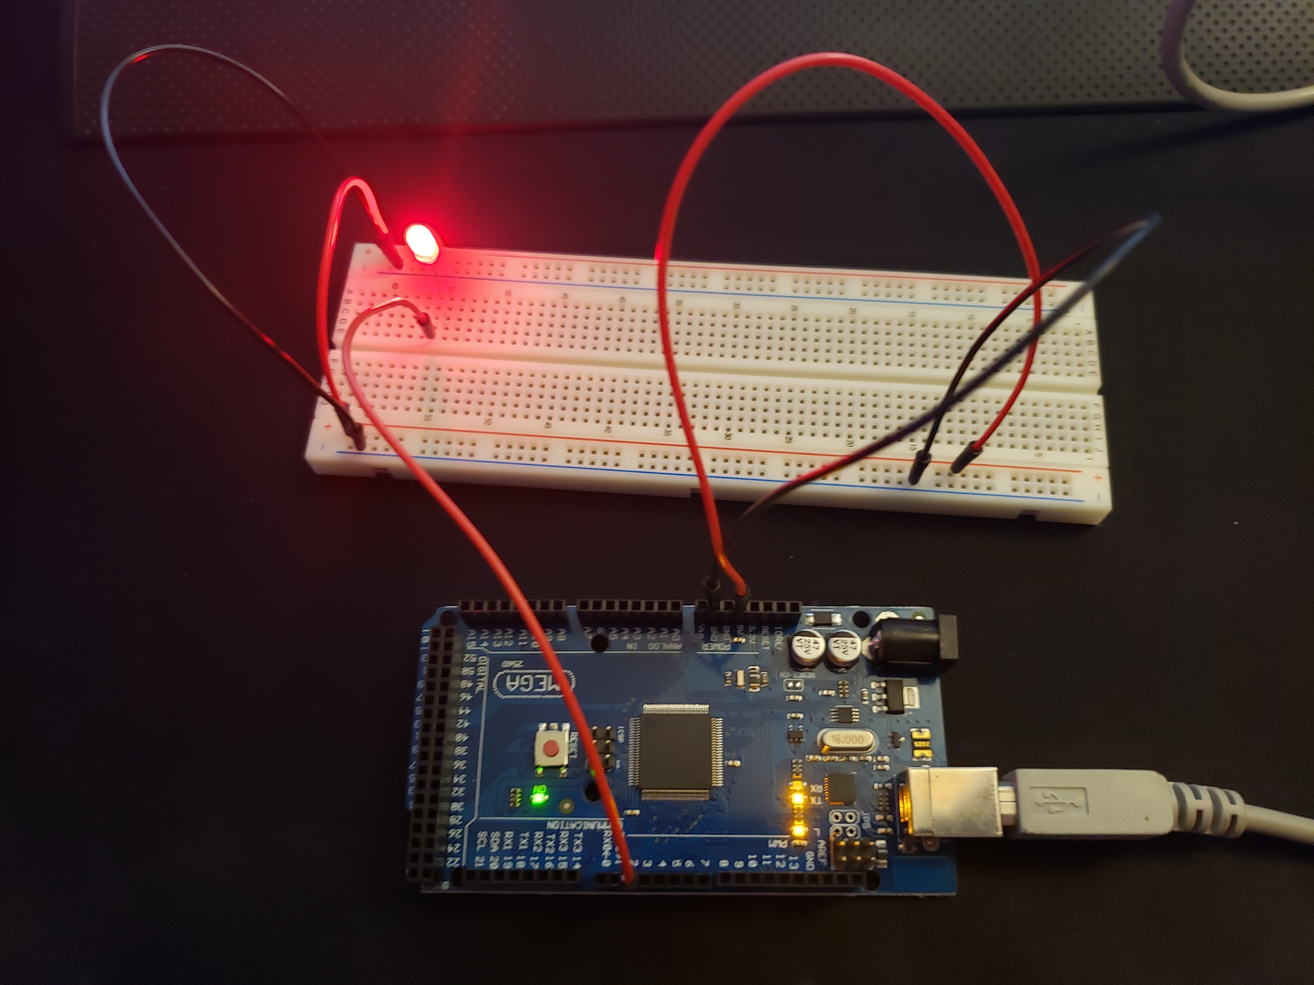
This was a demonstration of getting making sure the Arduino board was working and that the code running it was correct.

Slide 11
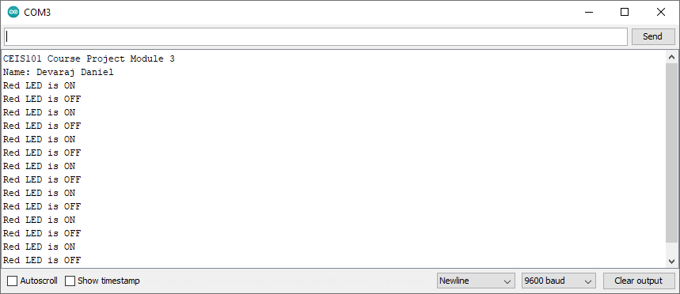
This was the output of the red led turning off and on based on the code we inputted into the Arduino

Slide 12
Door Sensor

Slide 13
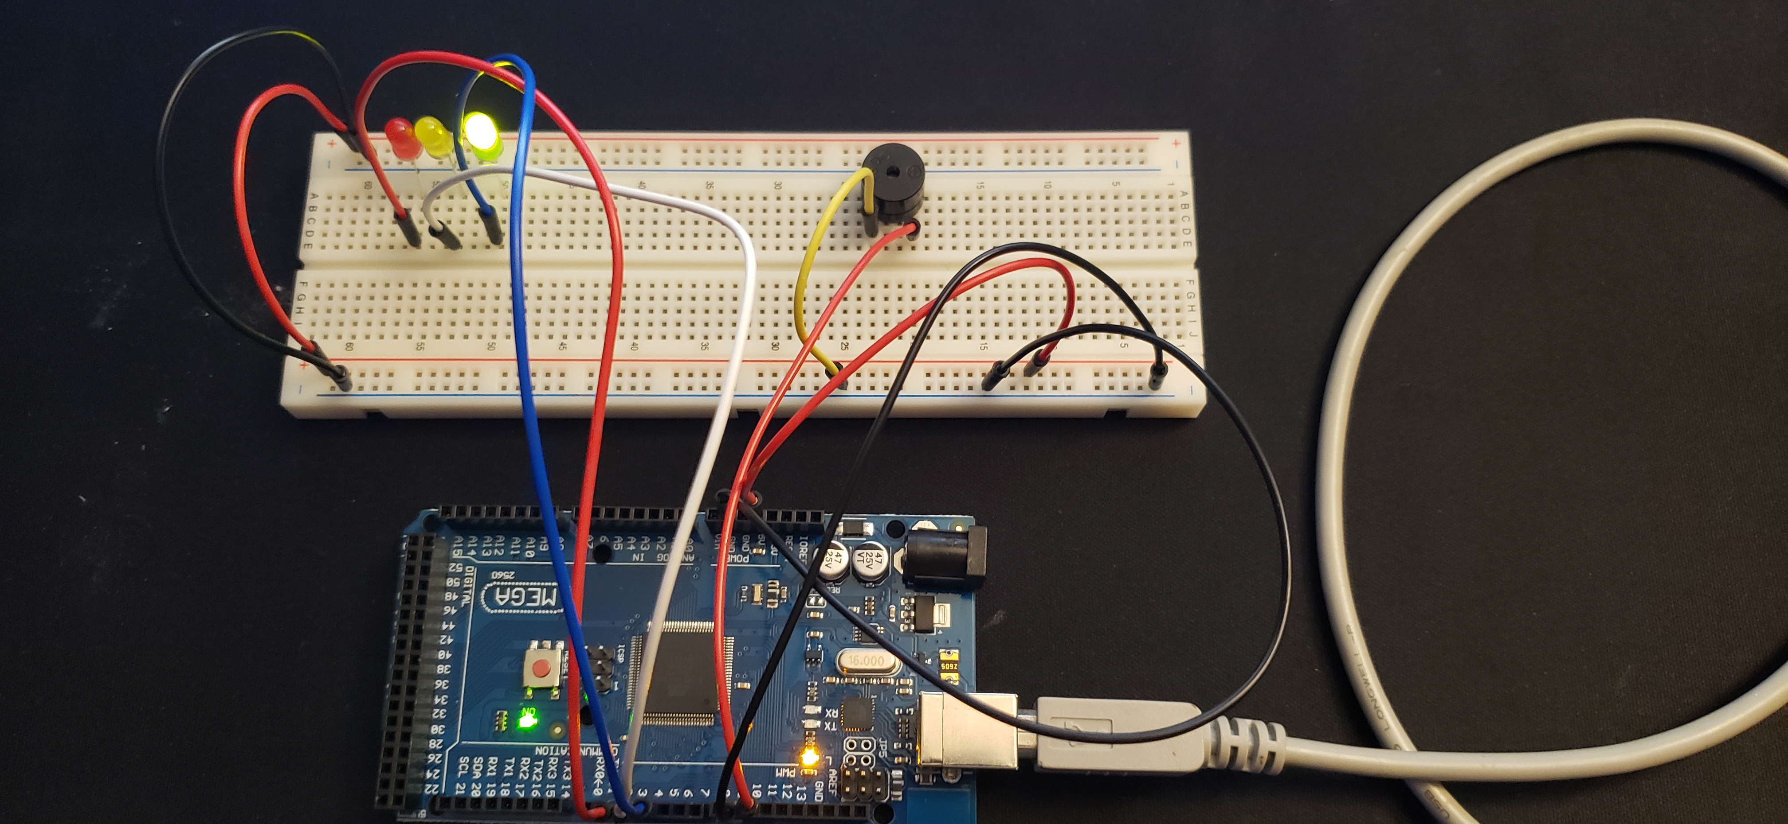
Circuit of door closed with Green LED ON (picture)

Slide 14
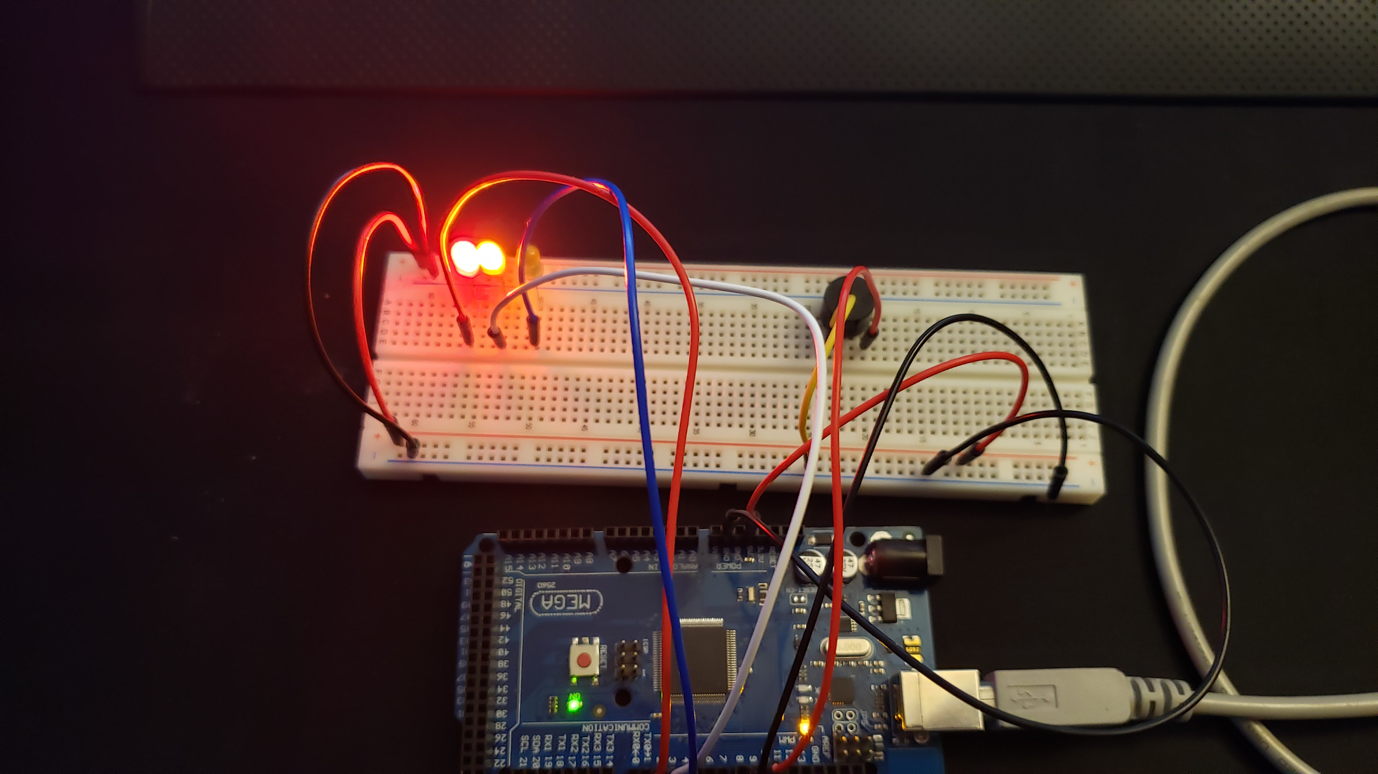
Circuit of door open with Green LED OFF (picture)

Slide 15
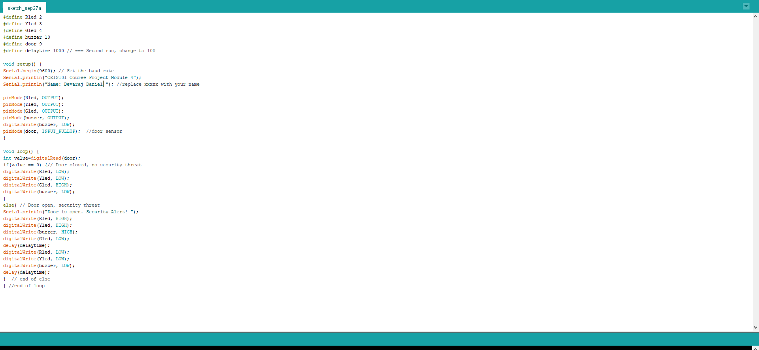
Arduino Code (screenshot)

Slide 16
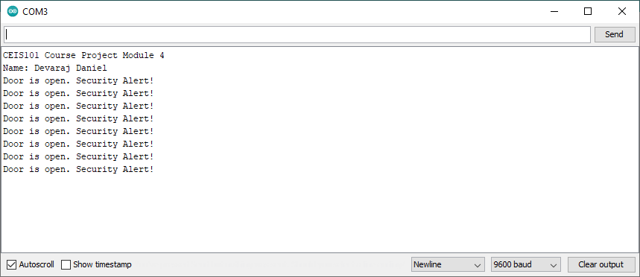
Serial Monitor (screenshot)

Slide 17
Distance Sensor

Slide 18
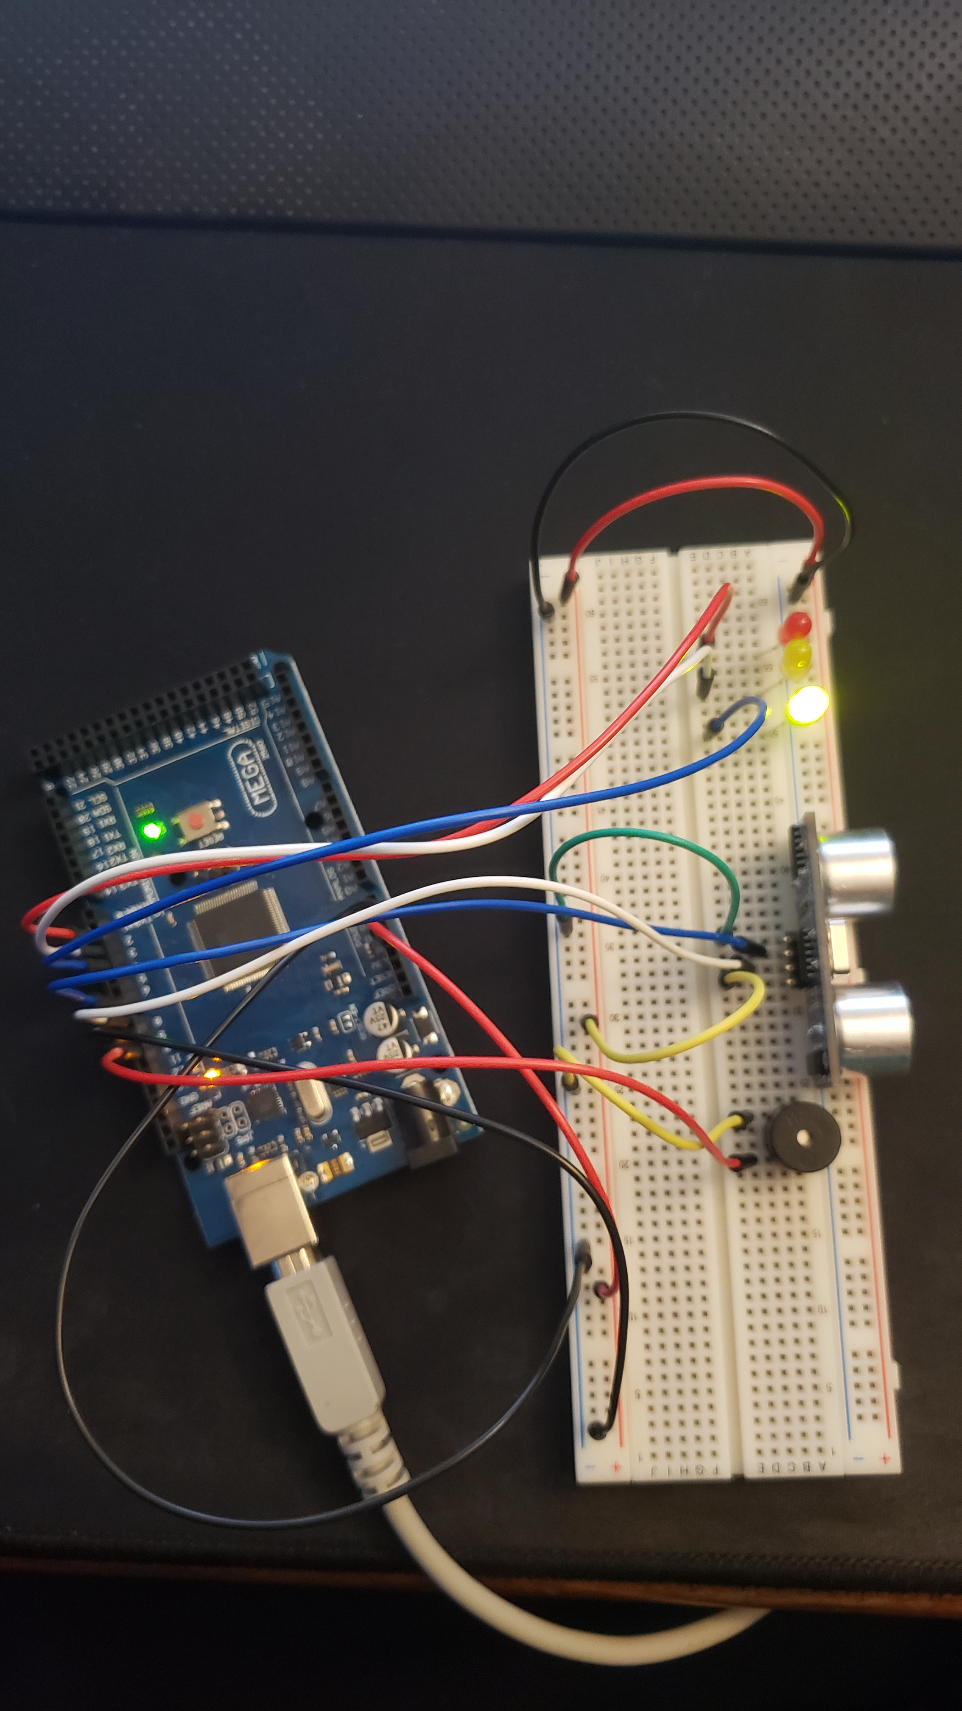
Circuit with green LED on (picture)

Slide 19
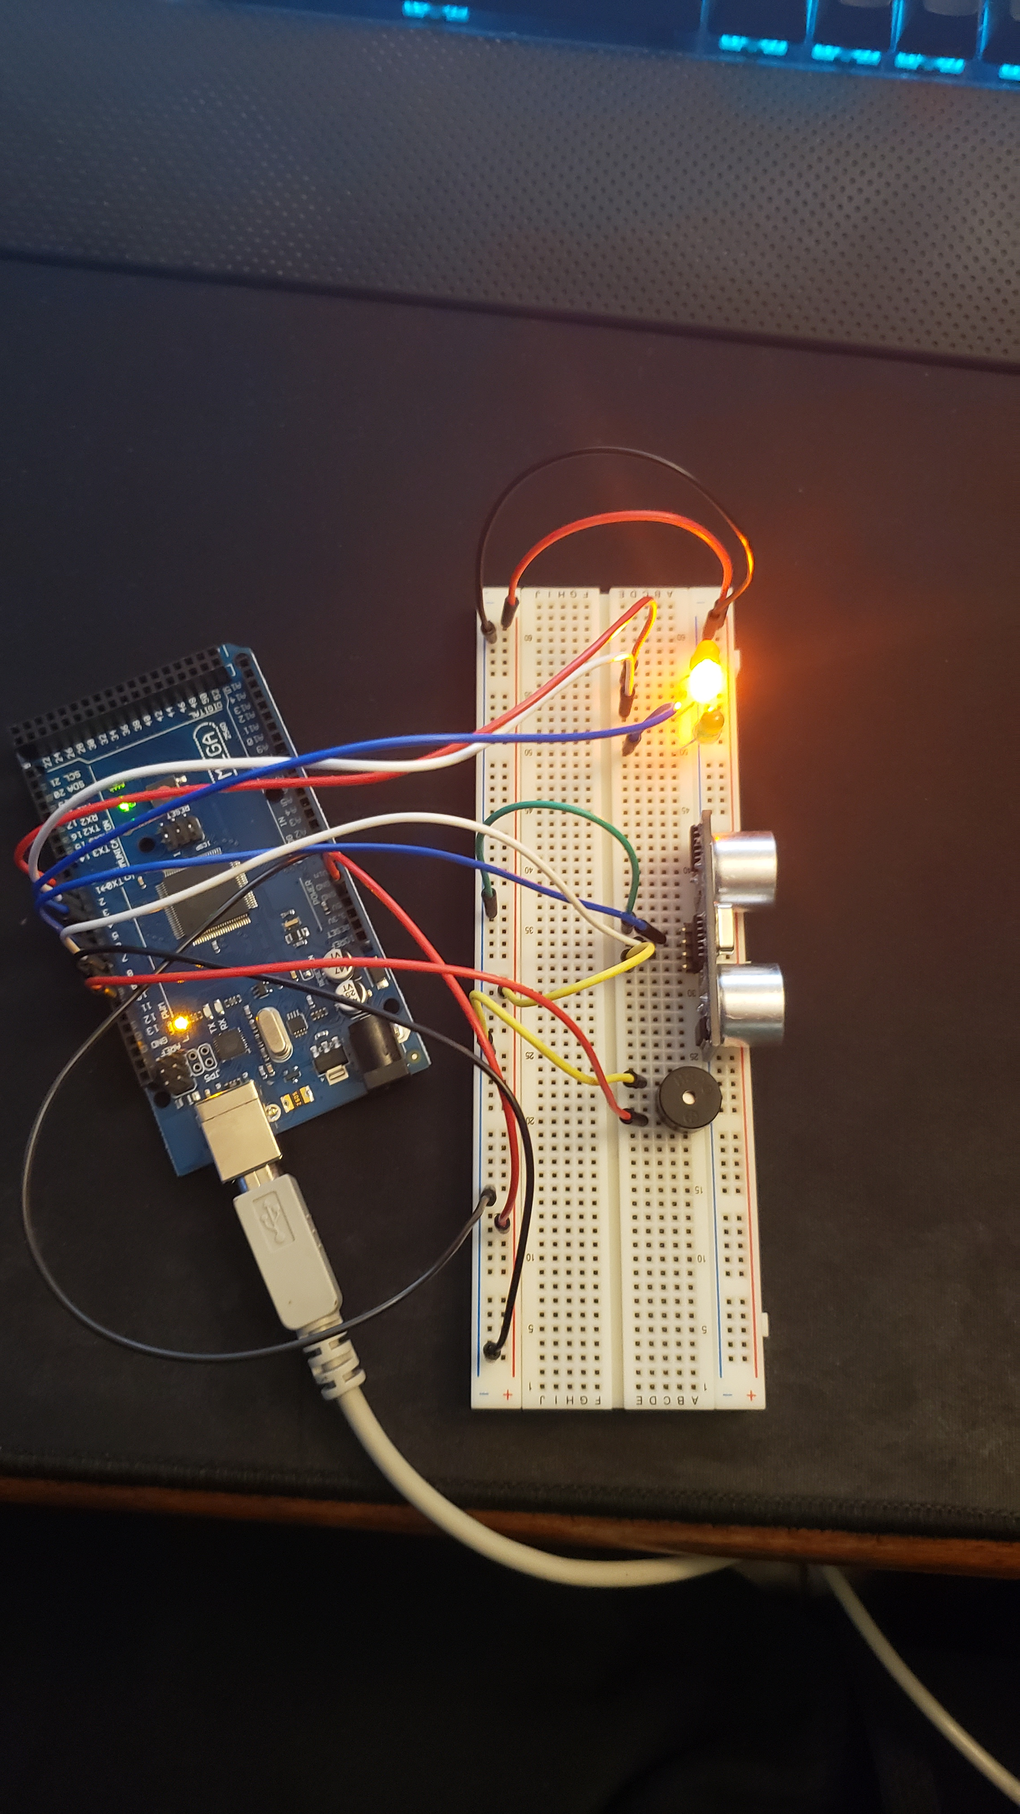
Circuit with yellow LED on (picture)

Slide 20
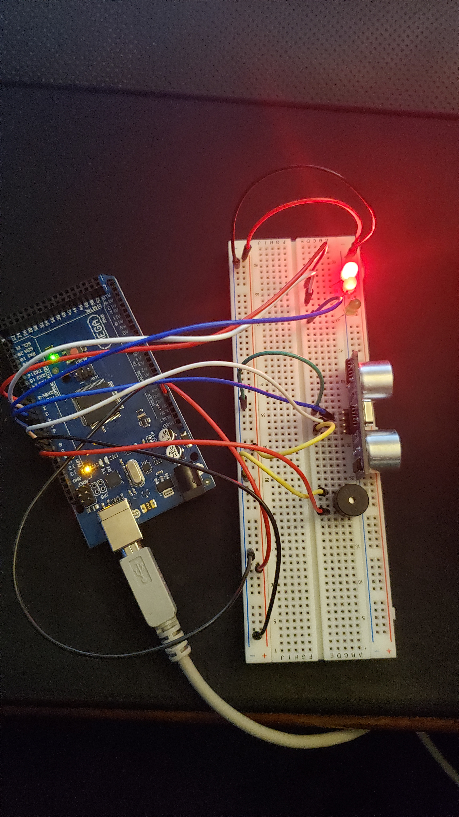
Circuit with red LED on (picture)

Slide 21
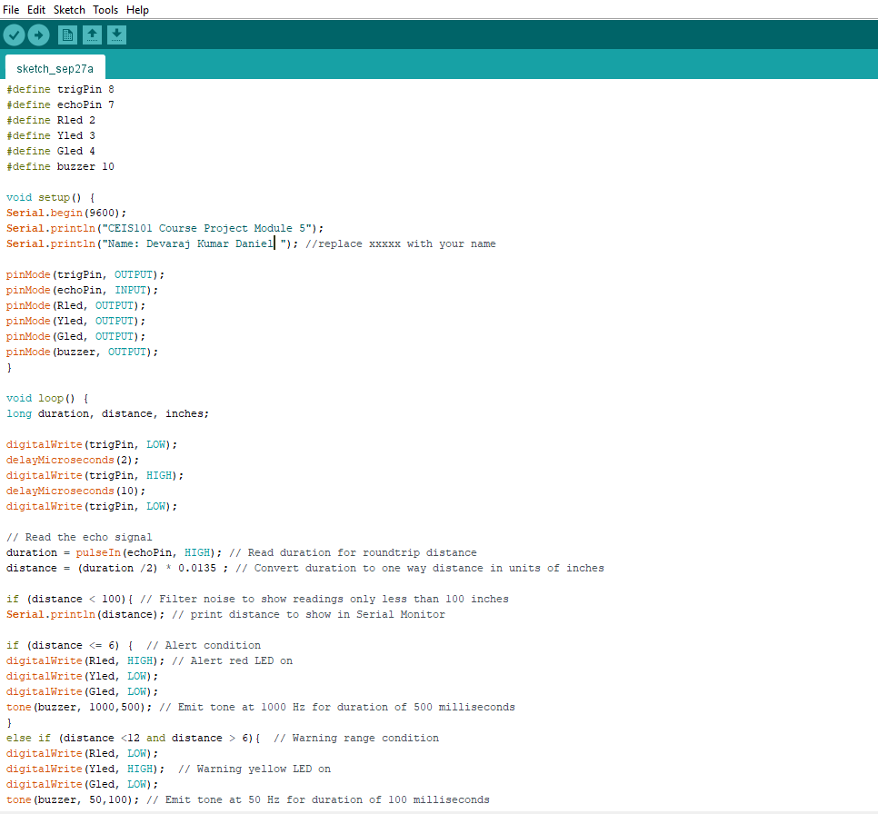
Arduino Code (screenshot)

Slide 22
Plot of data (graph from Excel)

Slide 23
Automated Light System

Slide 24
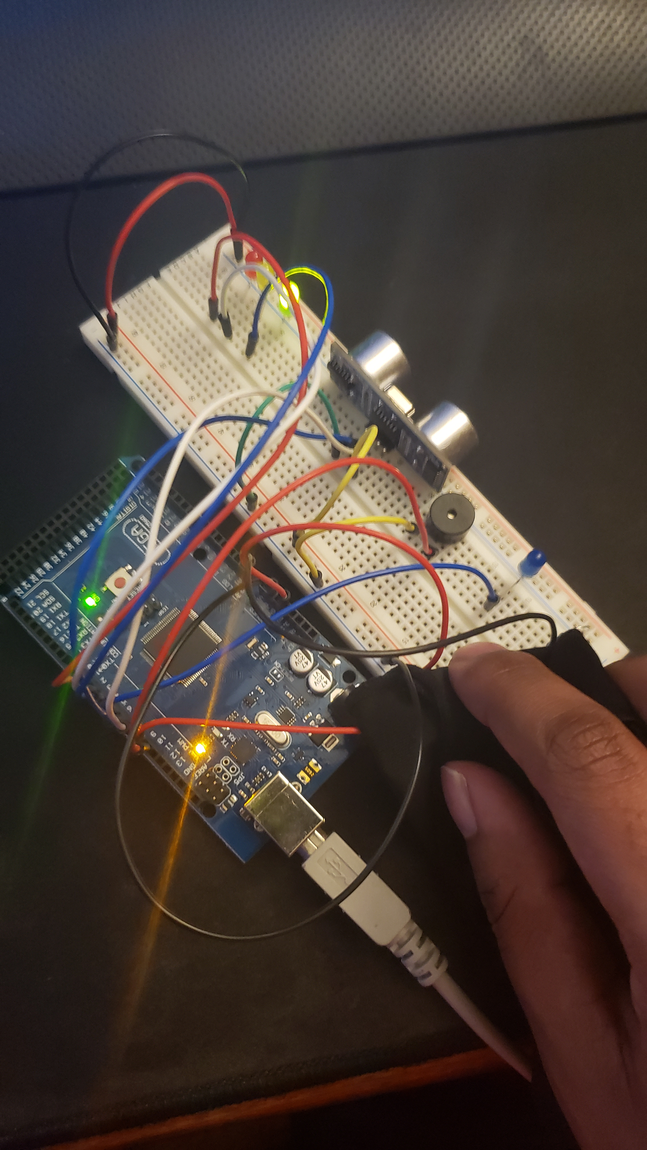
Circuit with automated LED off (picture)

Slide 25
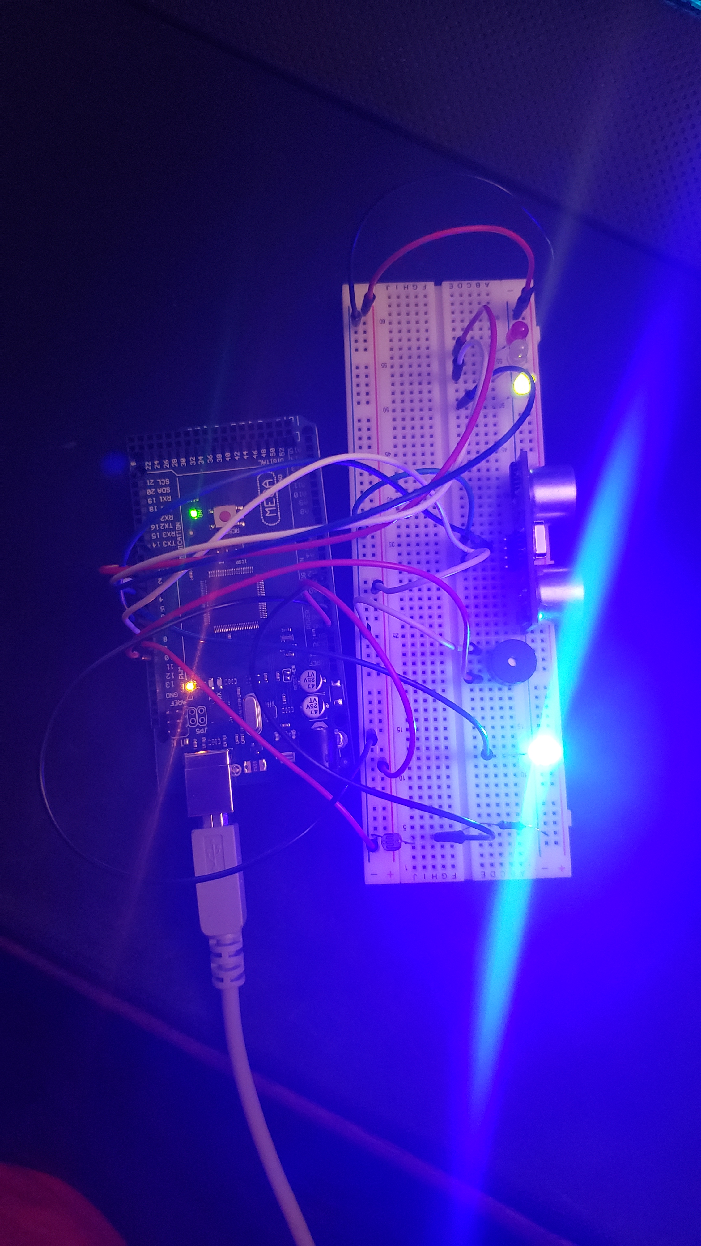
Circuit with automated LED on (picture)

Slide 26
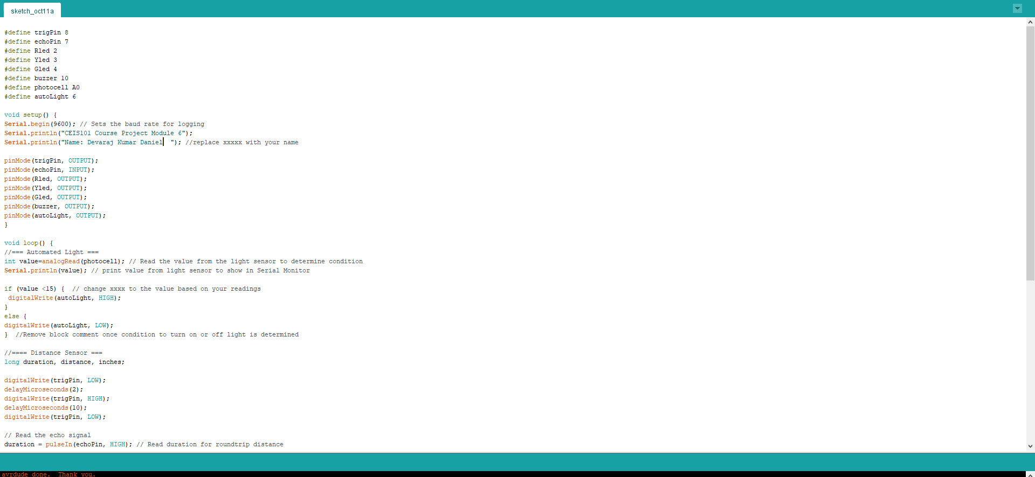
Arduino Code (screenshot)

Slide 27
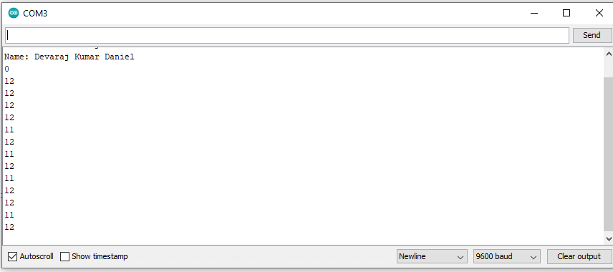
Serial Plotter (screenshot)

Slide 28
Challenges of project
Some of the challenges for this project are as follows:
Getting the circuit to work properly
Getting the right readings out of the serial monitor
Understanding the code for the circuit

Slide 29
Career Skills Acquired
Learning how to program a adruino board
Learning how to build a circuit from prototyping to real world devices
During the course I learned how network infrastructure works
For the project I learned how devices are made from the ground up

Slide 30
Conclusion
This entire course was fun to begin with and having this Arduino project was the capstone to it all. I really am a hands-on learner. This course has taught me a lot of how IoT can impact small to big things. This Arduino project showed my that tinkering around with electronics like the Arduino board can really teach you a lot about how electronics work. I feel this course really is going to help me grow in my IT career.

