Slide 1
CEIS 114 PROJECT:
Traffic Light
Devaraj Kumar Daniel

Slide 2
Table of Contents
Slide
Introduction 3
Planning for IoT Traffic Controller 4-8
Adding Traffic Lights 9-11
Adding Second Set of Lights 12-14
Adding Crosswalk Button 15-18
Adding LCD and Buzzer 19-22
Adding Smart Sensor 23-26
Challenges 27
Career Skills acquire 28
Conclusion 29

Slide 3
Introduction
The objective for this project was to create a Multiple traffic light controller with the option to either ad a smart sensor or make it a smart controller adding a Wi-Fi feature to it.
I choose the smart sensor.
We covered the following areas for the project:
Planning for the smart controller
Coding for the smart controller
Making a prototype of the smart controller with breadboards.
Before getting started I had to make sure that I had properly installed Arduino IDE.

Slide 4
Planning for Iot Traffic Controller

Slide 5
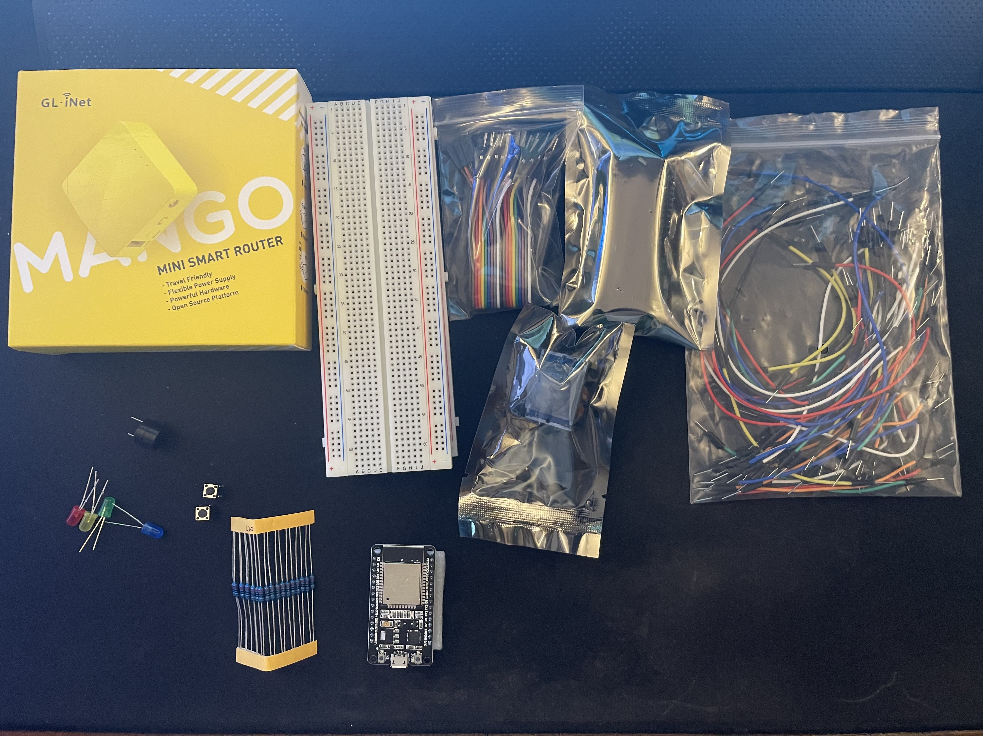
Inventory
ESP 32 Board
Colored LEDs: Red, Yellow, Green, and Blue
220 Ohm Resistors (optional)
Wires
Breadboard(s)
LCD Unit with I2C Adapter
Active Buzzer
Mini Router
Push Button(s)
PIR Motion Sensor
Inventoried all the necessary components for the project.

Slide 6
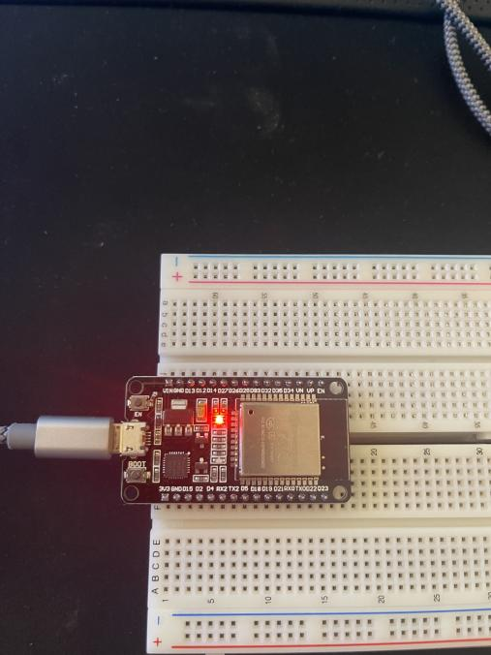
Powering and Mounting ESP32 Controller
Mounted the esp32 to breadboards and connected it to the computer to make sure it was recognized

Slide 7
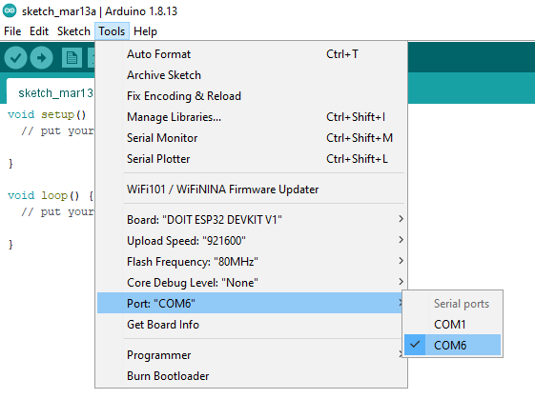
Installing Arduino Ide

Slide 8
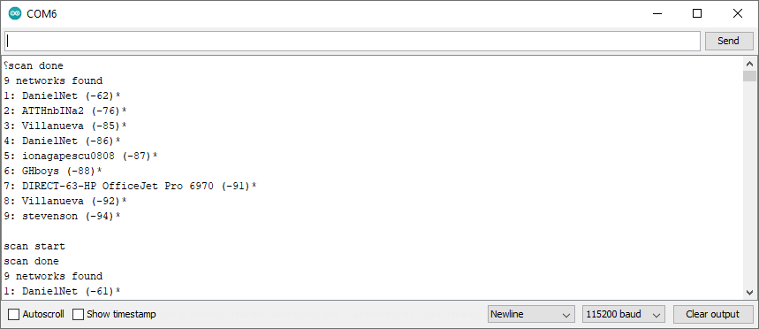
Using Wi-Fi Scan feature of Arduino IDE

Slide 9
Adding Traffic Lights
Creating the Traffic Controller

Slide 10
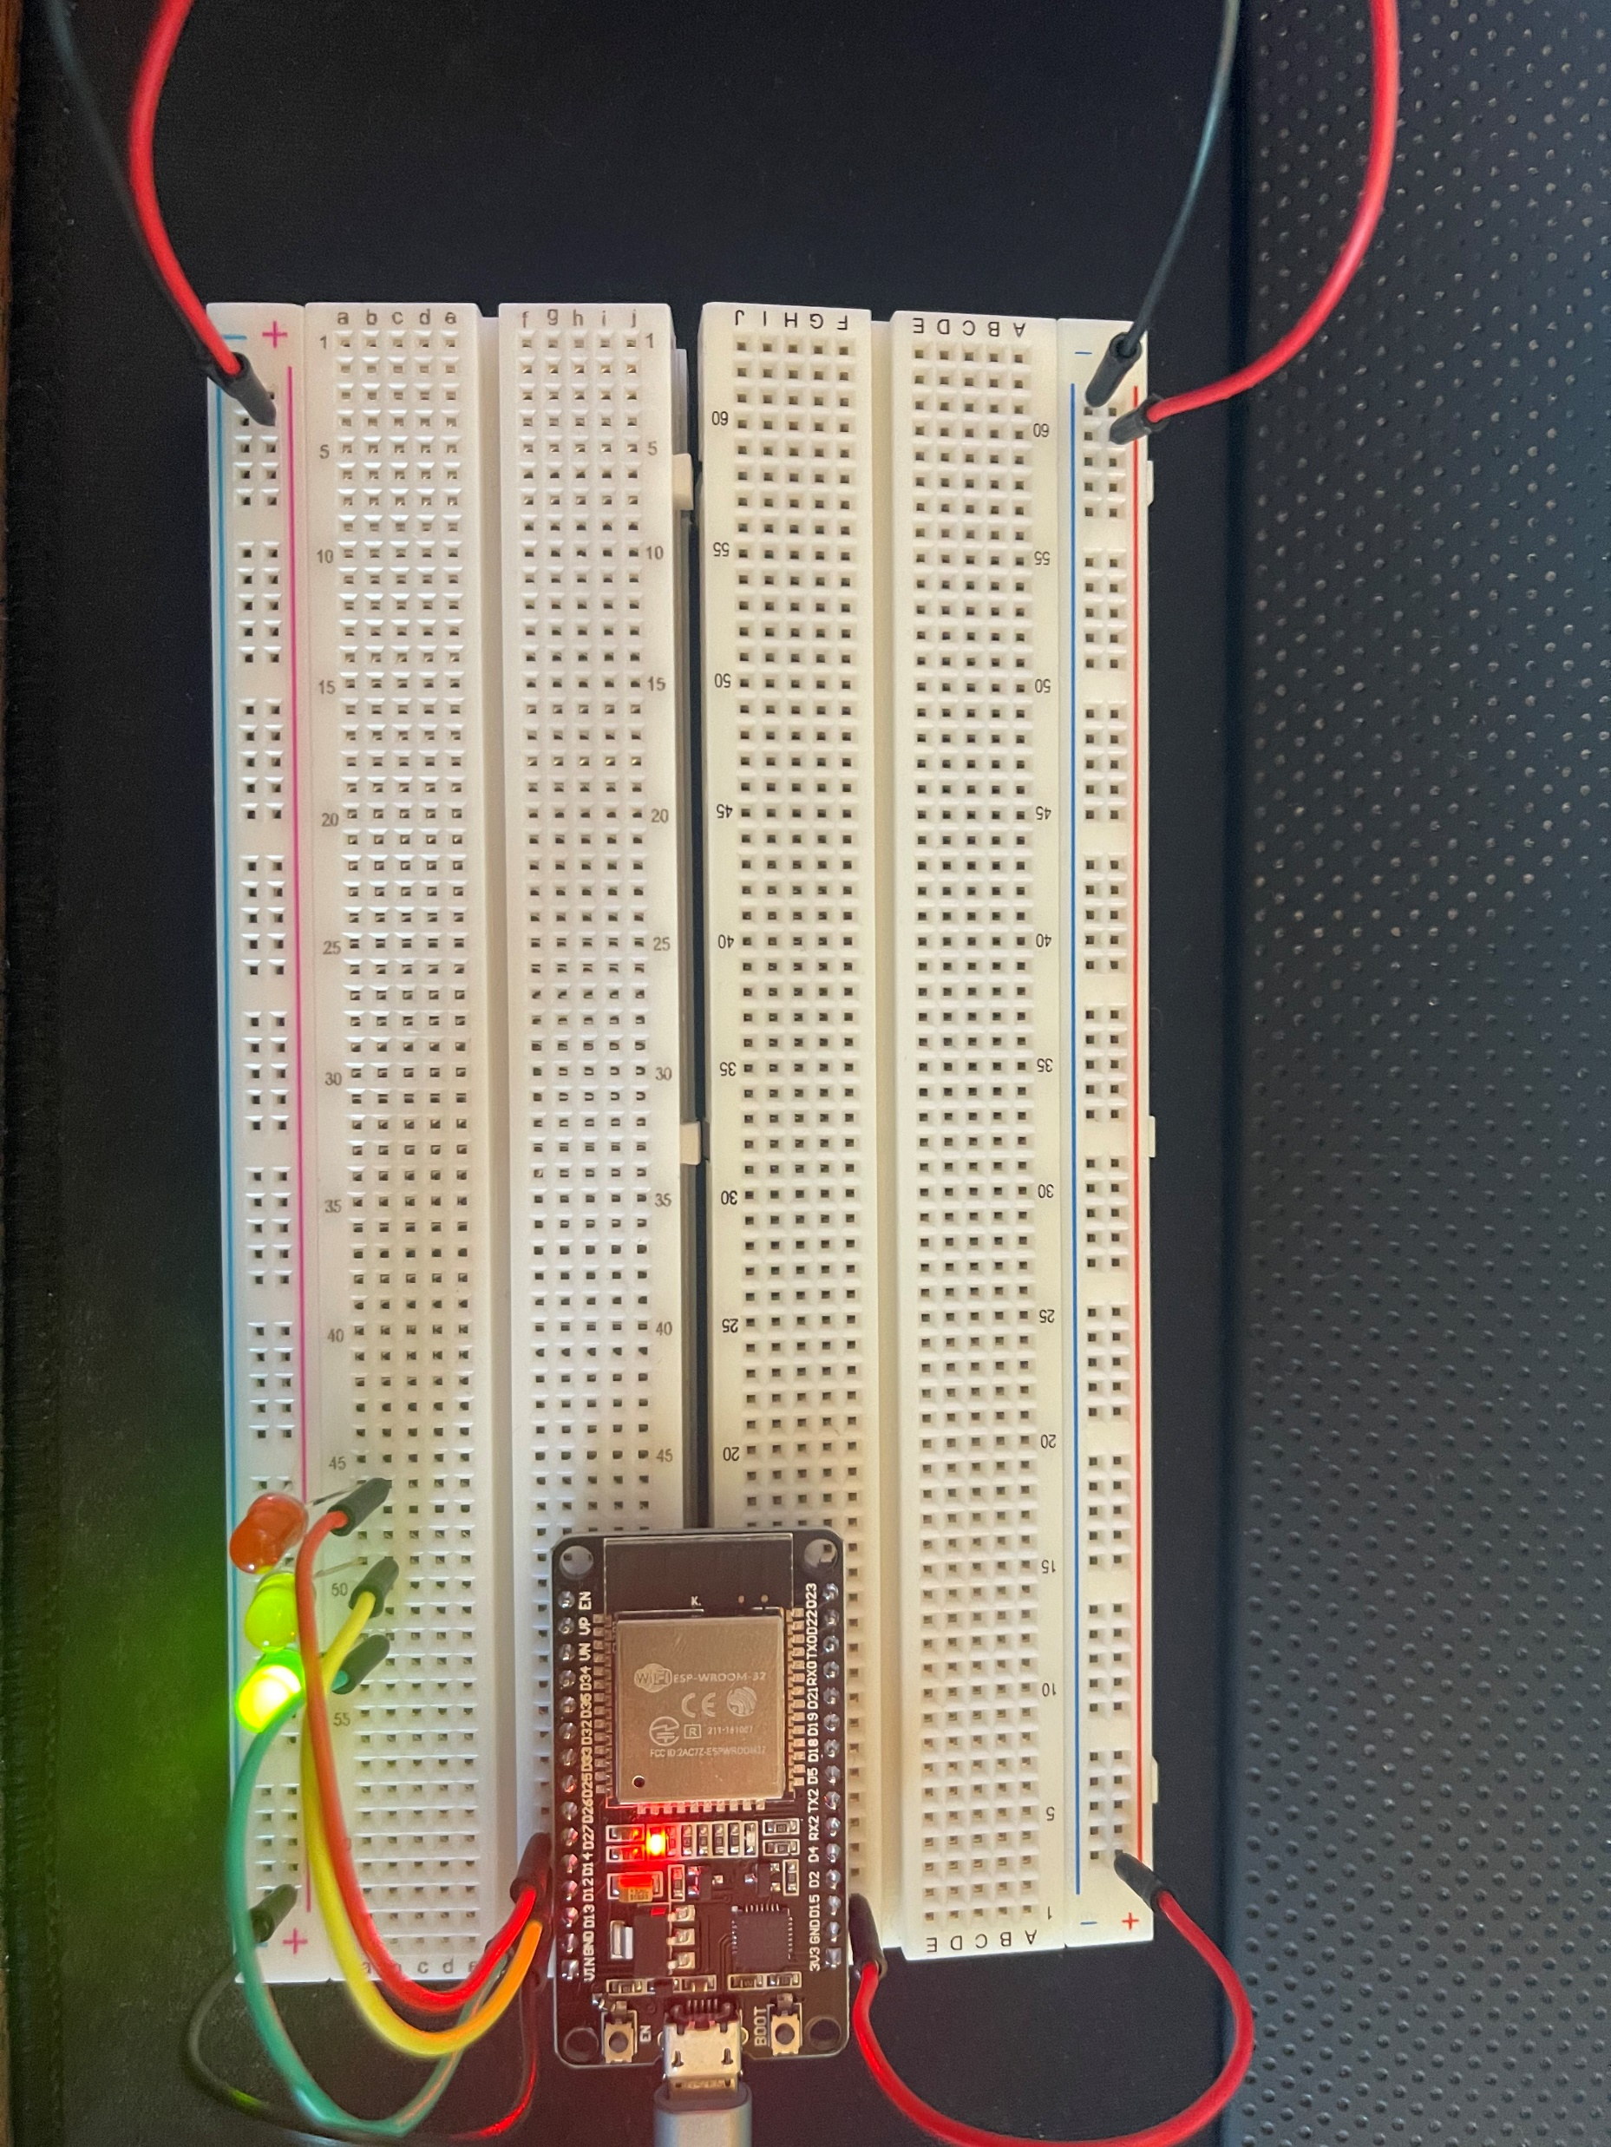
Working Circuit with LED’s
Added LED’s to circuit to simulate a traffic light

Slide 11
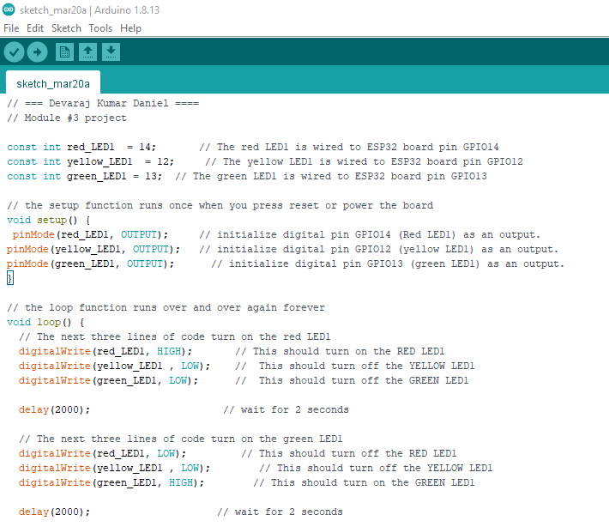
Code for ESP32 with LED’s

Slide 12
Adding Second Set of LED’s
Creating a multiple Traffic light Controller

Slide 13
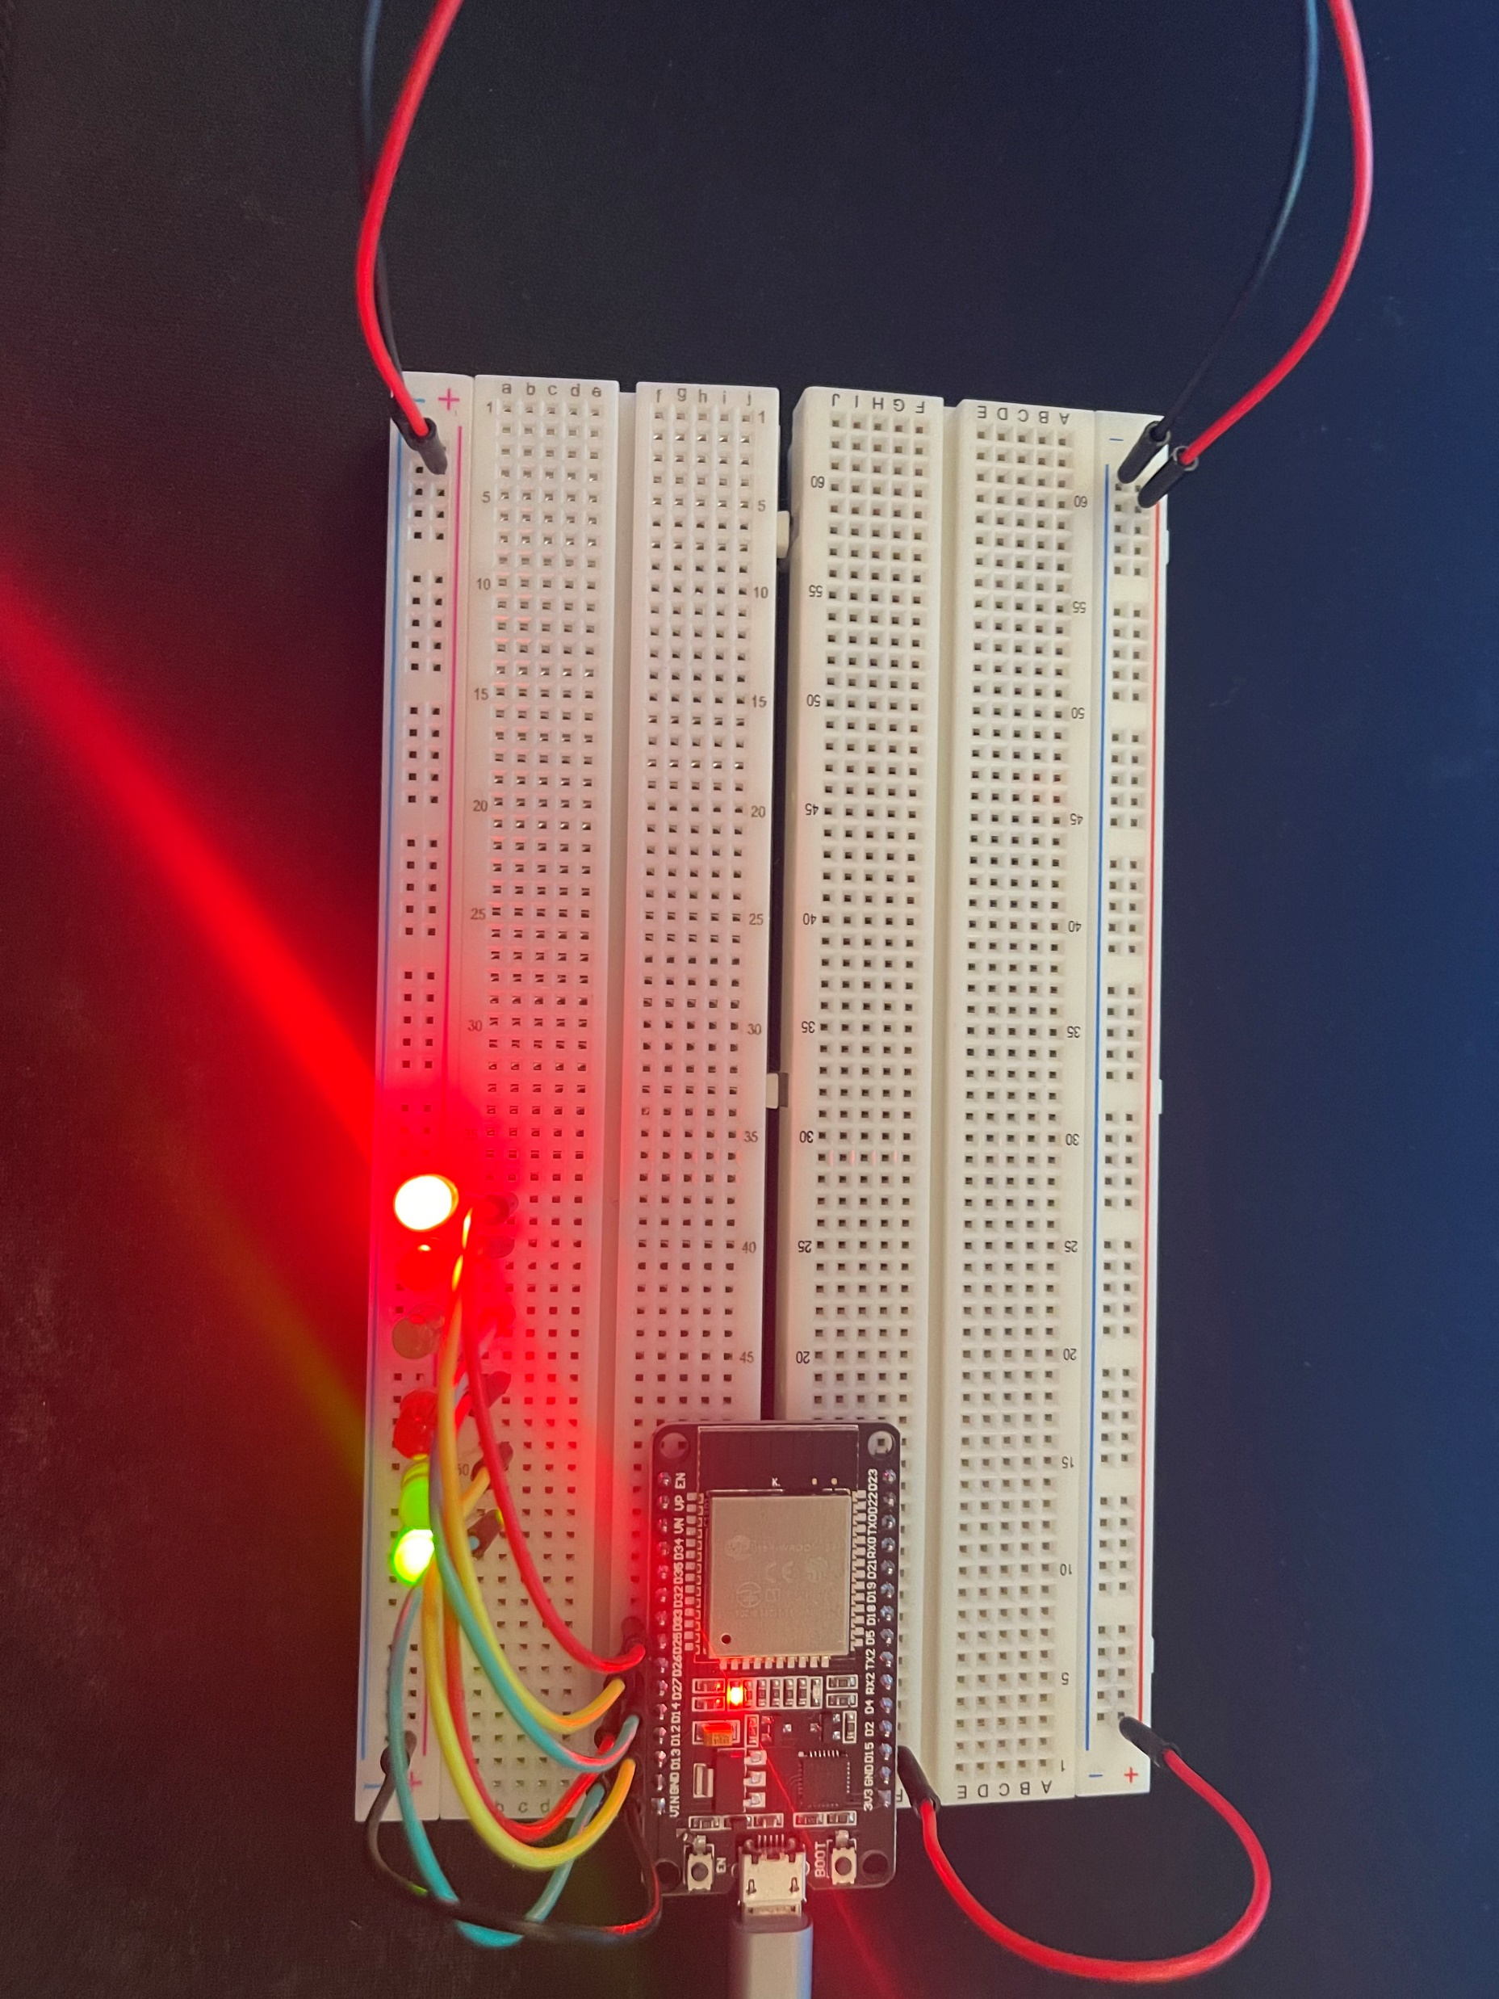
Circuit working with LED’s
We added a Second set of LED’s to simulate another traffic light

Slide 14
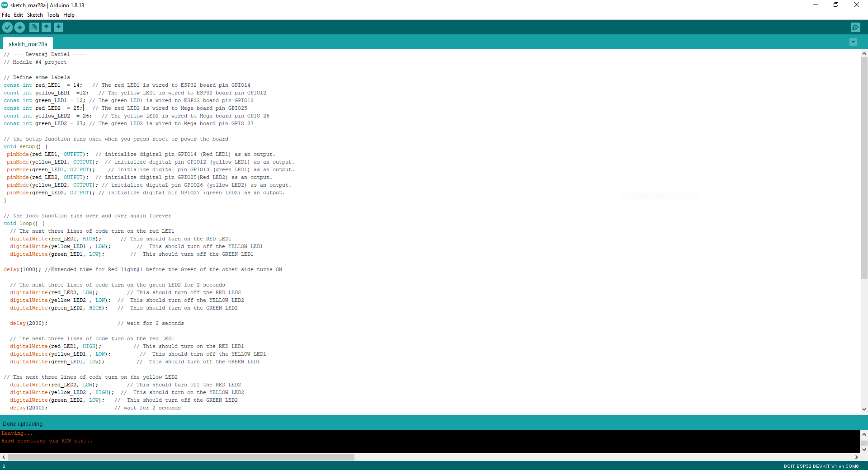
Code for additional traffic light added

Slide 15
Adding Crosswalk Button
Creating a Multiple Traffic Light Controller with a Cross Walk

Slide 16
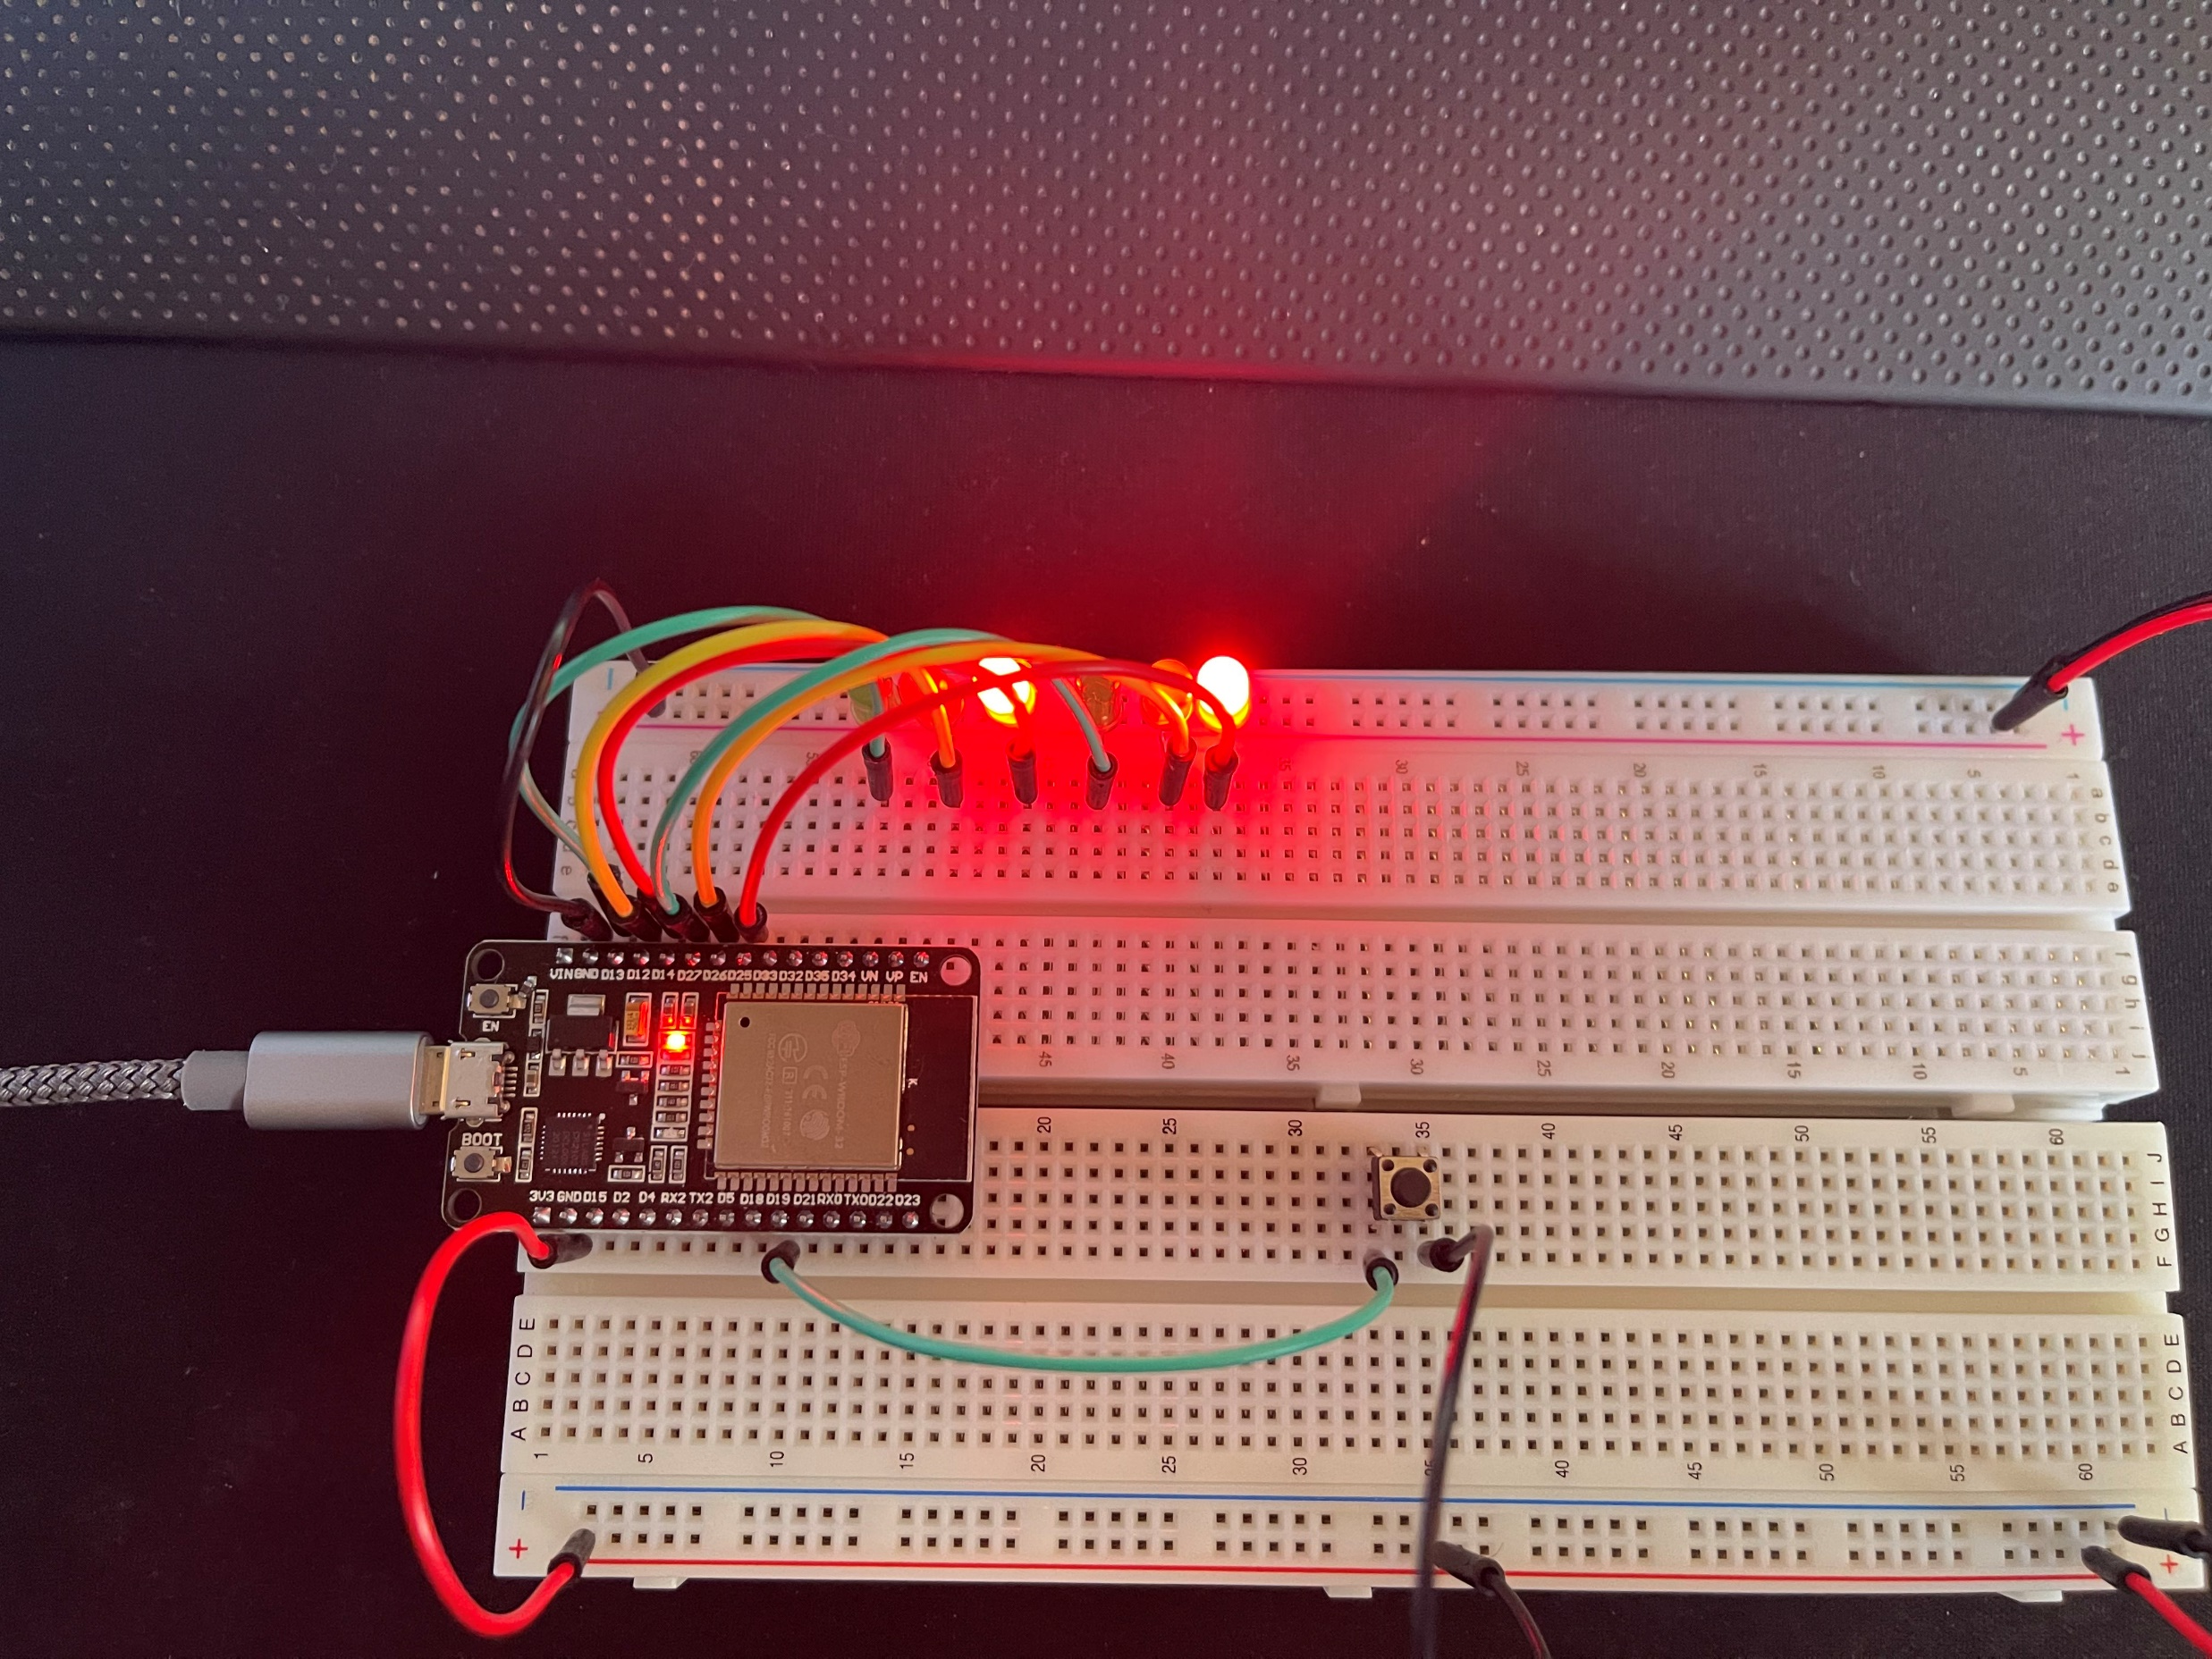
Added crosswalk button to Traffic Light
Added button to simulate real life crosswalk button

Slide 17
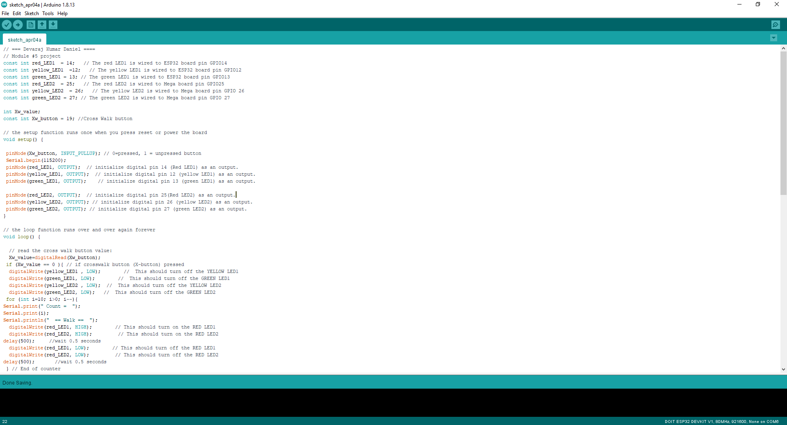
Code for circuit with crosswalk button added

Slide 18
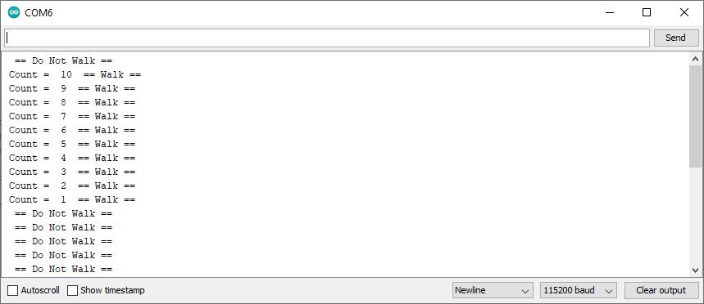
Serial Monitor showing code working for crosswalk button

Slide 19
Adding LCD and Buzzer
Creating a Multiple Traffic Light Controller with a Cross Walk and an Emergency Buzzer

Slide 20
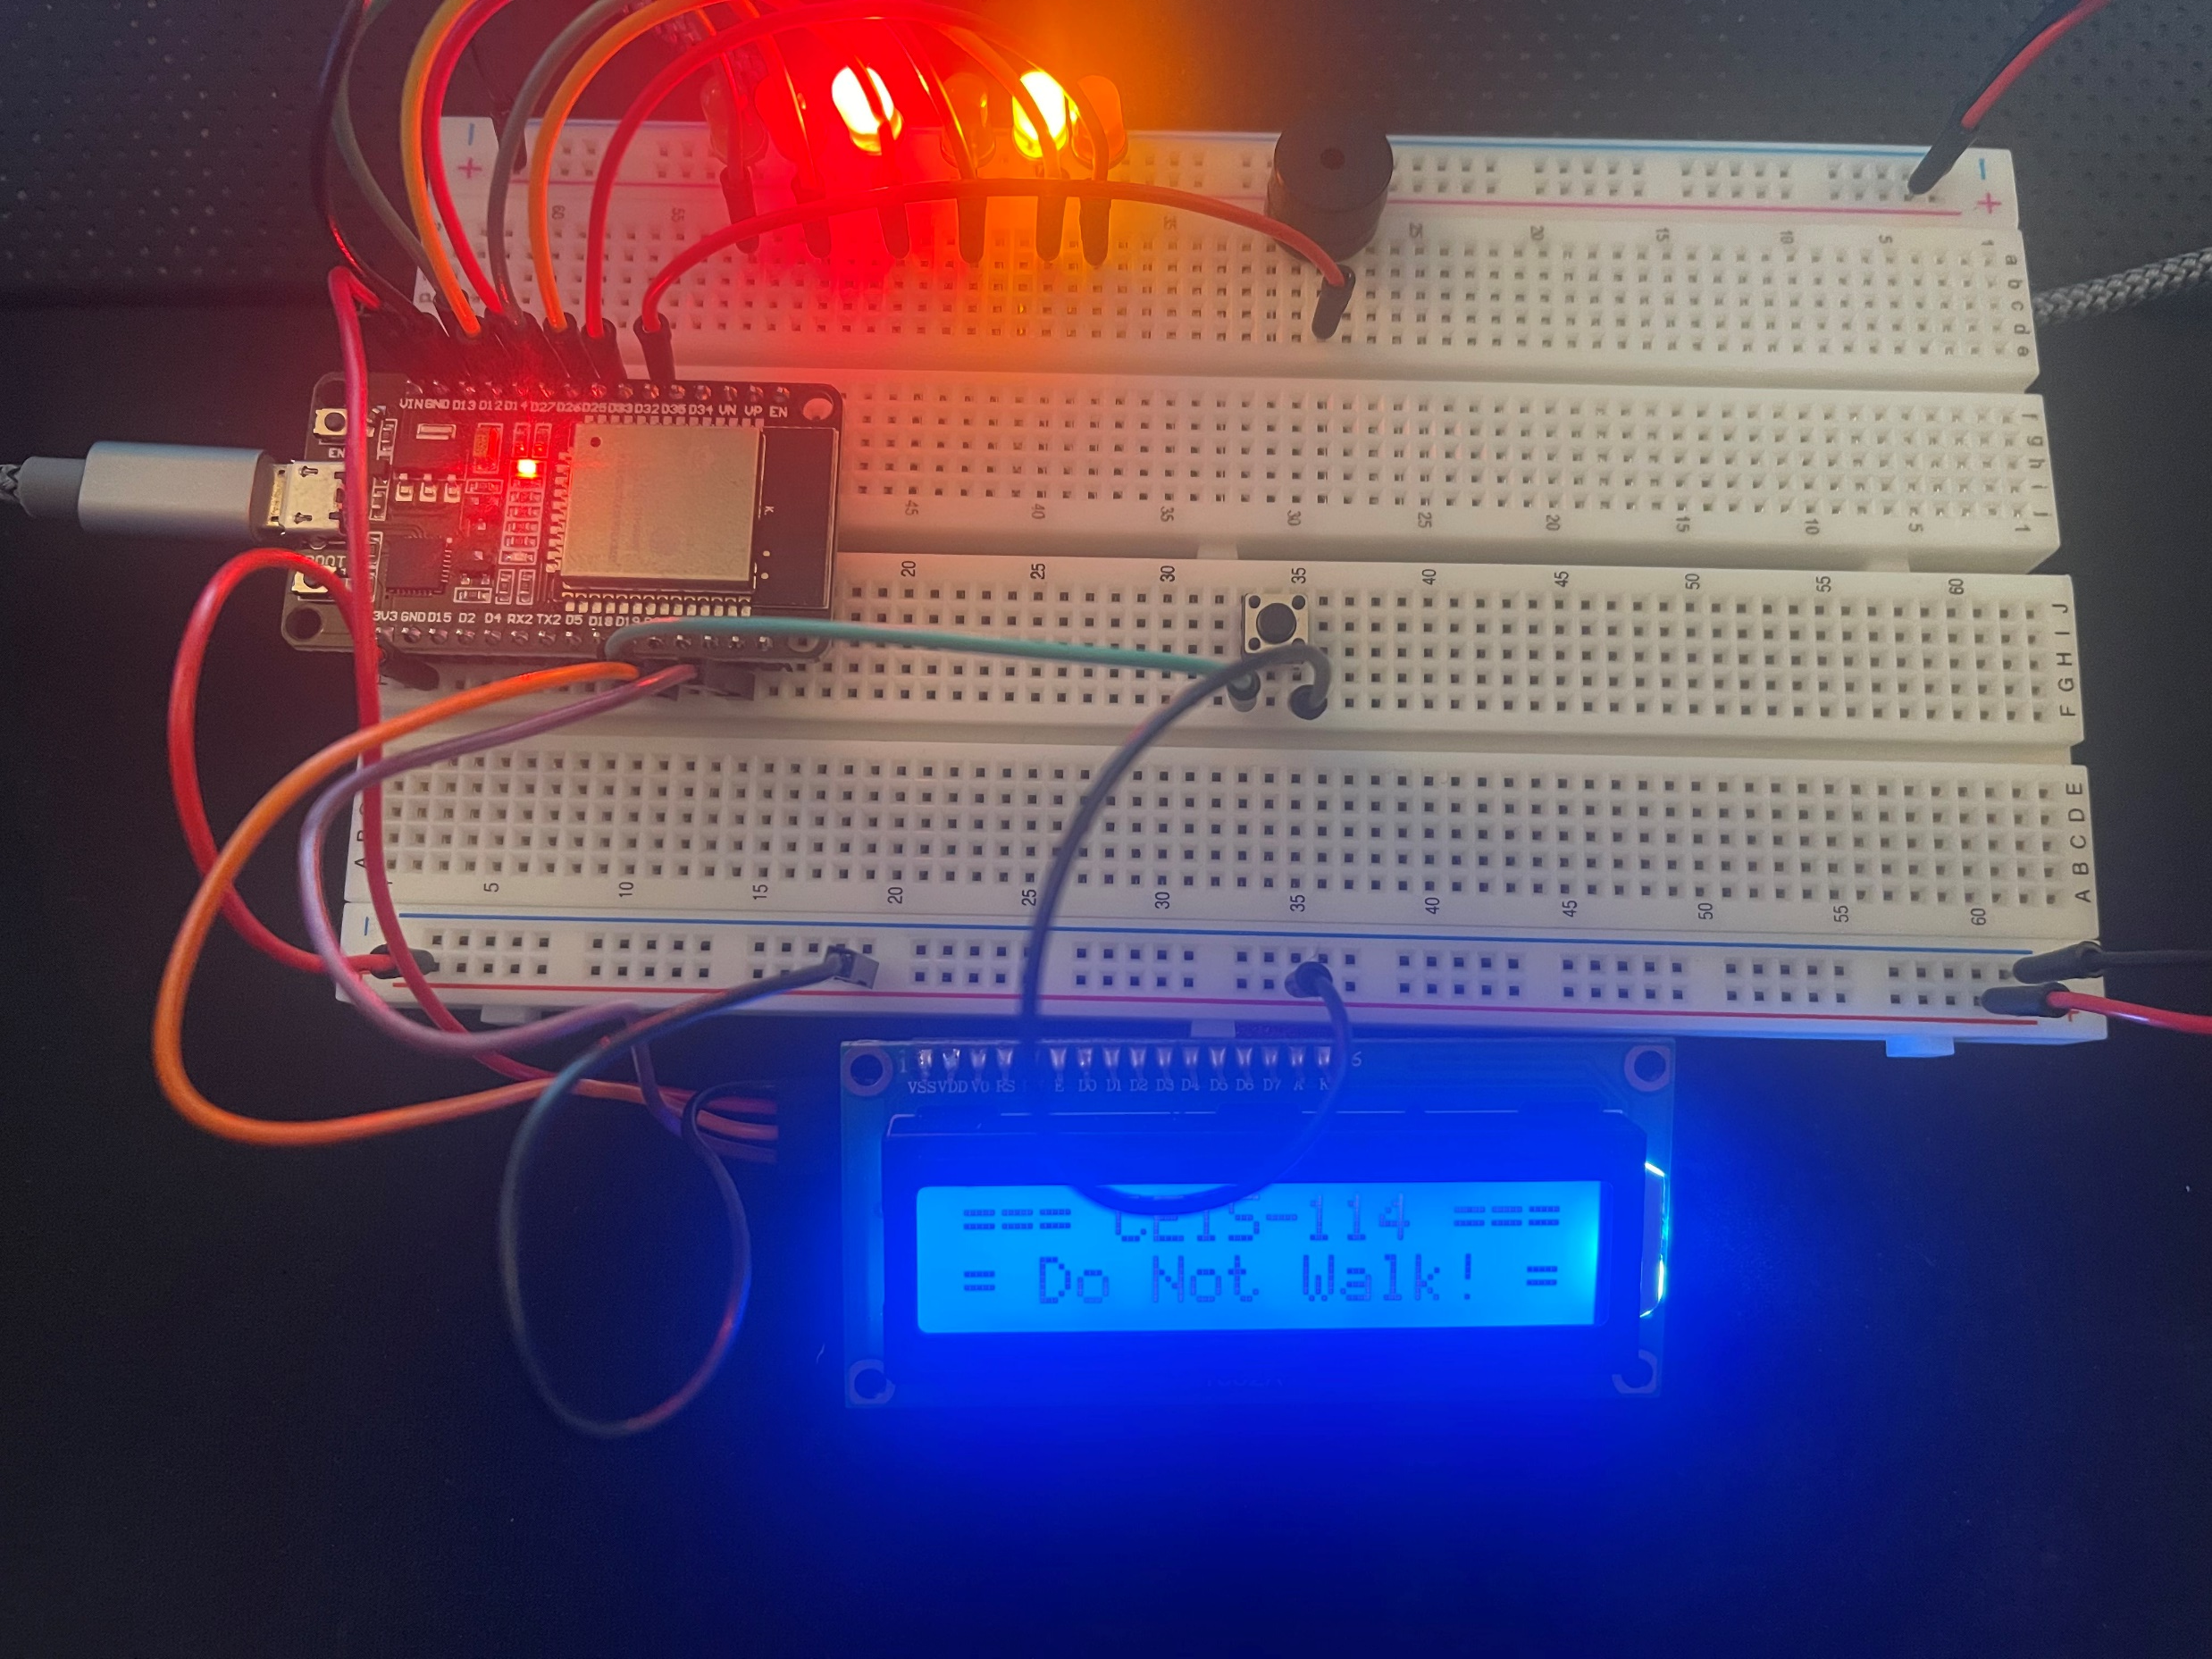
Added LCD for Crosswalk and Buzzer

Slide 21
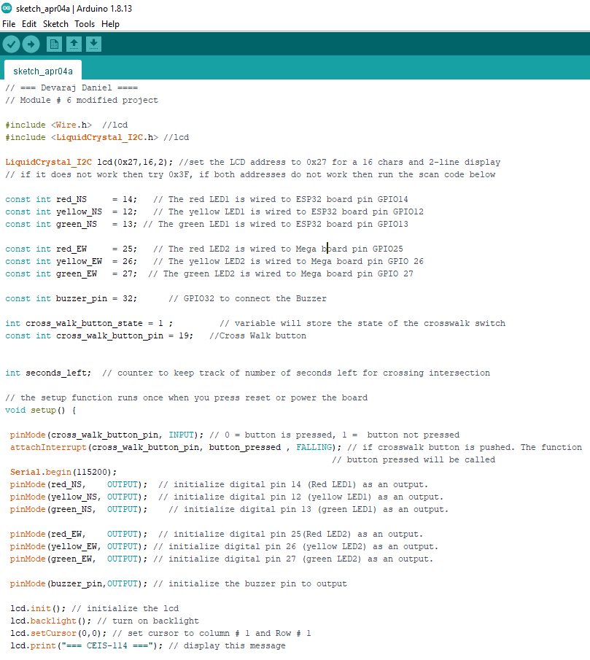
Code for Added LCD and Buzzer

Slide 22
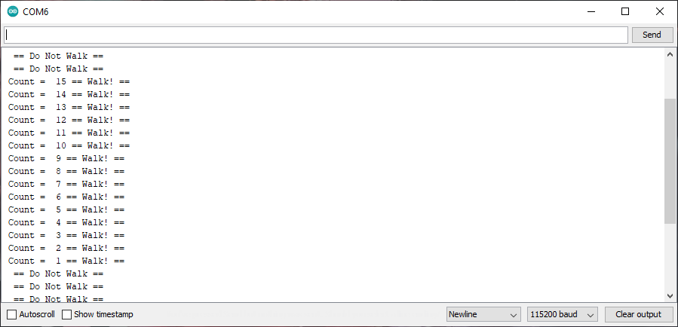
Serial Monitor to Show Crosswalk Working

Slide 23
Adding Smart Sensor
Creating a Multiple Traffic Light Controller with a Cross Walk and an Emergency Buzzer with SMART sensor

Slide 24
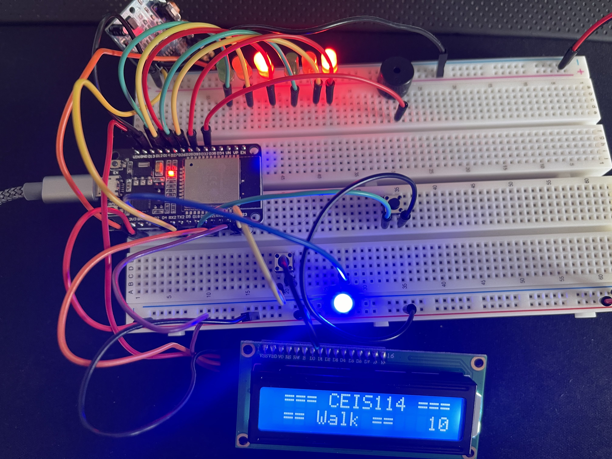
Working Traffic light with Emergency Button and Smart Sensor
Added emergency Button with Blue LED to simulate for emergency.
Added BOTH RED LEDs to blink
Smart Sensor works when something in front of it moves

Slide 25
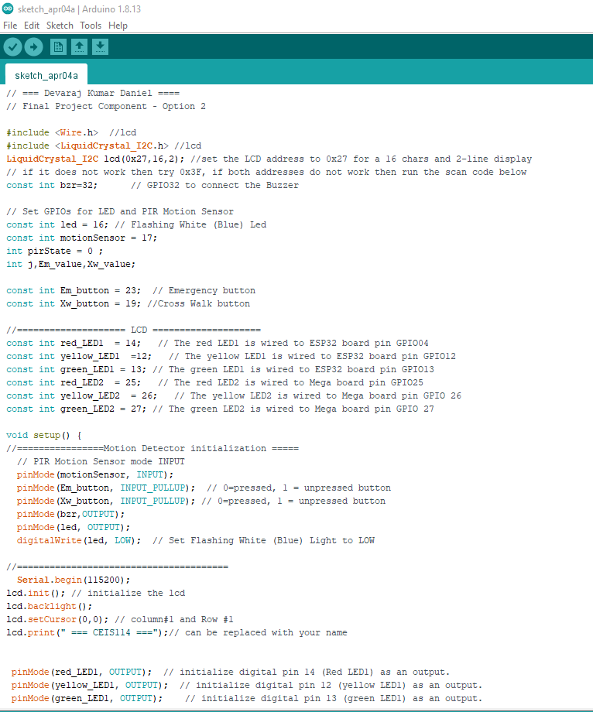
Code for Circuit
Added code for:
Blue LED
Emergency Button
Smart Sensor

Slide 26
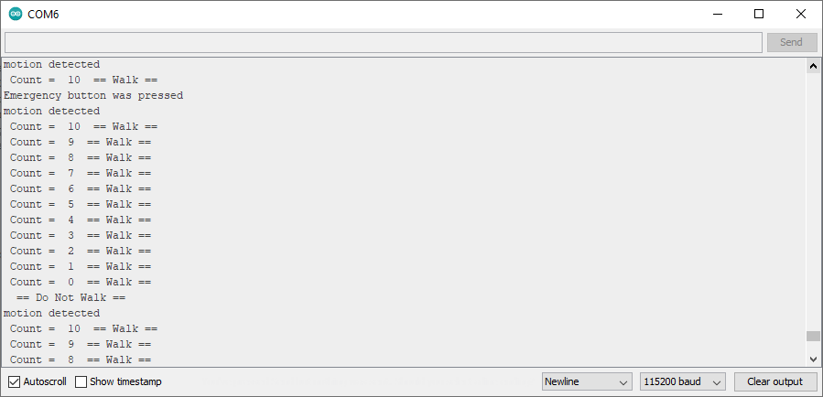
Serial Monitor to Show components Working

Slide 27
Challenges
Some of the Challenges faced during the project were as follows:
Connecting wires to right spots on the ESP32 board.
Making Sure polarity was right for components.
Sometimes uploading the code

Slide 28
Career Skills
Some the career skills that I acquired from this project were as follows:
Programming with Arduino IDE and adding components
Breadboarding with components to make a Smart Device
Hardware and Software Security
How automation works

Slide 29
Conclusions
This project was fun to do which made learning about it exciting. Throughout the course it was cool to learn about the different aspects of IoT and how software and hardware come together to make technologies that we use everyday. I also liked how hands on this course was. I hope DeVry continues to do projects like this and continue to teach in this way.

