Slide 1
NETW211 Using Amazon AWS
Devaraj Kumar Daniel

Slide 2
Table of Contents
Slide
Introduction 3
Virtual Machine (VM) Instances 4-7
Virtual Private Cloud 8-11
VM Instance Security 12-14
Cloud Storage 15-18
Cloud Monitoring 19-22
Challenges of project 23
Career Skills acquired 24
Conclusion 25

Slide 3
Introduction
The purpose of this project was to use various Amazon AWS tools.
Before I began, I had to make sure that I was able to successfully Launch the AWS console and make sure my home network could connect to the AWS VM.

Slide 4
Virtual Machine (VM) Instances

Slide 5
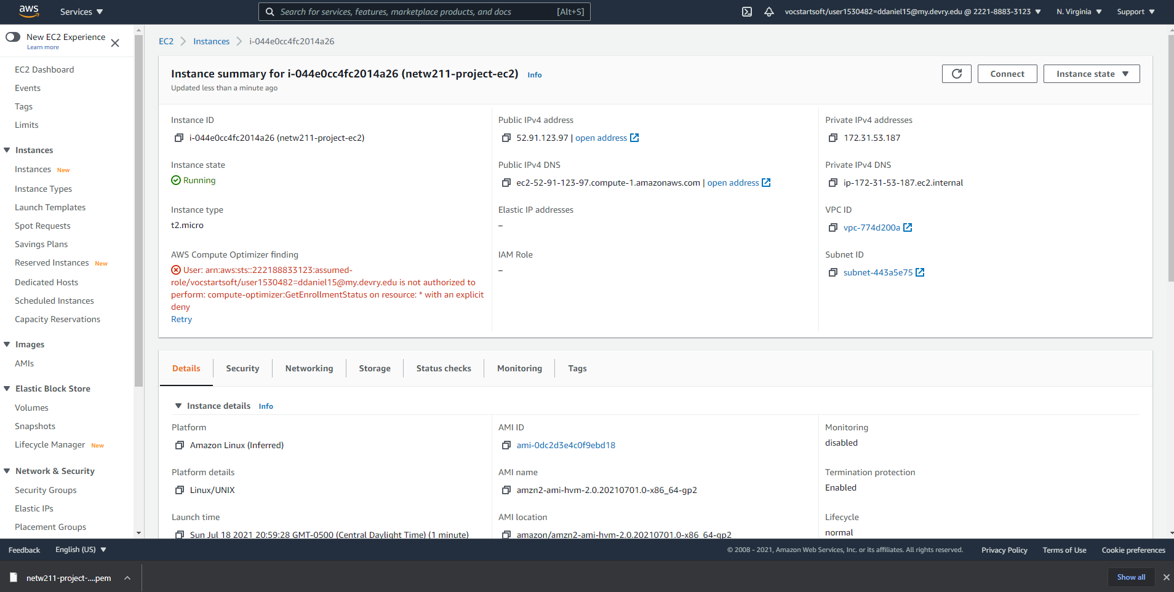
Launching an EC2 instance
This screenshot should show the instance summary page with the information about the instance.
We created an EC2 Instance and then recorded the IP of the instance and pinged it to check connectivity if the instance was working

Slide 6
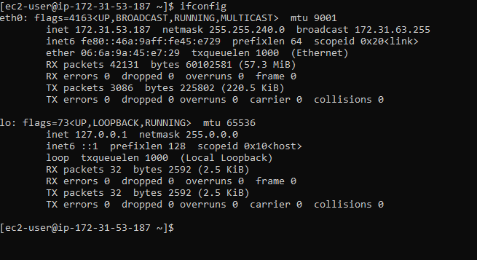
Connecting to the instance
This screenshot should show the Command Prompt window with the instance’s IPv4 address being displayed.
Testing the EC2 instance we just created

Slide 7
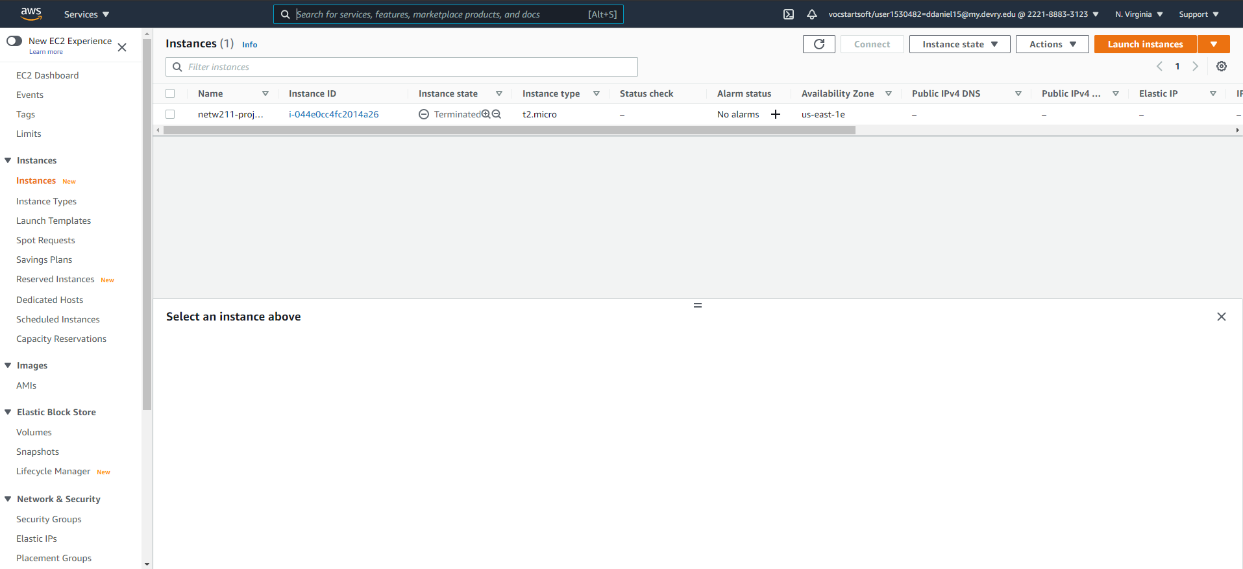
Terminating the instance
This screenshot should show the Instances page with the instance name and its state as terminated.
We terminated the previous EC2 instance

Slide 8
Virtual Private Cloud

Slide 9
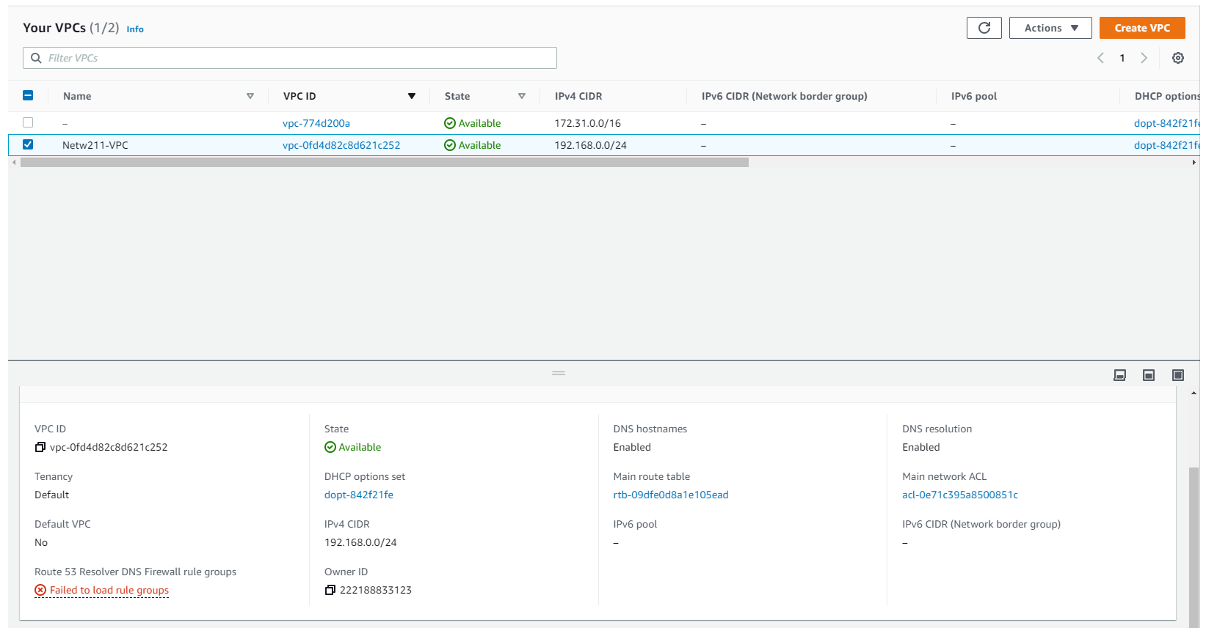
Launching a VPC with a single subnet
This screenshot should show the dashboard with the information about the VPC.
We created an virtual private cloud

Slide 10
Questions
1. With a /26 network prefix, how many usable IPv4 addresses are there? Why is the number of available IPv4 addresses HERE shown as 59?
Answer here:
With a prefix of /26 you can have 64 usable ipv4 address. The number 59 tells us that of the available host in this subnet, there only remains 59 out of the 64 usable hosts in this network. We know that three of these usable IP’s exists as the broadcast address, host address, and gateway. The two remaining IPs were automatically assigned to hosts on the network.
2. What’s the role of an Internet Gateway?
Answer here:
A gateway is used to connect networks that use different protocols for communicating. Data stops first at the gateway before it continues traveling to other parts of the network. The gateway also assigns our global ip and makes sures that the security rules set for the network allows relevant traffic.
References:
1.
2. https://docs.aws.amazon.com/vpc/latest/userguide/VPC_Internet_Gateway.html

Slide 11
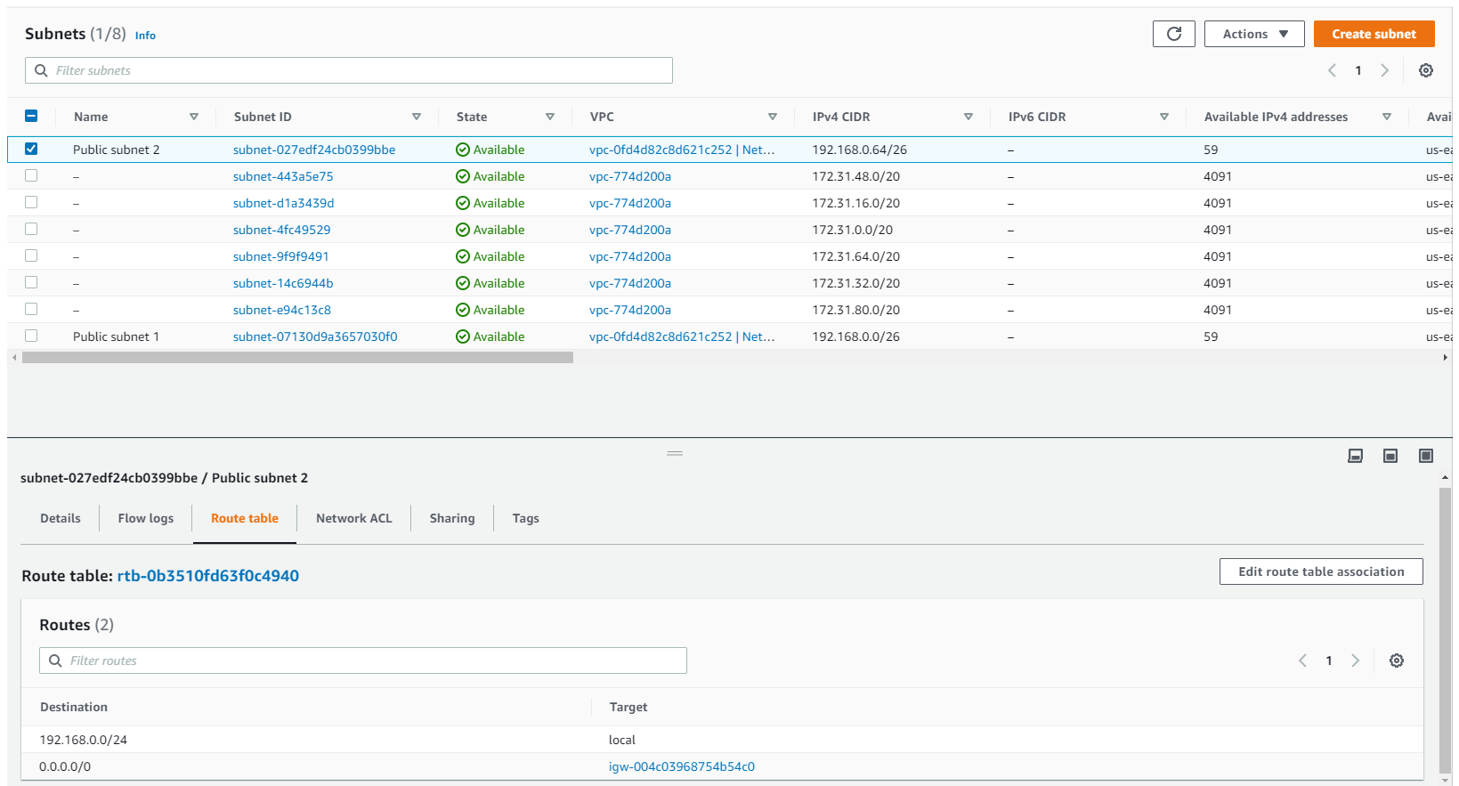
Adding another subnet
This screenshot should show the dashboard with two subnets and the route table of public subnet 2.

Slide 12
VM Instance Secruity

Slide 13
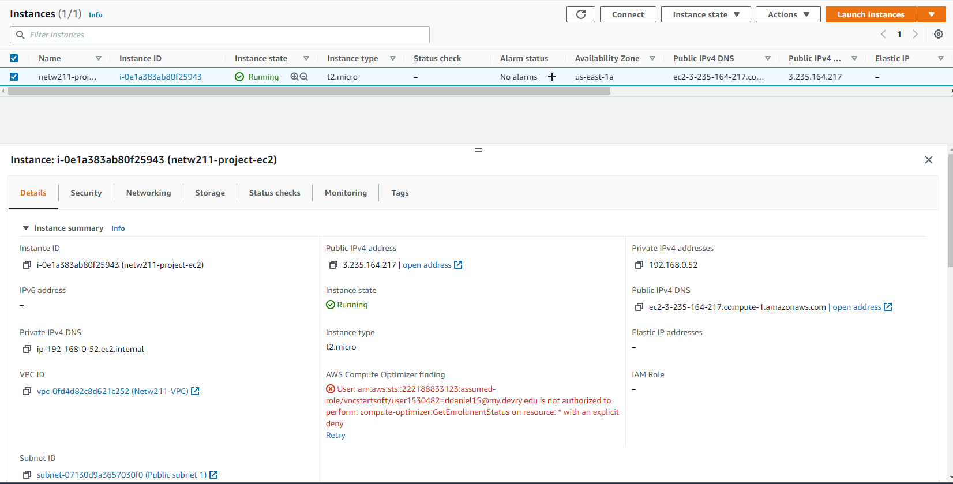
Launching an EC2 instance
This screenshot should show the Details section of the EC2 instance.

Slide 14
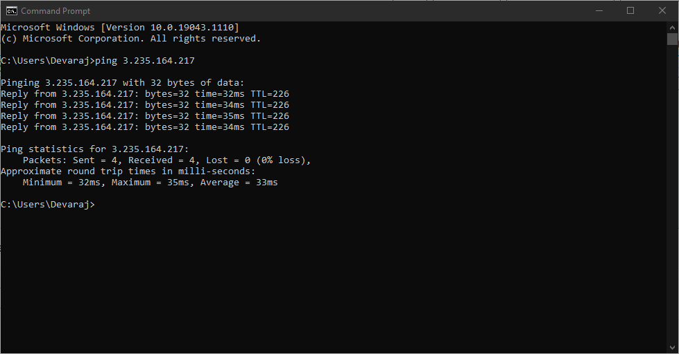
Setting up a security group
This screenshot should show the successful ping from your computer to the instance in the cloud.
We enable our EC2 instance to a security group and then Pinged it to test it

Slide 15
Cloud Storage

Slide 16
Question
What does the default encryption do?
Answer here:
The default encryption, encrypts everything that you place in the S3 Bucket. The items are encrypted on the server side and the keys are stored in AWS Key management.
References:
1. https://docs.aws.amazon.com/AmazonS3/latest/userguide/bucket-encryption.html
2.

Slide 17
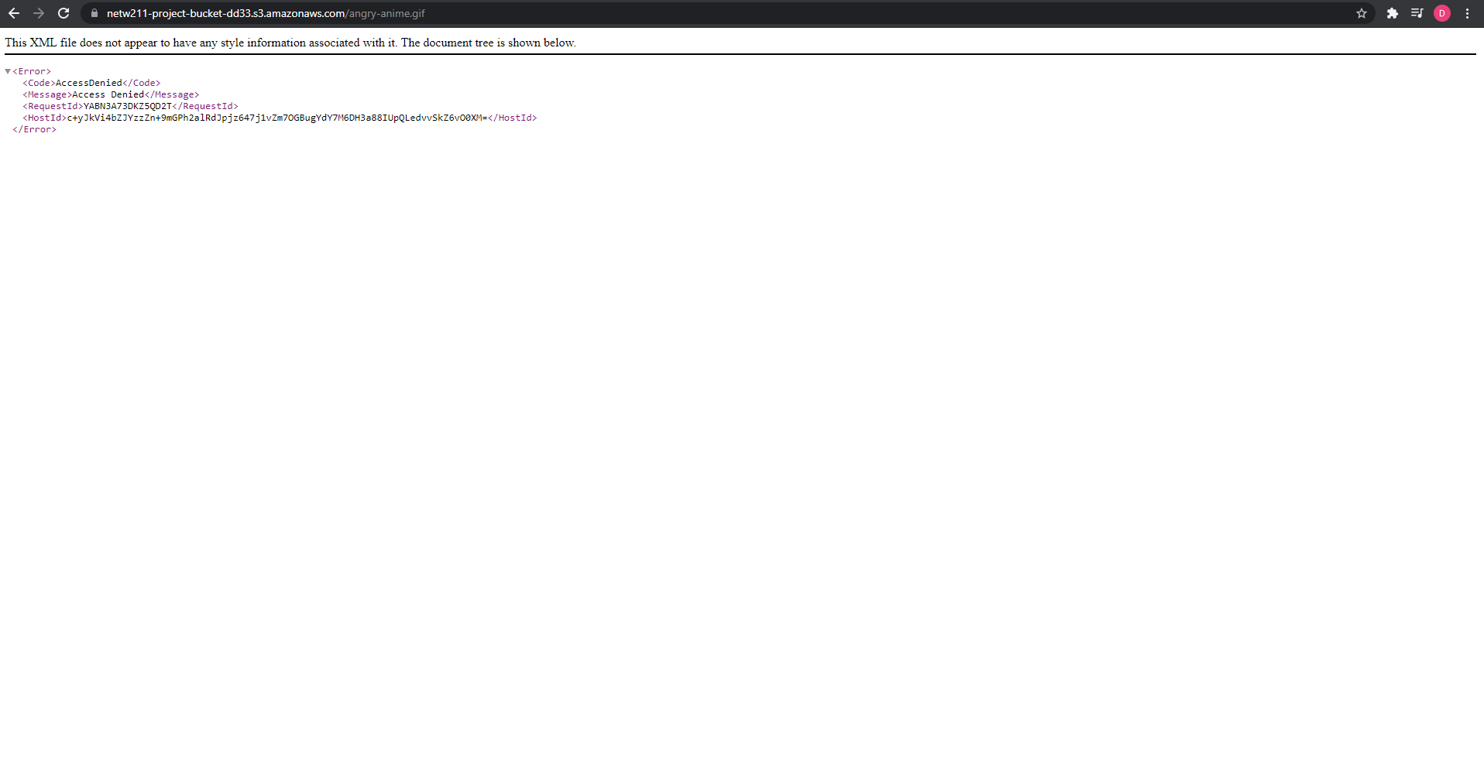
Uploading a file
This screenshot should show the Access Denied error message in a browser window.
We uploaded a file to our cloud and then had restrictions on it. This is the error message we received because our file had restrictions

Slide 18
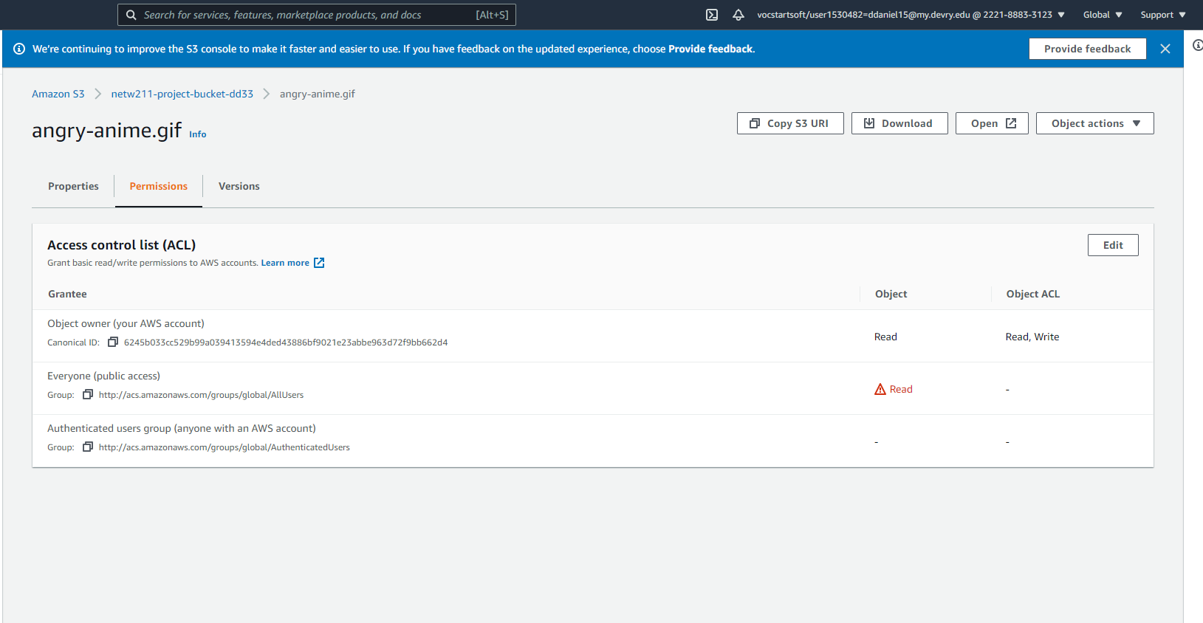
Changing permissions
This screenshot should show the permissions or access control list (ACL) information of the uploaded file.
We changed the permission for the file, and we could successfully view it

Slide 19
Cloud Monitoring

Slide 20
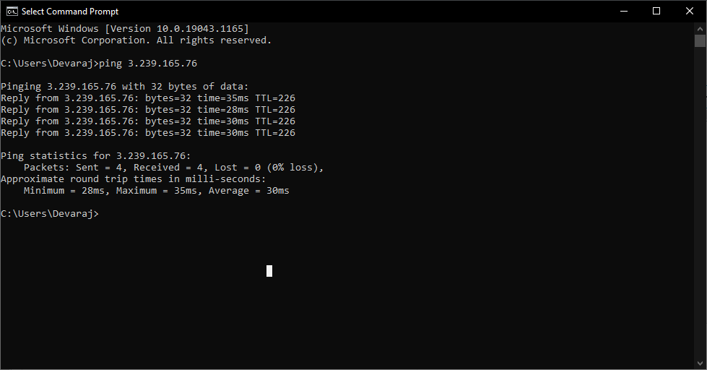
Launching an EC2 instance
This screenshot should show the successful ping from your local computer to the EC2 instance.

Slide 21
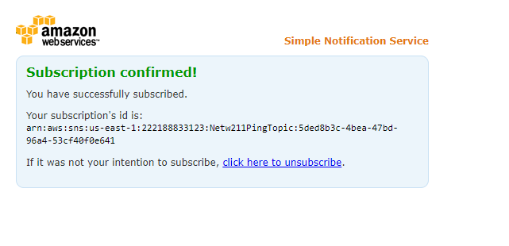
Setting up SNS notification and subscription
This screenshot should show the browser window with the “Subscription confirmed!” message (not the email!).
We started another EC2 instance and enabled SNS notifications

Slide 22
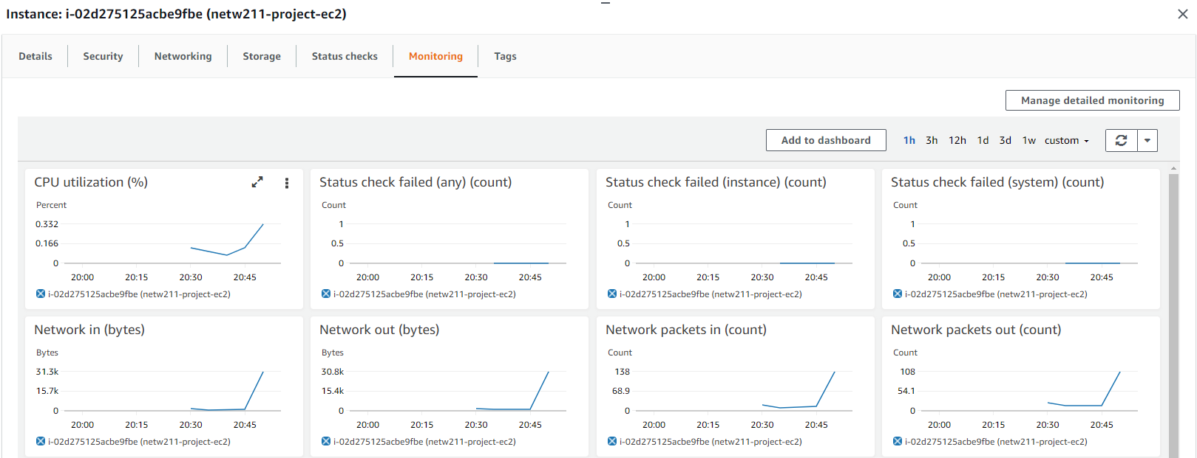
Setting up a CloudWatch alarm
This screenshot should show the EC2 dashboard with several CloudWatch metrics.

Slide 23
Challenges of Project
Some of the challenges for this project were as follows:
Navigating the AWS console
Looking up some metrics that AWS provides
Understanding what some of AWS console features do

Slide 24
Career Skills Acquired
Some of the Career skills acquired were as follows:
Using Amazon AWS
Using a Cloud platform and enable virtual machines
Using various Cloud platform features and Enabling security for a cloud platform

Slide 25
Conclusion
Using amazon AWS was cool and interesting. It was challenging to understand all the features it has and I believe If I keep using AWS a lot of the features that console/dashboard has will become second nature to use. I like that devry is doing these hands on projects and I hope they continue to do them.

